Slide 1
Key Vocab Terms
Civil case- case in which there are only monetary consequences (ex: car accident).
Criminal Case- case in which there are non-monetary punishments like jail time, community service, or death penalty (ex: murder or larceny).
Appropriations- setting apart money for specific government usage.
Impeach- to accuse government officials of misconduct in office.
Annexation- spreading municipal (city or town government) jurisdiction
Bureaucracy- complex systems with many departments many rules, and many people in the chain of command.
**Council of State- State version of President’s Cabinet (with governor)
Domestic Policy- government policy relating to or occurring in one’s own country.
**Zoning- government deciding how property can and cannot be used in certain areas (typically handled by state or local gov.).
Brief- a written document explaining the position of one side or the other in a case.

Slide 2
NC Court System
EQ: What does the State Judicial system look like and how is it similar to the federal court system?

Slide 3
State Judicial Branch
Responsible for interpreting the laws and consists of five levels of court
Juvenile
District
Superior
Appeals
Supreme

Slide 4
NC District Court
Can be divided into four categories: civil, criminal, juvenile & magistrate
A magistrate is a judicial officer of the district court (issue warrants, set bail, accept guilty pleas for minor misdemeanors)
Criminal cases in a District Court are always tried without a jury
District Court hears civil cases involving child custody or cases involving up to $10,000
Small claims court is a branch of the District Court; handles civil cases involving less than $4,000
District Court judges are elected for four year terms

Slide 5
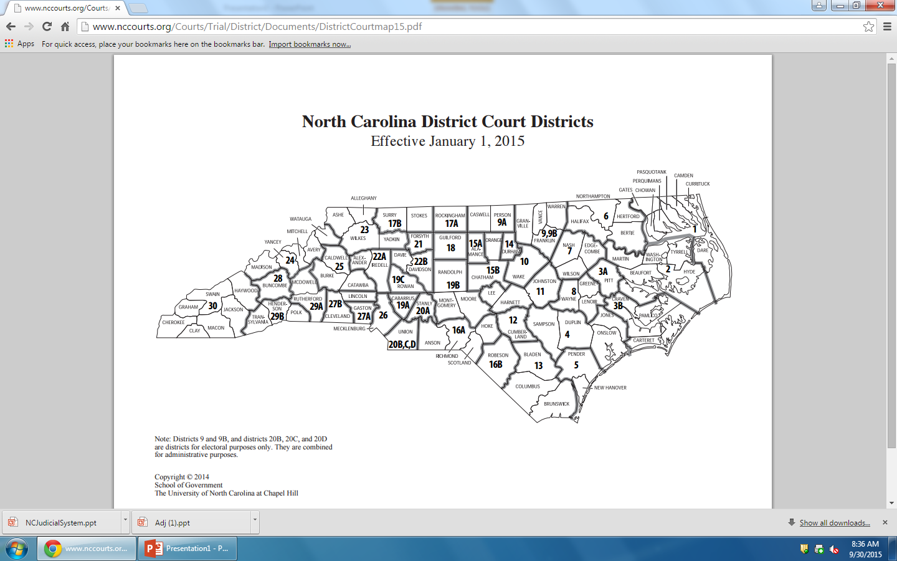

Slide 6
NC Superior Court
All felony cases, civil cases involving more than $10,000 & certain appeals from the District Courts are heard in the Superior Courts
A 12 person jury hears the criminal cases; in civil cases, juries are often waived
Superior Court judges are elected for eight year terms

Slide 7
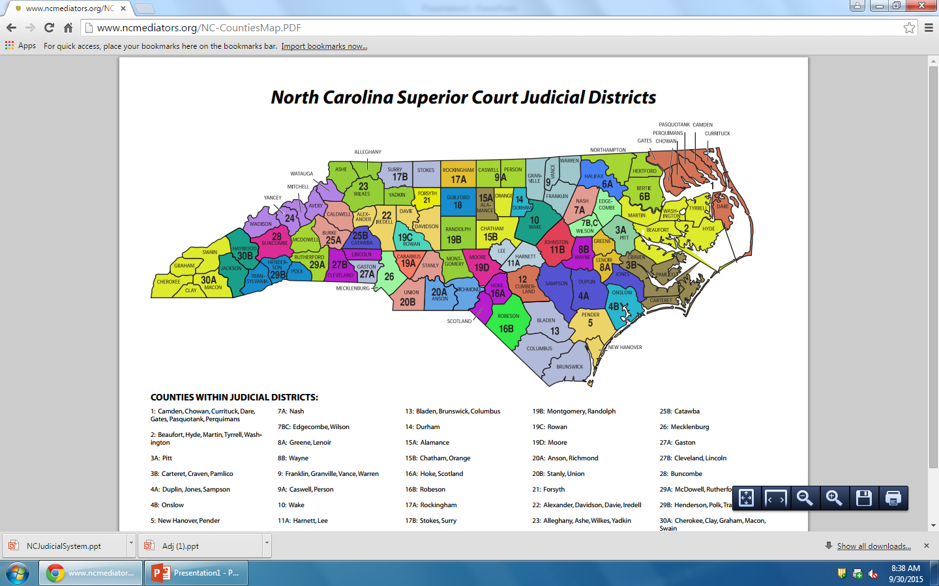

Slide 8
NC Court of Appeals
Hear all cases appealed from the Superior Court except death penalty cases
Consists of 15 judges total 3 are present in the court room
judges are elected for eight year terms

Slide 9
NC Supreme Court
Highest court in N.C
Consists of 1 Chief Justice & 6 Associate Justices; justices are elected for eight year terms
Hear all appealed death penalty cases
Hear all cases challenging the NC Constitution
Chief Justice presides over the impeachment hearings of the Governor

Slide 10
Important NC Supreme Court Cases

Slide 11
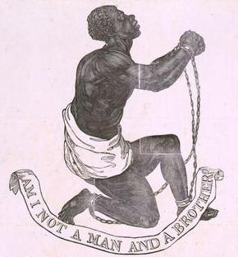
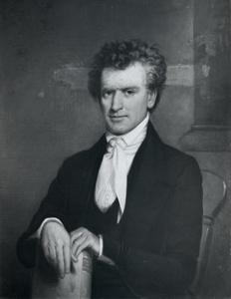
II. Civil Rights
State vs. Mann (1830)
owner charged for beating and shooting a slave
Court affirmed right of slavery, Supremacy of the NC Constitution
Notes:
http://museum.unc.edu/exhibits/slavery/thomas-ruffin-1787-1870/

Slide 12
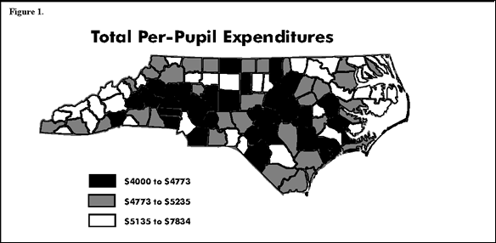
Leandro vs NC (1997-2007)
Poor counties sued the state because not equal education funding
ruled that every student receive an adequate and “sound, basic” education
created criteria (state tests) for achieving grade level

Slide 13
NC State Executive and Legislative Branch
#1 Executive-
Made up of Council of State- governor, lieutenant governor, and cabinet
Mirrors President’s Cabinet
Primary role: carry out laws that have been passed by the General Assembly
State board of Elections- group that administers the laws, policies, and procedures of federal, state, and local election process
#2 Legislative-
Made up of the NC General Assembly
the state legislature for the State of North Carolina
Responsible for making and passing laws
Bicameral: House of Reps and Senate
Both laid out similar to Federal Gov.

Slide 14
State Gov. v. Federal Gov.
https://www.youtube.com/watch?v=Osui4inQgFE

