Slide 1
Bell Ringer #1 3/20/19
1. The Harlem Renaissance of the 1920’s was a period when African-Americans
Left the United States in large numbers to settle in Nigeria
Used civil disobedience to fight segregation in the Armed Forces
Created noteworthy works of art and literature
Migrated to the west in search of land and jobs
2. Which of the following BEST describes a Flapper?
A modest woman who obeyed all rules of traditional society
A young mother who worked outside of the home
A religious woman who would have rejected modern, scientific ideas
A rebellious woman who changed her style of dress and behavior

Slide 2
Bell Ringer #2 3/21/19
“Public Ignores Prohibition Restrictions”
“Evolution and Creation Debated in Scopes Trial”
“Women Bring Change to the Industrial Workforces
1. What do headlines such as these from the 1920’s illustrate?
Trend toward mass consumption of consumer goods
Hostility to certain groups toward ethnic minorities
Conflict between traditional and modern values
2. Who was the first person to fly solo non-stop across the Atlantic?
Amelia Earhart
Charles Lindbergh
Louis Armstrong
3. How was the rising generation in the 1920’s similar to your rising generation?

Slide 3
A Booming Economy

Slide 4
How did Mass Production and The Automobile Change the Economy?
After the quick post-war recession, the American economy experienced an explosion of growth
Henry Ford perfected mass production by using assembly lines to produce affordable cars (Model T)
Car owners in 1919: 10%; 1927: 56%
His manufacturing process helped create the modern consumer economy

Slide 5
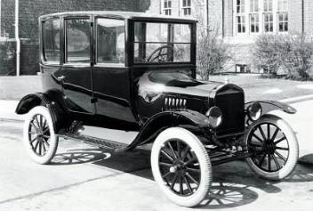
The automobile industry stimulated growth and changed social trends
Other industries related to car use such as, steel, rubber, asphalt, insurance, and gasoline all benefited heavily
Gave Americans more freedom by allowing them to be more mobile than ever before
Suburbs grew on the outskirts of cities

Slide 6
How did Consumer Culture Grow the Economy?
New and affordable goods along with widespread electricity became available to the public
The advertising industry grew and was able to sell more products to more Americans than ever before → they focused on wants rather than needs of consumers
Credit allowed people to buy more via installment buying → small down deposit followed by monthly payments
https://www.youtube.com/watch?v=NvtsYZjL-wI

Slide 7
During the 1920’s, the stock market experienced a bull market → stock prices rise of a period of time
More people began to invest in stocks by buying stock on margin
Made the stock market very susceptible to a crash…

Slide 8
Who benefited from this economic Boom?
More people moved to the cities as technological advancements became more available job opportunities increased
Immigrants, rural-to-urban, great migration
Improved mass transit and cars made suburbs swell in size → drained people and resources from the cities over the century
America’s wealth was poorly distributed and led to a severe decline in the agricultural sector

Slide 9
Prohibition 1920-1933
Which Amendment was this?
What does this mean?
Speakeasy: Illegal liquor store or night club during the Prohibition
Bootlegger: A person who makes, distributes, or sells alcohol illegally.

Slide 10
The Business of Government

Slide 11
What was Harding’s “Return to Normalcy”?
Warren G. Harding was elected president in 1920 on a pledge to “return to normalcy”
Favored big business and had a laissez-faire approach
Appointed Andrew Mellon as Secretary of Treasury → helped cut federal spending from $18 billion to $3 billion
Lowered taxes and raised protective tariff rates
29th president of the United States

Slide 12
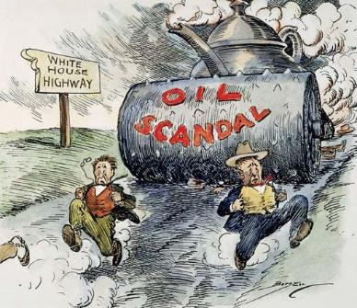
Secretary of Interior Albert Fall
The Department of the Interior: responsible for management & conservation of most federal land and natural resources
Teapot Dome Scandal → transferred oil from the Navy Department to the Interior Department. He then “sold” it to private oilmen
The Teapot Dome scandal was a bribery scandal involving the administration of United States President Warren G. Harding from 1921 to 1923
https://www.youtube.com/watch?v=XjL-uE4lSvI

Slide 13
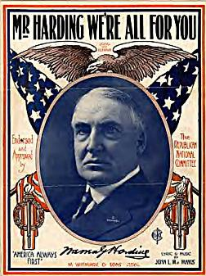
Led to a Senate investigation → return of oil to the Navy Department → Albert Fall in jail for 1 year
Harding signed off on the original transfer but never saw the full extent of the scandal and died before the investigation went public

Slide 14
What happened when Coolidge took Office?
The height of the roaring 20’s happened under Coolidge’s presidency
Was silent on societal issues such as struggling farmers, labor wages, discrimination against blacks, and Mexican Americans being taken advantage of
Coolidge did not trust the use of legislation to achieve social change and that “the business of America is business”

Slide 15
How did America’s role in the World Change after WWI?
America emerged out of WWI as a world leader in business and trade, but largely returned to isolationism
America played a large role in trying to avoid another war like WWI
The Washington Naval Disarmament aimed to reduce arms race and size of navies

Slide 16
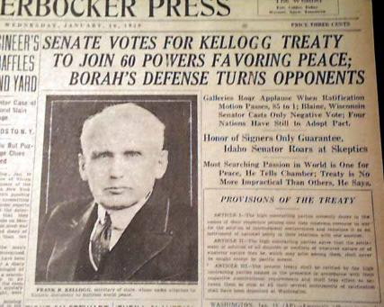
In 1928, in a ceremonial attempt at ending war all together, 62 nations ratified the Kellogg-Briand Pact which outlawed war
It was obvious from the beginning that it could not be enforced
War debt became a huge issue

Slide 17
Germany owed reparations to Britain and France as part of the Treaty of Versailles → Britain and France had to repay huge war debts to the U.S.
In the end, the U.S. financed Germany and in turn helped Britain and France repay the US.
This was called the Dawes Plan
Fell apart after the stock market crash in 1929
Created negative image towards America that would be repaired after WWII

