Slide 1
Bell Ringer #6
4/10/19
What happens when you buy a share of stock?
  you own a small piece of a corporation
  you loan a company money and collect later with interest added
  funds are transferred from a company bank account to your personal account
Some companies pay shareholders a regular sum of money based on the number of share they own. What are these payments called?
  bonds
  interest
  dividends
Which financial institutions offer full banking services to individuals and businesses?
  commercial banks
  central bank
  credit unions

Slide 2
Achieving your financial goals and avoiding scams

Slide 3
What kind of spender are you?
Careful spenders avoid pitfalls, such as impulse buying, on their way to meeting their financial goals.
What you have to work with
  Gross Pay- your salary BEFORE taxes and deductions are taken out
  Net Pay- your salary AFTER taxes and deductions are taken out
  Different than disposable and discretionary income!

Slide 4
Sample Question
Christian has a job where he makes $20 per hour and works 40 hours every week. After 4 weeks he gets a paycheck for $3200. However, deducted from that paycheck was $950 for state and federal taxes. Based on this information, which of these statements is true?
He does not have enough money to pay for rent and other bills
He was illegally taxed for the amount of money he made
His net pay was $950
His gross pay was $3,200

Slide 5
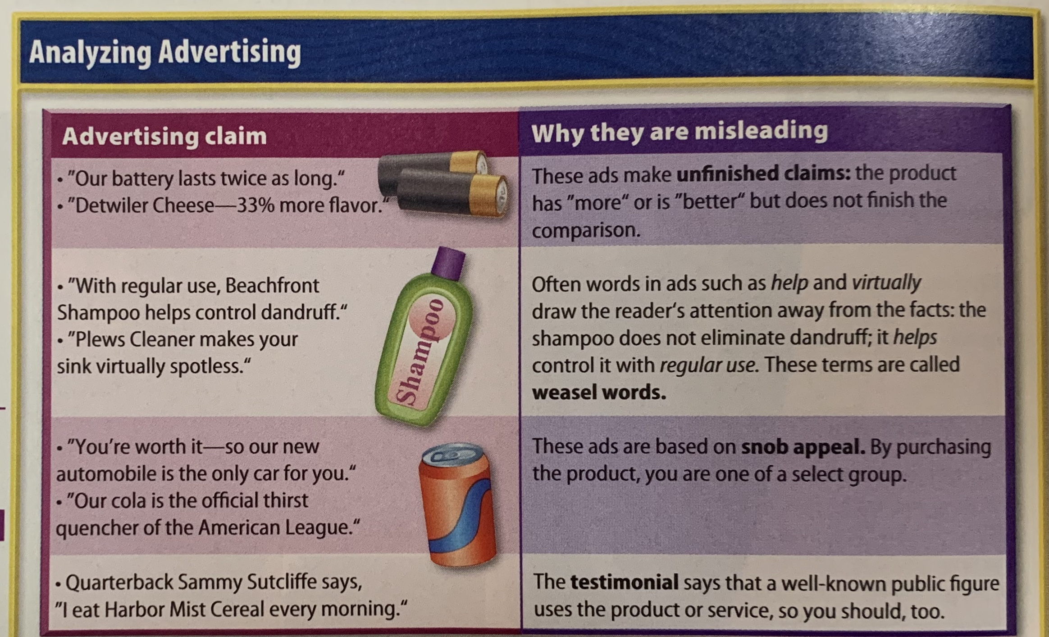
Analyzing Advertising

Slide 6
Your goals and buying decisions
The buying decisions you make can have a major impact on your life and career choices!
Set long term and short term goals → then make plans!
  Ask yourself what are you saving for? Then use that as a motivation to keep saving!
It is easier to save when you give yourself the motivation
Your budget and savings will fluctuate as your more through various stages of life

Slide 7
Ponzi Schemes
A Ponzi scheme: a form of fraud that lures investors and pays profits to earlier investors with funds from more recent investors.
  Leads victims to believe that profits are coming from product sales or other means, and they remain unaware that other investors are the source of funds.
    Getting investments from one person to pay off another
  Can maintain the illusion of a sustainable “business” as long as new investors contribute new funds, and do not demand full repayment
  The scheme is named after Charles Ponzi who became notorious for using the technique in the 1920s.

