Slide 1
Bell ringer #3 4/25/19
Due to scarcity, every society must collective answer three questions about how to use scarce resource. What are the three economic questions?
what to borrow, how to collecting, and when to make interest payments.
what to produce, how to produce, and for whom to produce.
how to improve standard of living, increase overtime, and improve product quality.
Every society must answer three economic questions because of scarcity. Which example below best illustrates society’s choice of WHAT to produce?
where to drill for oil.
how cheaply businesses produce goods.
whether to improve roads or build schools.
Which choice best completes the analogy below?
Investment is to production as education and training are to _____________________.
Outputs
Competition
human capital

Slide 2
Bell Ringer #4 4/26/19
What is an example of a low cost/low benefit situation?
It is a nice day out, so you decide to go outside to read in the grass. Which of the following is an example of a cost?
The nice weather
Grass allergies
Knowledge
What does the term specialization refer to when it comes to production?

Slide 3
The American Economy
EQ: How are products made, bought, and sold within the US?

Slide 4
Economic resources
Producing Goods and Services
Goods – tangible, physical objects (books, shirts, cars)
Services – actions or activities that one performs for another (haircuts, home repairs)
The United States Economic System is called Free Enterprise Capitalism (more details on that later!)

Slide 5
Factors of production
Land/Natural Resources – all natural resources used to make goods and services (fertile land, rainfall, forests, minerals )
Labor – labor force; effort that people devote to a task for which they are paid
Capital – human made resource used to produce other goods/services
Physical Capital – tools, buildings, bulldozers, saws
Human Capital – human knowledge, skills a worker gains through education/experience/training
Entrepreneurs – people who put together land, labor, and capital to create new businesses (goods and services);
Improve management techniques. Need to be innovative and wiling to take risks.

Slide 6
Gross domestic product
(measuring tool of the overall economy)
GDP – total value of all the FINAL goods and services produced in a country in a single year. Used goods are NOT counted in the GDP (used cars – not counted)
Bread – final good
Wheat, flour, sugar used to make bread – not a final good, but an intermediate good – not counted in GDP
Standard of Living – quality of life based on the possession of necessities and luxuries that make life easier. GDP helps measure standard of living.
GDP cannot be used to measure a country’s overall well-being as there are numerous other facts that can contribute…crime rate, equality of opportunity, education, drug and alcohol abuse, etc.
**Quantity versus Quality – GDP measures quantity, not improvements in the quality of products

Slide 7
productivity
Market – location or other situation that allows buyers and sellers to exchange certain products.
Circular Flow of Economic Activity (see page 522)
Consumer Sector – consumers earn income in the factor market
Factor Markets – markets where productive resources are bought and sold
Business Sector
Product Markets – markets where producers offer goods and services for sale (consumers buy it with their income earned in the factor market)
Business use payments to pay for natural resources, labor, capital…then these are used to manufacture new products to sell in the market

Slide 8
Productivity cont.
Government Sector
produces goods and services (defense, health, education) and receives revenue for these items, but most of revenue comes from taxes
Government uses revenue to purchase final goods/services in the product market (purchase approximately 20% of our GDP)
Foreign Sector
we sell products to and buy products from foreign countries
https://www.youtube.com/watch?v=YNfIlfua6L0

Slide 9
Productivity and economic growth
growth occurs when total output of goods/services increases
over time growth leads to an increase in the standard of living
Productivity – measure of the amount of output produced by a given amount of inputs in a specific period of time (want to be efficient)
Specialization – when people, businesses, regions, countries concentrate on goods/services that they can produce better than anyone else…leads to dependence on others. Specialize because you can earn more money for doing things well.
How likely is it that each and every household could produce their own food, shelter, and clothing?

Slide 10
Division of Labor – breaking down a job into separate, smaller tasks performed by different workers (form of specialization that improves productivity)
Human Capital – productivity increases when businesses invest in the skills, abilities and motivation of the people…generally get higher quality products and increased profits
Economic Interdependence – relying on others and others rely on us to provide goods/services.
Droughts or natural disasters in agricultural regions can affect multiple countries around the world

Slide 11
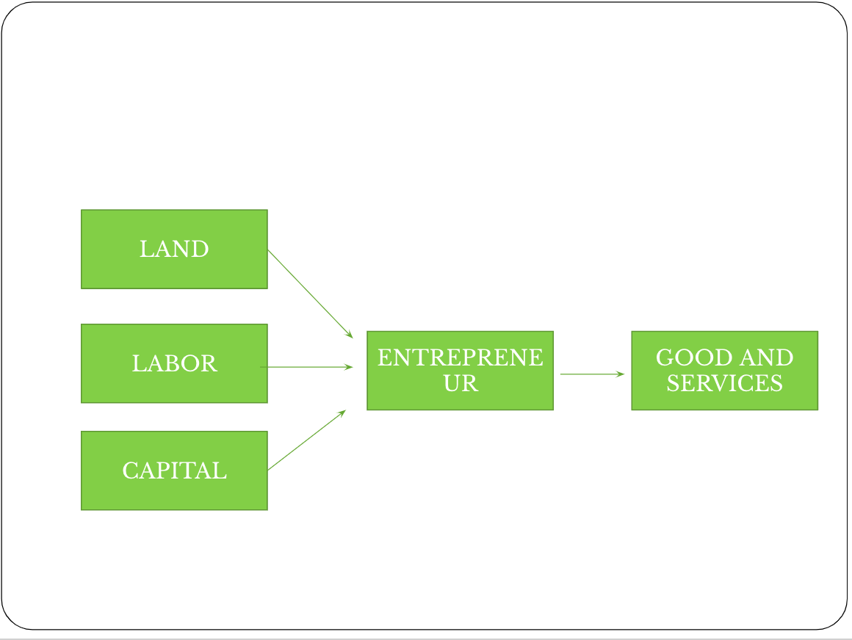
4 broad categories of resources needed for production

Slide 12
Specialization Activity!
Get into groups of 4
ROUND 1
You have 5 minutes to make as many of the following as possible.
Paper Airplanes (cost $20 to make, but is worth $30)
Paper Balls (Cost $3 to make, but is worth $5)
Write “up, up and away” LARGELY AND CLEARLY (costs $12 to make, but is worth $20)
Prices go down if they are not neat (use full sheets)
YOU START WITH $70
On a sheet of paper, write the total money you spent to make your stuff, and the total amount you made. Also write your strategy

Slide 13
Round II
How did round 1 go?
Try again!
This time, try to earn even more money than you did in round 1
You have 5 minutes again
GO!!!
Count how much you spent and how much you made.
Was it more than round I??
What did you do differently this time?

Slide 14
Round III
There is a job position that has become available. They are looking for the most efficient team to help commission air planes…
NOW, join with other groups until we have roughly 2 equal class teams.
Discuss your strategy for 3 minutes (everyone must participate)
You will have 5 minutes
DISCUSS: What happened? Were we more or less successful as a larger group?

Slide 15
capitalism

Slide 16
Capitalism and free enterprise
Capitalism - economic system in which private citizens own and use the factors of production to seek a profit
Free Enterprise – economy in which competition is allowed to flourish with little government intervention

Slide 17
Features of capitalism
Markets – where prices of goods/services are determined and where exchanges take place
Consumer Sovereignty – consumers are considered the ruler of the market…the ones who determine what products will be produced
Economic Freedom – Key to the free enterprise system; We are free to choose our job, products we buy and sell.
Private Property Rights – having the freedom to own, use, dispose of our property as we choose (tend to take better care of things we own)

Slide 18
Features cont.
Competition – struggle that goes on between buyers and sellers to get the best product at the lowest prices.
Competition keeps quality of goods high. Competition rewards the most efficient producers & forces the least efficient out of business.
Profit Motive:
Profit – amount of money left over after all production costs have been paid.
Profit Motive – driving force that encourages people to improve their well being…responsible for the growth in the free enterprise system
Voluntary Exchange – act of buyers and sellers freely and willingly engaging in market activity/transactions.

Slide 19
Spread of Capitalism
The Spread of Capitalism – capitalism developed over time throughout Europe
Adam Smith and Capitalism
Wealth of Nations, 1776 – described the basic principles of economics and came the basic ideas of laissez-faire economics.
Laissez-faire means “to let alone” – meaning that the government should not interfere in the market
Remember the name and the idea!!

