Slide 1
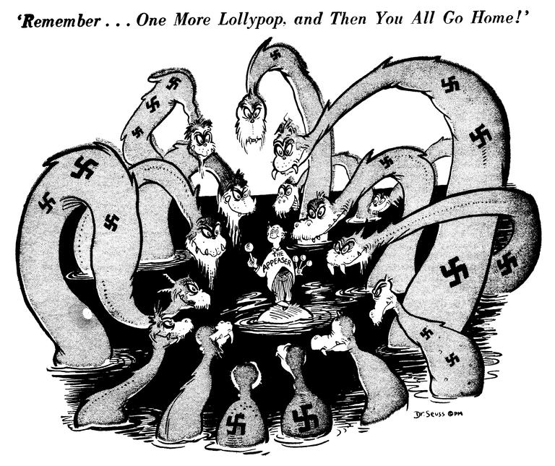
Unit 8: Bell Ringer #2 12/17/19
What do you know about WWII?
Who were the Allied Powers and who were the Axis Powers?
How is Nazi Germany portrayed in this cartoon?
As a giving and considerate caretaker
As a monster looking to take as much as possible
As a strong, noble force for good
As a small children of whom you can easily take advantage

Slide 2
Appeasement
Unit 8

Slide 3
WhAT is appeasement?
When Hitler annexed Austria, neither the League of Nations nor Western politicians did anything concrete to stop him. When he took over the rest of Czechoslovakia, they again did nothing. It was not until Hitler invaded Poland that the Chamberlain of England and Daladier of France finally did something, but by then it was too late. These countries seemed to let World War II happen. The question is why?
Appeasement: Foreign policy of pacifying an upset nation through negotiation in order to prevent war.

Slide 4
WHY??
The reason why the rest of the world allowed Hitler and Mussolini to have their way in Europe is that they had not paid a great deal of attention to the events going on in Europe. For North Americans, since Europe was all the way across the Atlantic Ocean, we had a sense of isolationism and seemed at a distance from the events. Another reason is that the governments of the world were following a policy of appeasement. In effect, this meant letting Hitler and Mussolini have want he wanted. The Allies, led by England and France, hoped that eventually Hitler would be satisfied and another war could be avoided.

Slide 5
Was it a mistake?
Appeasement was a popular policy around the world. Many people believe that it was only fair for Germany to get back what it had lost in the Treaty of Versailles. Few people outside of Germany had bothered to read Hitler’s book Mein Kampf and did not know his plains for Germany and Europe. Some historians have since criticized the policy of appeasement, but at the time there were only a few people who opposed it. The question remains unanswered, was appeasement a mistake?

