Slide 1
Bell ringer #5 4/29/19
In a market economy who owns the factors of production?
The central government
Both the central government and the individuals
The individuals
The equipment and tools used to build your school are an example of which factor of production?
natural resources
capital goods
consumer goods
What type of market involves the buying and selling of productive resources?
factor
consumer
product

Slide 2
Productivity and economic growth
growth occurs when total output of goods/services increases
over time growth leads to an increase in the standard of living
Productivity – measure of the amount of output produced by a given amount of inputs in a specific period of time (want to be efficient)
Specialization – when people, businesses, regions, countries concentrate on goods/services that they can produce better than anyone else…leads to dependence on others. Specialize because you can earn more money for doing things well.
How likely is it that each and every household could produce their own food, shelter, and clothing?

Slide 3
Division of Labor – breaking down a job into separate, smaller tasks performed by different workers (form of specialization that improves productivity)
Human Capital – productivity increases when businesses invest in the skills, abilities and motivation of the people…generally get higher quality products and increased profits
Economic Interdependence – relying on others and others rely on us to provide goods/services.
Droughts or natural disasters in agricultural regions can affect multiple countries around the world

Slide 4
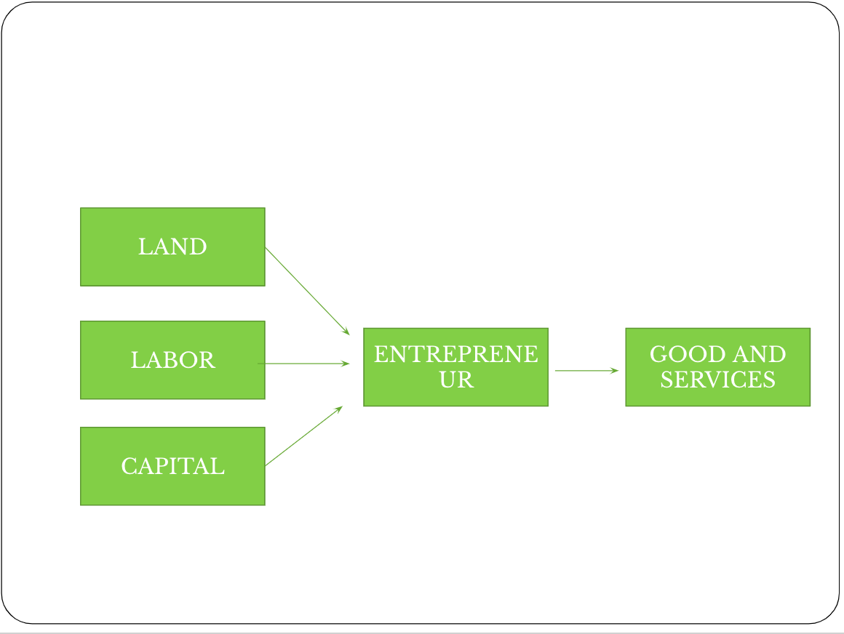
4 broad categories of resources needed for production

Slide 5
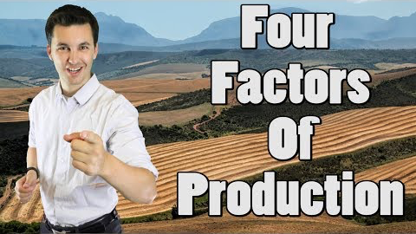
https://www.youtube.com/watch?v=iU64lU4-yZ0

Slide 6
capitalism
EQ: What is capitalism and what does it look like in the American economy?

Slide 7
Capitalism and free enterprise
Capitalism - economic system in which private citizens own and use the factors of production to seek a profit
Free Enterprise – economy in which competition is allowed to flourish with little government intervention

Slide 8
Features of capitalism
Markets – where prices of goods/services are determined and where exchanges take place
Consumer Sovereignty – consumers are considered the ruler of the market…the ones who determine what products will be produced
Economic Freedom – Key to the free enterprise system; We are free to choose our job, products we buy and sell.
Private Property Rights – having the freedom to own, use, dispose of our property as we choose (tend to take better care of things we own)

Slide 9
Features cont.
Competition – struggle that goes on between buyers and sellers to get the best product at the lowest prices.
Competition keeps quality of goods high. Competition rewards the most efficient producers & forces the least efficient out of business.
Profit Motive:
Profit – amount of money left over after all production costs have been paid.
Profit Motive – driving force that encourages people to improve their well being…responsible for the growth in the free enterprise system
Voluntary Exchange – act of buyers and sellers freely and willingly engaging in market activity/transactions.

Slide 10
Spread of Capitalism
The Spread of Capitalism – capitalism developed over time throughout Europe
Adam Smith and Capitalism
Wealth of Nations, 1776 – described the basic principles of economics and came the basic ideas of laissez-faire economics.
Laissez-faire means “to let alone” – meaning that the government should not interfere in the market
Remember the name and the idea!!

Slide 11
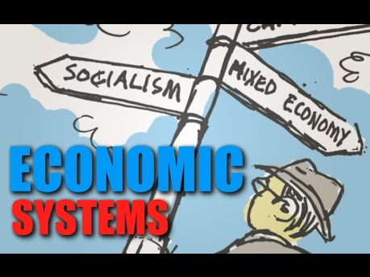
Other Types of Economies

