Slide 1
Causes of WWI
Unit 7

Slide 2
Rising Tensions in Europe
The MAIN Causes of World War I:
Militarism → policy of building up strong military forces to prepare for war
Alliances → agreements between nations to aid and protect one another
Imperialism → when one country takes over another country economically, politically, and/or socially
Nationalism → pride in and/or devotion to one’s country or ethnic identity

Slide 3
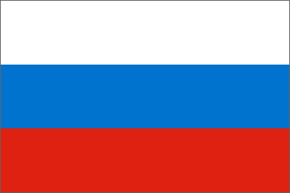
Triple Entente:
Triple Alliance:
Great Britain
Germany
France
Austria-Hungary
Tension
Russia
Italy

Slide 4
Allied Powers:
Central Powers:
Germany
Great Britain
World War I
France
Austria-Hungary
Russia
Ottoman Empire
Italy

Slide 5
How did alliance systems contribute to the outbreak of World War I?
What type of problem might the Triple Alliance experience based on geography?

Slide 6
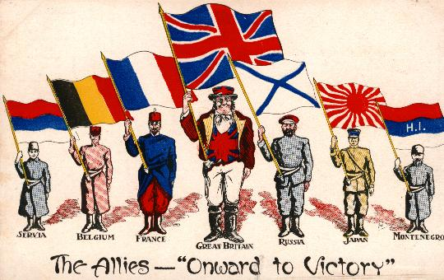
Europe Plunges Into War
By 1914, Europe was divided into two rival alliances.
Triple Entente = Great Britain, France, and Russia
Triple Alliance = Germany, Austria-Hungary, and Italy.
Austria’s declaration of war set off a chain reaction…
Countries of Europe pledged to
support each other.
As a result, nearly all of Europe
was fighting what would be one
of the longest, most destructive
wars the world had seen.

Slide 7
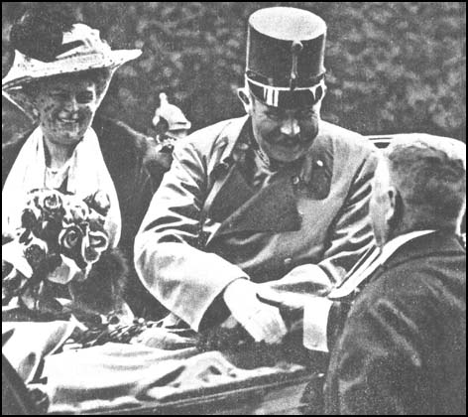
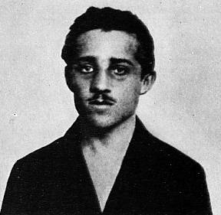
Outbreak of War
June 28, 1914, Austrian Archduke Franz Ferdinand and his wife traveled to Sarajevo, capital of Bosnia
The archduke/archduchess were shot and killed by Gavrilo Princip, a member of the Black Hand (secret society committed to ridding Bosnia of Austrian rule)
Austria used assassination as excuse to punish Serbia, presented an ultimatum (allow Austria to investigate assassination, suppress anti-Austrian propaganda)
Serbia tried to negotiate; Austria rejected Serbia’s offer and declared war on July 28, 1914
Russia, Serbia’s ally, mobilized troops towards Austrian border

Slide 8
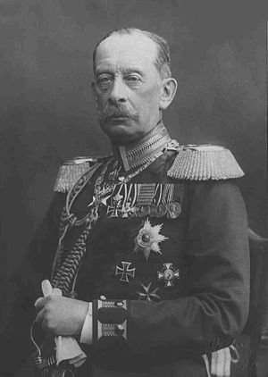
Outbreak of War
General Alfred von Schlieffen, a German leader, came up with the Schlieffen Plan
Two-front war with France and Russia
Small holding action on Russia while most of the German Army would rapidly invade and defeat France
German troops had to march through Belgium to reach France
Violated Belgian neutrality, so Great Britain declared war on Germany on August 4, 1914

Slide 9
Total War
The world enters a “Total War”
War that is unrestricted in terms of the weapons used, the territory involved, or the objectives pursued, especially one in which the laws of war are disregarded.
https://www.youtube.com/watch?v=dHSQAEam2yc

