Slide 1
Rise of Communism, Fascism, & Dictators
Unit 7

Slide 2
Soviet Union
Lenin ended Russian involvement in World War I, sent Leon Trotsky to negotiate peace with Central Powers
1922, Lenin officially created new state known as Union of Soviet Socialist Republics – USSR – “Soviet Union”
Other member of communist party vying for control was Joseph Stalin
1929, Stalin removed Bolsheviks from revolutionary era from Politburo, established a dictatorship
Collectivization is a system in which private farms were eliminated and government owned all land with peasants working it
In response, Stalin cut off agricultural supplies to Ukraine, resulting in the deaths of 5-7 million people – The Great Famine

Slide 3
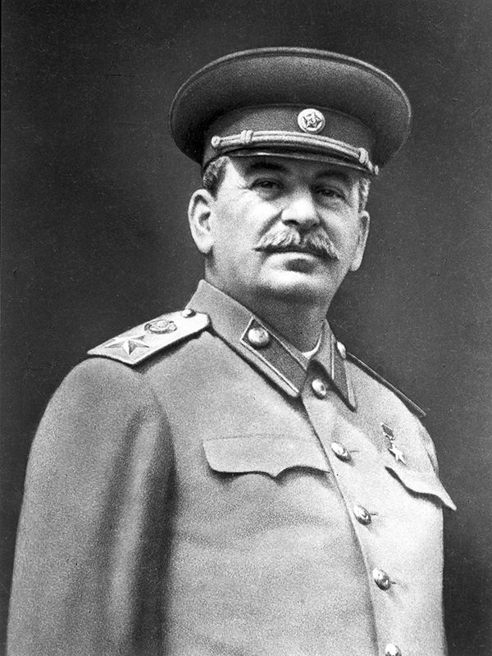
Joseph STalin
Stalin strengthened control over party, those who resisted were sent to forced labor camps in Siberia – Gulags
Great Purge - Stalin expelled and killed army officers, diplomats, union officials, intellectuals, and other dissidents
Stalin purged the communist party of Old Bolsheviks, many were condemned to death
Stalin solidified totalitarian regime, leaving few people that would oppose him

Slide 4
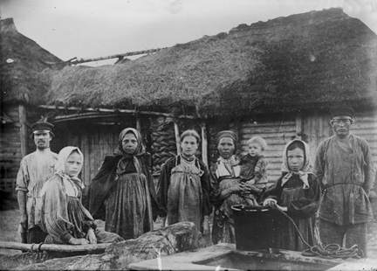
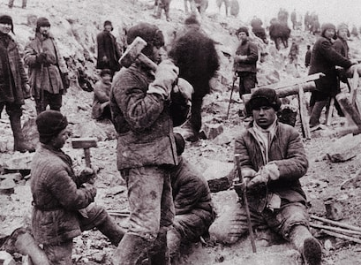
Communism
Communism- type of government and philosophy. Its goal is to form a society where everything is shared equally.
Government owns and controls most everything including property, means of production, education, transportation, and agriculture.

Slide 5
Fascism
ITALY:
Benito Mussolini created Fascism in 1922 when he established a dictatorship in Italy
Fascism-- a militant political movement, socialist and conservative, that emphasized loyalty to the state and obedience to the leader
Weak political leadership, high unemployment rates, a depressed economy, communist fears, and disappointment with Treaty of Versailles helped Fascist Party gain power
Mussolini used force to establish dictatorship, ending freedom of press, encouraging economic growth by ending labor conflicts, disbanding labor unions

Slide 6
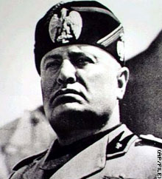
Mussolini
Mussolini killed political opponents and abolished opposition parties, believing that too many political parties would destroy any type of unity in the state
Instead, Mussolini supported a single party with a strong leader (surprise, surprise… he meant himself!)
By seeking military conquests, Mussolini looked to regain the old glory of ancient Rome

Slide 7
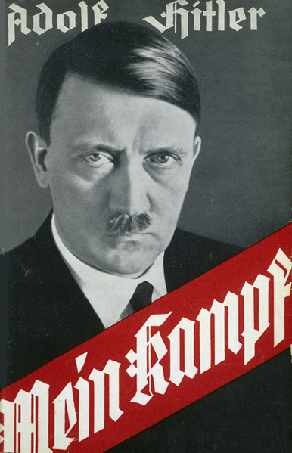
Nazism
The Nazis started as a small right-wing political group
Eventually were renamed the National Socialist German Worker’s Party (Nazi)
Adolf Hitler emerged as leader of the Nazi Party when he wrote Mein Kampf (My Struggle) in 1923 while in jail
Became the blueprint for the Nazi Party Platform
Blamed Germany’s defeat in WWI and subsequent problems on “traitors” - communists and Jews
Nazi Party promoted German nationalism using Hitler’s theory of the “master race”
Aryan race was considered superior to all others and Hitler advocated German expansion using nearby “living space” in Eastern Europe
Hitler continued to use racist philosophy to justify many of the actions of the Nazi Party
Purged Germany of its former cultural values, including religion

