Slide 1
Unit 9: Government in the Economy
With elections coming up, what does it all mean?

Slide 2
Bell Ringer #1: 5/14
What are ownership shares of a corporation called?
stocks
bonds
charters
How does inflation affect the average consumer?
creates higher prices for consumer goods
creates opportunities for investment in the stock market
allows for loans at a lower rate of interest
What could be a possible negative effect of free trade?
government regulation can suppress competition
fewer countries will have access to goods
countries with less resources can lose out

Slide 3
Essential Question:
What does our tax money really go to?

Slide 4
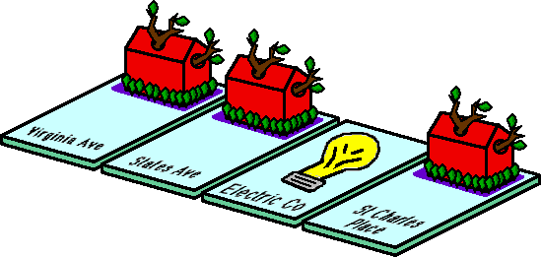
Fiscal Policy: Change in Gov’t spending or tax policies
We’ll talk international later
Give Public Services--with risk of externalities (unintended side effects)
Regulations: Advertising
Federal Trade Commission to regulate advertising
Food and Drug Administration to regulate labels, foods, drugs
Consumer Product Safety Commission to issue recalls to regulate product safety
Regulations: Mergers
Monopolies
Market controlled by one business--bad because restrict competition and take away free market
Makes laws to prevent them (Example: Sherman AntiTrust Act)--ban monopolies and other business combinations that prevent competition
NOT TO BE CONFUSED WITH Natural Monopolies and Oligopolies and Mergers
Natural Monopolies: When cost of production are minimized by having only one firm, which is regulated by the government--ALLOWED
Oligopolies: Controlled by a FEW
Mergers: Businesses can combine so long as NOT monopoly

Slide 5
Business Cycle
Business ebbs and flows: Expansion→ Peak→ Recession→ Trough→ Expansion
During Expansion:Booming investment, steady money flow, increase in employment, income, production, sales. Inflation begins as cost of living rises. Inflation is sustained increase in general level of prices.
Government uses Consumer Price Index to track it...tracks about 400 goods
During Peak: Gets as high as it is going to be
Recession: High unemployment, demand for goods down. Might call for gov’t to increase spending and reduce taxes. COULD lead to increase in federal debt
Trough: High unemployment, low production, low demand for loans. Great Depression!
Deficit vs. Surplus
Deficit: spend more than is collected→ Borrow $$ to pay bills and cut spending
Surplus: Spend less than is collected in revenues

Slide 6
Business Cycle
The Business Cycle describes the rise and fall in production output of goods and services in an economy. Business cycles are generally measured using the rise and fall in real gross domestic product (GDP) or GDP adjusted for inflation.
One Cycle
One Cycle
c. Peak – highest point in expansion
a. Expansion/Recovery – Growth as real GDP is going up
b. Recession – real GDP down for 6 months
d. Trough

Slide 7
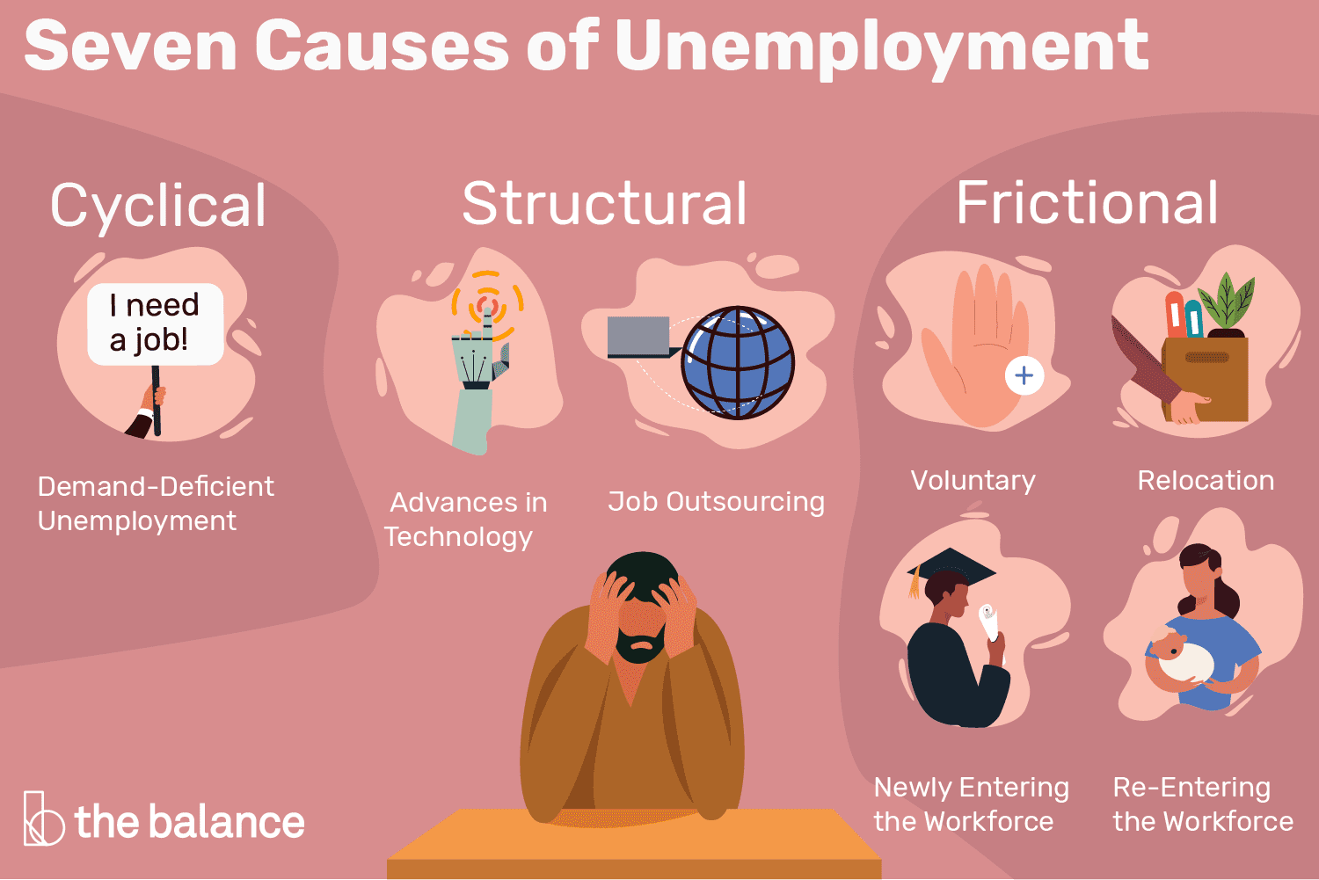
Unemployment
Civilian Labor Force--all civilian labor 16+ who are working or looking for work--about ½ people in the US
Unemployment Rate: Percentage of people in CLF who are NOT working but looking
TYPES OF UNEMPLOYMENT:
Frictional: People who are temporarily between jobs.
Seasonal: Unemployed during other parts of the year because weather (camp counselor)
Cyclical: Rises in recession. So maybe not enough spending in economy so laid off
Structural: Mismatch between job seekers and job openings

Slide 8
Essential Question: How much control does the bank have? How does the government regulate the economy?

Slide 9
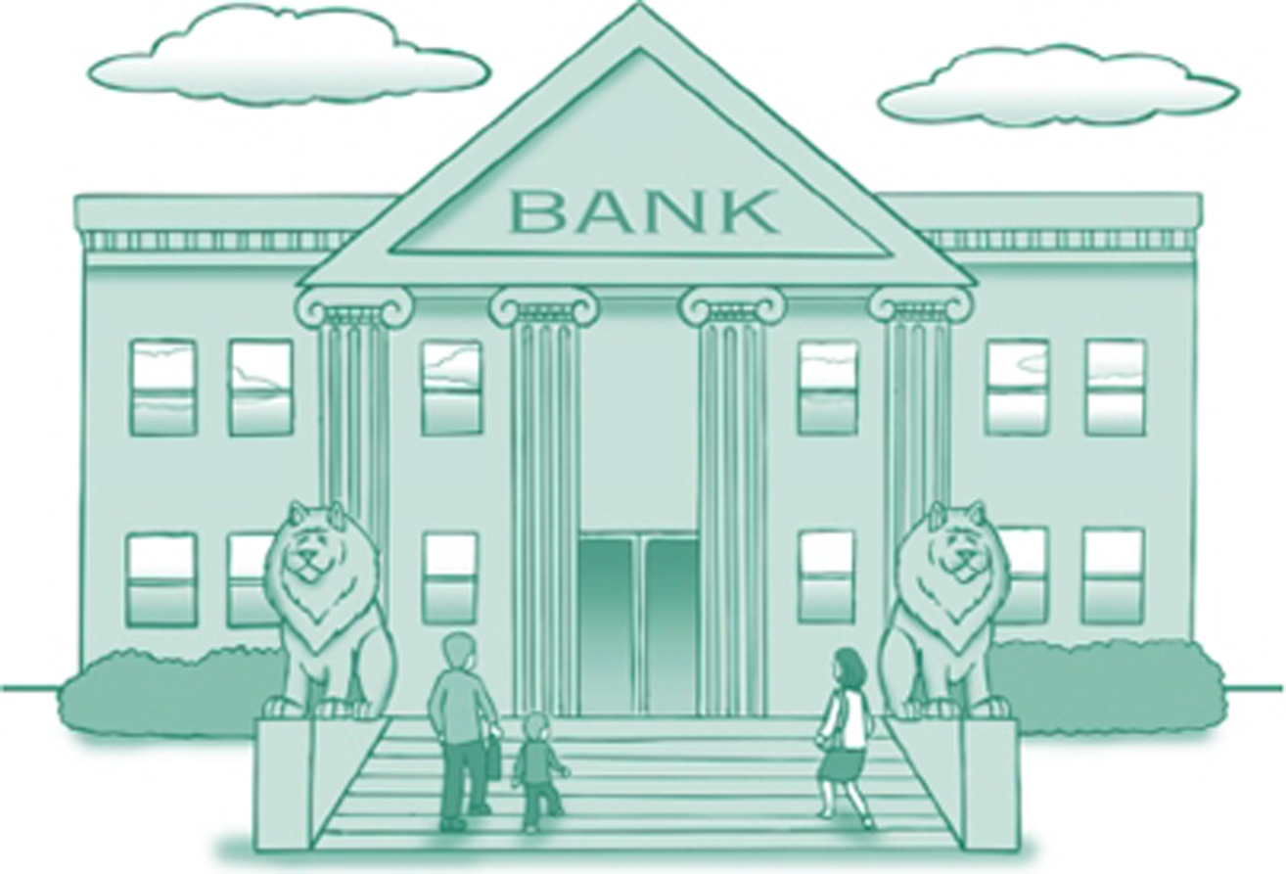
Banking: Types of Financial Institutions
Commercial Banks: Full banking services to individuals and businesses
Savings and Loans: Traditionally loaned money to those buying houses; today very similar to commercial banks
Credit Unions (non profit) gives members a financial institution that has low costs
Federal Deposit Insurance Company (FDIC) insures up to $250,000
Financial Institutions do NOT put money in a safe and leave it! They put the money to work by lending it to other people or businesses that need funds and then charge interest.

Slide 10
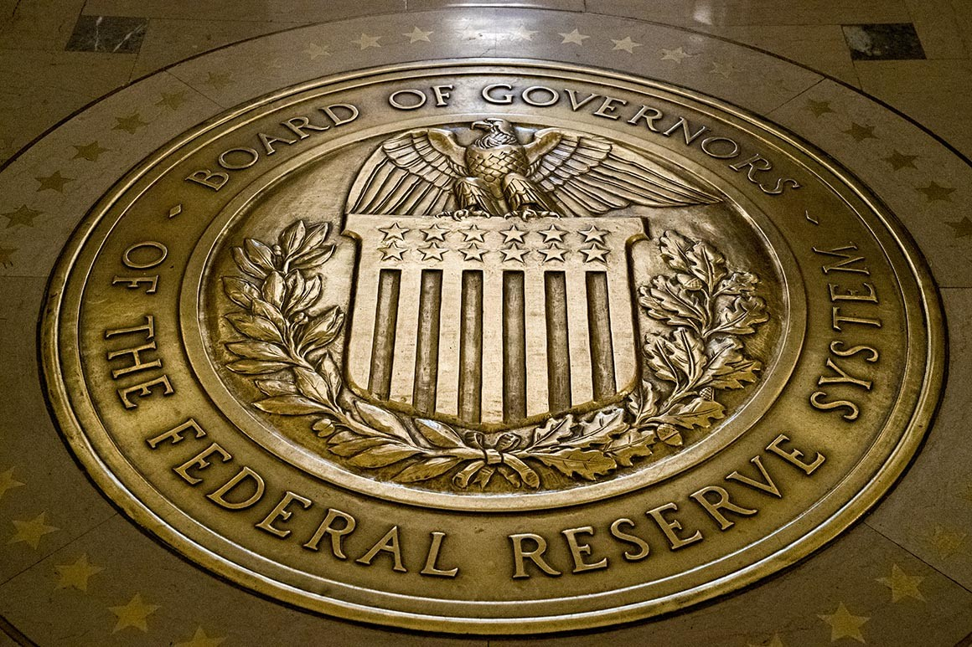
Federal Reserve System
Central bank of the US
If banks need money they borrow it from the “fed”
US is broken up into 12 Federal Reserve Districts
FUNCTIONS:
Oversees banking system
Holds gov’t money
Sells US gov’t bonds (used to borrow $$)
Issues currency and controls circulation--Decides how much $ in economy

Slide 11
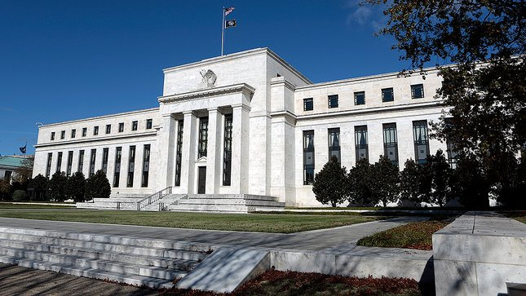
Federal Reserve System
Deals with:
Banking Regulation
Consumer credit
Overseeing bank mergers
Regulates connections with foreign banks
Enforces laws of consumer borrowing
Operates the monetary policy--controlling the supply of money and the cost of borrowing money (interest rates). Independent of Congress
→ Federal Open Market Committee helps regulate monetary policy through discount rate and trading securitites

