Slide 1
Credit Review!

Slide 2
Credit Report/score
Credit Rating is an evaluation of the likelihood to repay a loan
The purpose of credit scoring is to provide a reliable, inexpensive and ready assessment for an individual's credit-worthiness.
The higher the score, the more qualified the candidate
Credit scores are required for major purchases such as renting an apartment, buying a car, or purchasing a home.
The easiest way to build credit is by making payments on a credit card.

Slide 3
Real World Example
Hillary and Stephanie have both borrowed $15,000 from the same bank to buy the same model of a new car. Hillary's credit score is 732 and Stephanie's credit score is 588. Who is likely to pay a lower finance charge?
Hillary
Finance Charge: a finance charge is any fee representing the cost of credit, or the cost of borrowing. Not only interest, but any financial transaction fees

Slide 4
debt
Debt: The state of owing money
Can be useful for building credit score
What is good debt and what is bad debt?

Slide 5
Budgeting
Fixed cost: business costs, such as rent, that are constant whatever the quantity of goods or services produced.
Ex: Rent, employee salaries, insurance, and office supplies.
Variable cost: a cost that varies with the level of output.
Ex: Sales commissions, direct labor costs, cost of raw materials used in production, and utility costs
Sample Questions:
Erik is a college student and lives in an apartment. Why would his rent be considered a FIXED cost?
Which of these would be considered a VARIABLE cost when making a budget?
gas for your car
car payment
$100 taken every month for savings

Slide 6
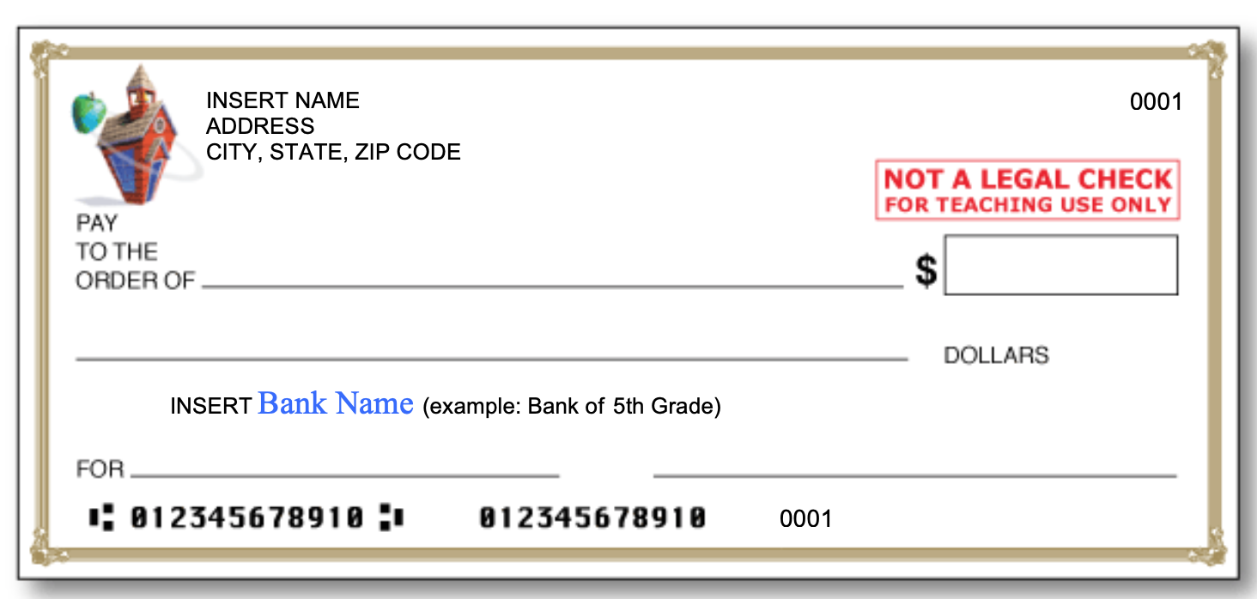
Quick recap
Tell me what these letters identify on this blank check?

Slide 7
How credit card payments work

