Slide 1
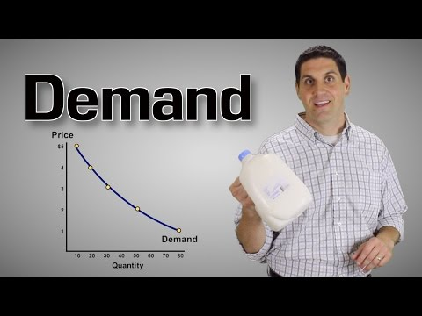
https://youtu.be/LwLh6ax0zTE

Slide 2
Bell Ringer #7 5/3/19
Which term describes the pleasure, usefulness, or satisfaction a person gets from using a product?
Demand
Utility
marketability
Which series includes the four broad categories of resources needed for production?
Land, labor, capital, and entrepreneurial skill.
Entrepreneurial skill, incentives, standard of living, and loans.
Resources, scarcity, transportation, and leisure time.
What term refers to the desire, willingness, and ability to buy a good or service?
supply
demand
law of demand

Slide 3
Demand
EQ: How does demand for a product change as cost decreases?

Slide 4
Demand
Definition: Desire, willingness, and ability to buy a good or service (must want it, be willing to buy it, and have resources to buy it)
Individual Demand Schedule – lists various quantities of a product or service that someone is willing to buy over a range of prices (p. 571)

Slide 5
Demand Curve
Individual Demand Curve – graph that shows the amount of a product that would be bought at all possible prices in the market (prices are on the vertical axis and quantities on the horizontal axis) (p. 571)
P
Q

Slide 6
Law of Demand
Law of Demand –
Demand curves usually slope downward because people are generally willing to buy less of a product if the price is high
Law of Demand – quantity demanded and price move in opposite directions (P↑Q↓ and P↓Q↑)
Market Demand – total demand of all consumers for their product or service

Slide 7
Utility
Utility- the pleasure, usefulness, or satisfaction we get from using a product.
Marginal utility- Additional satisfaction from each additional unit consumed
Diminishing marginal utility- principle that our additional satisfaction (marginal utility) tends to go down as more units are consumed.

Slide 8
Factors Affecting Demand
Why does DEMAND change?
Increase/decrease of consumers in the market
Incomes, tastes, and expectations change
Changes in price of related goods

Slide 9
Changes in Demand
When demand goes down the curve shifts to the left
Smaller the population, less demand
Loss of jobs, less demand
Popularity fades over time (VCR’s), less demand
Expect a new product to come out in the future, lessens demand today
Expect the country to enter into war or economic hard times, less demand
When demand goes up the curve shifts to the right
Larger the population, more demand
Increase in income (raises, bonuses), more demand
Popular product (“must have” holiday product), demand increases
Expect a shortage of food or gasoline, demand increases

Slide 10
Product Related Changes
Demand can be influenced by changes in the price or quality of related products
Substitutes – competing products – you can use one in place of another
A change in price of Good A causes the demand for Good B to change (Pepsi vs. Coke)
Compliments – products used together (PB and Jelly) –
A change in price of Good A causes the demand for Good B to change as well

Slide 11
Elasticity of Demand
Elasticity of Demand – the extent to which a change in price causes a change in quantity demanded.
with some goods, no matter what the price is or goes to the demand will stay constant and it won’t go down as the Law of Demand says
Elastic – demand is very responsive to a change in price
Inelastic – demand is not very responsive to a change in price (necessities)

Slide 12
Sample Question

Slide 13
Practice Problems
What is Demand?
What does the law of demand state?
What are demand shifters?
What causes a change in quantity demanded?

Slide 14
Practice Problems:
Citizens of Jamaica are expecting a category 10 hurricane in two months. What will happen to their demand for goods and services?
As of late the price of hamburger meat has gone up. What will happen to the demand for hamburger buns? What’s their relationship?

Slide 15
Practice Problems
The prices of cookies are going up this week, what will happen to the demand for potato chips? What’s their relationship? Show this graphically.
If the price of bananas goes down, what will happen to demand

Slide 16
Practice Problems:
A new manufacturing company has arrived in Raleigh, and has doubled the population. What will happen to the demand for goods and services in the city? Show graphically.

