Slide 1
Dictators and War

Slide 2
What is Totalitarianism?
Government that attempts to control every aspect of a society: economic, social, intellectual & cultural
Government takes away all personal freedoms
Modern day example → North Korea

Slide 3
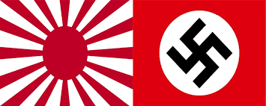
What types of totalitarianism existed before WWII?
Italy & Germany: fascism
Soviet Union (USSR): communism
Japan: imperialism

Slide 4
What was Italian & German Fascism Like?
Fascism was based on the idea that people should glorify their nation and race through force
Italy: Fascist Party founded by Benito Mussolini and seized power in Italy in 1922
Germany: Nazi Party founded by Adolf Hitler and seized control of Germany in 1933
Mein Kampf → expressed extreme anti-Semitism and his views on what burdened Germany

Slide 5
Both fascist states were ran through one party dictatorship
They felt extreme nationalism
Did not agree with democracy or communism → did not like U.S. and USSR
Militaristic → both developed powerful militaries

Slide 6
What was Soviet Communism Like?
One party dictatorship: Communist Party lead by Joseph Stalin
Took power after the death of Vladimir Lenin in 1924
No private property → state ownership of everything
Advocated spread of communist revolution to other nations

Slide 7
What was Japanese Imperialism Like?
Ruled by Emperor Hirohito and his military leaders
Extreme sense of nationalism
Very militaristic and practiced expansionism → wanted to control east Asia and the Pacific
Attacked and took control of Manchuria in 1931

Slide 8
Violated the Nine Power Treaty of 1922 (Open Door Policy) and the League of Nations covenant
League of Nations could do nothing → lack of U.S. representation hurt
Japan withdrew from League of Nations
The Stimson Doctrine
Named after U.S. Secretary of State Henry Stimson
U.S. would honor Open Door Policy and not recognize Machukuo (Manchuria)

Slide 9
How was the Spanish Civil War a preview for WWII?
The Spanish Civil War (1936-1939)
Spanish fascists vs. Spanish Loyalists
Hitler and Mussolini armed and backed Francisco Franco’s fascists
The British and French armed and backed the Loyalists
In 1939 Franco and the fascists established a military dictatorship

Slide 10
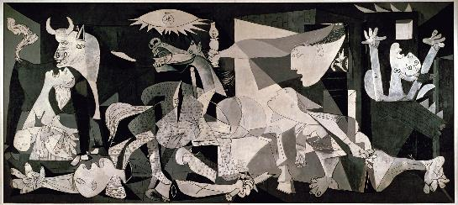
Franco’s regime was very brutal on the Spanish population
Testing ground for WWII weapons and tactics (airpower and tanks)
Famous artists such as Pablo Picasso and Francisco Goya depicted the atrocities

Slide 11
What was appeasement?
Giving in to an aggressor to preserve peace
Allowing Hitler to get away with acts of aggression to avoid conflict
Policy of western democracies towards fascist aggression

Slide 12
Reasons for appeasement
Great Depression made it too expensive to fight
Opposing fascists would make a default alliance with communism (USSR)
Fear of Germany’s rebuilt military

Slide 13
What were examples of fascist agression in the 1930’s?
Ethiopia (1935)
Ethiopia was the only independent African nation in the League of Nations
Italy invaded Ethiopia October 3, 1935
League of Nations objected, but did nothing
Rhineland (1936)
Permanently demilitarized zone in western Germany by Treaty of Versailles → Hitler occupies the Rhineland

Slide 14
China (1938)
Full-scale war broke out between China and Japan in 1937
A US gunboat sunk by Japanese plans
U.S. was quick to accept this apology
Sudentenland (1938)
Hitler announced his intentions to take over Sudetenland → German speaking strip of Czechoslovakia

Slide 15
The Munich Conference: Neville Chamberlain (Britain) & Edouard Daladier (France) gave Hitler Sudetenland in exchange for a promise to take over nothing else → “Peace in our time” – Chamberlain
Best example of appeasement
U.S response to fascist aggression
FDR supported The Good Neighbor Policy → cease intervention in Latin American nations
Led Congress to nullify the Platt Amendment → retained only Guantanamo

Slide 16
FDR proposed a “quarantine” of Japan by the world’s democracies → eventually dropped due to isolationist resistance
FDR did convince Congress to approve money for military preparedness in 1938

