Slide 1
Bell Ringer #7 3/13/19
Do you feel social media has a positive or negative impact on politics? Why? (Use at lest 2 complete sentences)
Each political party formally chooses its presidential candidate at which event?
National Convention
General Election
Local Precinct meeting
Which amendment lowered the voting age to 18

Slide 2
Bell Ringer #8 3/14/19
Which propaganda technique attempts to turn people against a candidate or idea by using an unpleasant label or description?
Which of the following is not a propaganda strategy used during elections?
At the RNC, the party delegates elect Bob Green for president, Annie Walker for vice president, and pass a list of policies the party supports. Among these are longer prison sentences, stricter guidelines governing abortions, increased military spending, and lower corporate taxes. Which of the following is an accurate statement?
Annie was the runner up in the party primary and automatically becomes vice president
The list of polices that the party passes is the platform and increased military spending is the plank
Bob and Annie are considered the Republican platform for the election and the list of policies is the plank

Slide 3
Election Basics
https://youtu.be/48EZKXweGDo

Slide 4
Elections
EQ: What is the easiest way for citizens to influence the government?

Slide 5
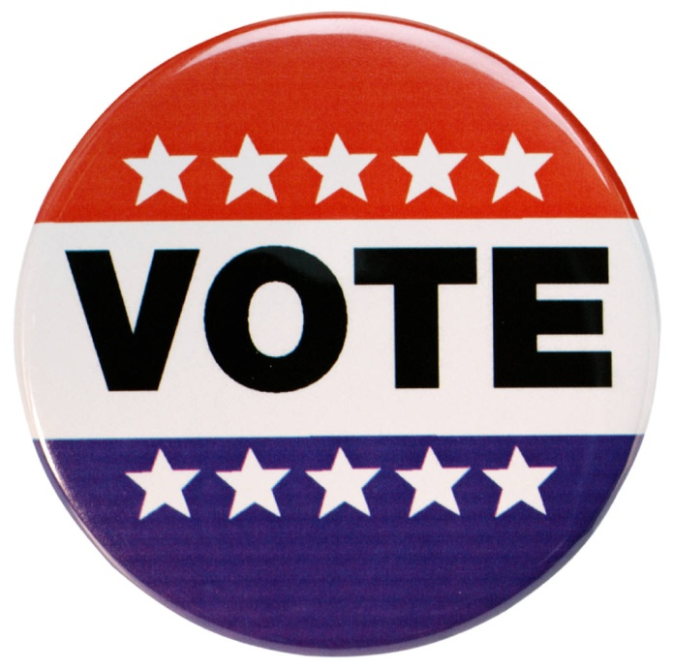
Who Can Vote?
In order to vote, you must be a US citizen, 18 years old, not in prison, and registered to vote.
Some convicted felons lose the right to vote forever. In NC, felons can vote when they have completed their sentences.
You can get registration materials many places including libraries, schools, and county election offices.
You can also register at the DMV when you renew your driver’s license (motor voter act).

Slide 6
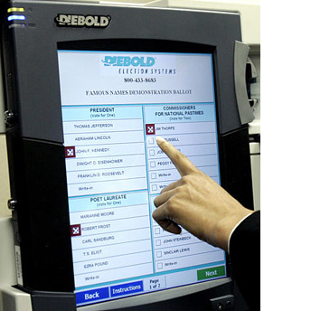
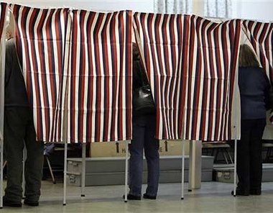
Voting Process
Each county is divided into pieces of equal population called precincts. Registered voters are assigned a precinct with a polling place based on where they live.
After proving their identities, voters complete their ballot by choosing one candidate for each open office.
Straight ticket: vote for the same party in each race.
Split ticket: vote for different parties on same ballot.

Slide 7
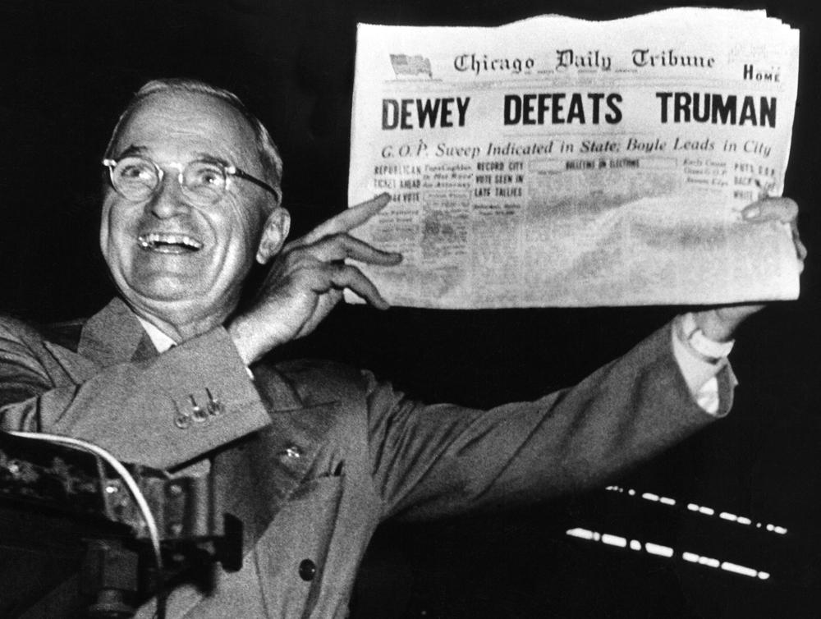
Process Continued…
If unable to reach the polling place on election day, a voter can complete an absentee ballot and mail it in.
Winners of races are determined by counting all ballots, but many media outlets guess (called making a projection) on who has won a race based on a percentage of the votes.
This can sometimes cause people not to vote, Also, these projections can be wrong.

Slide 8
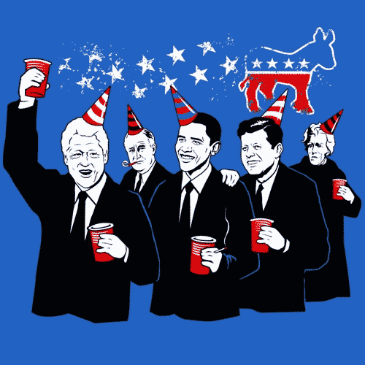
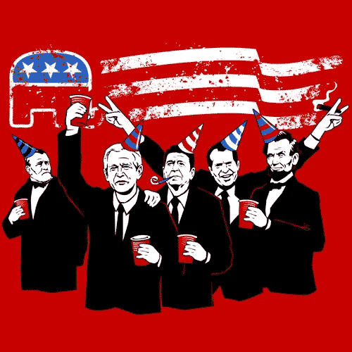
Who to vote for?
Stay informed with TV, magazines, newspapers, and the internet
Questions to consider:
1. Does the candidate share your same views?
2. Is the candidate reliable?
3. Is the candidate experienced?
4. Will the candidate be effective?
5. Does the candidate have a chance to win?

Slide 9
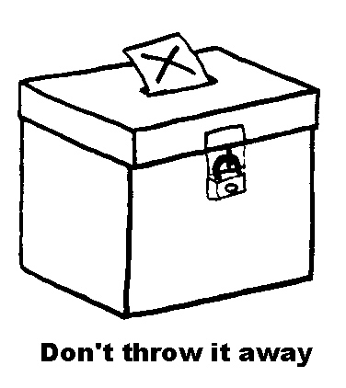
Types of Elections
Primary elections- a preliminary election to appoint delegates to a party
General elections: decide people who will fill positions in government.
Always take place on the first Tuesday after the first Monday of November in even years.
- Who’s elected?: President every four years; all members of House and Senators every two years; several members of State and Local government
Presidential Primary vs. Presidential General Elections:
The winner of a political party's primary election goes on to represent that party in the presidential general election. The general election is held every four years. The winner of the general election becomes president (through Electoral College)

Slide 10
Runoff elections- settles the matter, providing a final decision when an initial vote did not result in a winner because it tied.
Caucus- a meeting of political party members to conduct party business
National Convention- each political party formally chooses its presidential candidate
Issue Elections: decide government issues other than who will take part. Can take place any time of year
- Initiative: piece of legislature that comes from the people
- Referendum: voters decide to support or reject a new law
- Recall: voters call special election to decide whether or not to remove someone from office

Slide 12
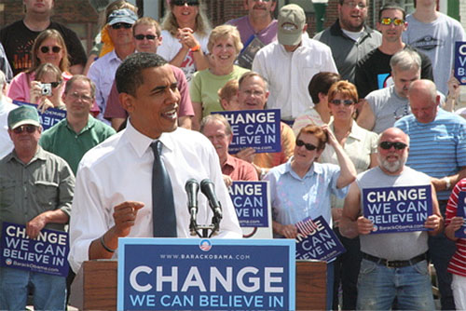
Campaigns
Over $4 billion are spent every four years on political campaigns
Canvassing: people go door to door to promote a candidate or take a poll
Advertising and Image Molding: candidates use many techniques to convince potential voters of what type of person they are.

Slide 13
Who Pays For Campaigns?
Most campaigns are paid for by donations
1971 Federal Campaign Finance Act: all candidates must disclose who donates money and how much. The act also sets a maximum amount of money that any one person can donate to a candidate
Soft Money: individuals can donate unlimited sums of money to political parties, who then give the money to specific candidates

Slide 14
Comprehension Check
Look at the Electoral Map on Weebly
How many electoral votes does North Carolina have?
What are three things that you noticed?/ Did anything surprise you?
What state has the most amount of votes?
What state has the least amount of votes?
What is your opinion of the electoral college system?

Slide 15
Electoral College
https://www.youtube.com/watch?v=OUS9mM8Xbbw&t=15s
What is this all about?

