Slide 1
The Fight in Europe and the Turning Point of the War

Slide 2
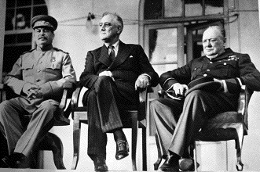
How was WWII really two wars in one for the U.S?
The war was divided into two fronts or theaters of war: European theater and Pacific theater
The big three (FDR, Churchill, and Stalin) had agreed to fight the European war first, then turn to the Pacific theater

Slide 3
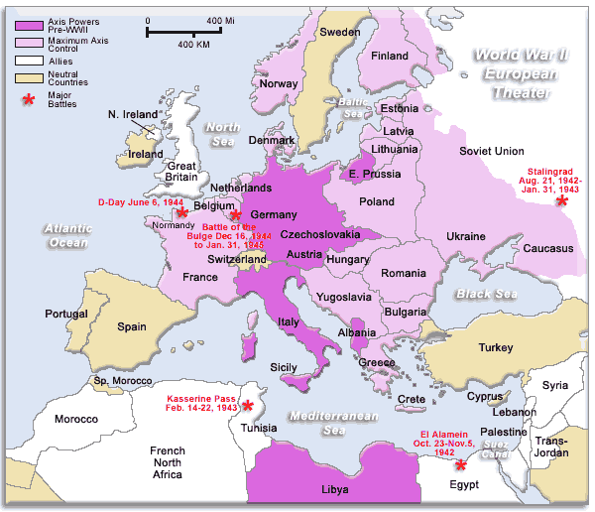

Slide 4
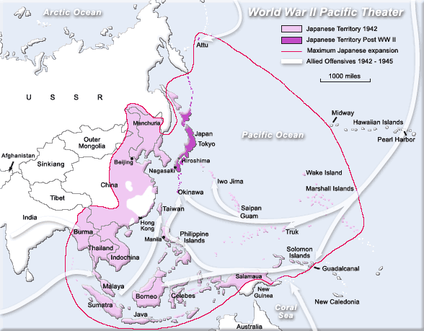

Slide 5
What was the war like in Europe?
Germany vs. USSR
After the fall of France, there was no western front
Hitler turned his attention east towards the USSR
The German advance into the USSR ended at the battle of Stalingrad (1943) → turning point in Europe
Hitler was forced to retreat west and ended his dream of conquering all of Europe
Stalin believed that Churchill and FDR were deliberately giving up the western front in an attempt to let the communists and fascists kill each other off

Slide 6
Early Allied military strategy (1942)
The Battle of the Atlantic
Sea war to control Atlantic shipping lanes
German U-boats sank over 500 Allied ships in 1942
The Allies developed new technologies/techniques for battling U-boats → radar, sonar, and bombing German naval bases
Bombing raids on German cities
Destroy German production capabilities
Prepare for eventual invasion
African American fighter squadron known as the Tuskegee Airmen → 1,500 missions and 0 casualties

Slide 7
Allied invasion of North Africa and Italy
Operation Torch (November 1942): the Allied North African campaign
Objective → drive German forces out of North Africa in preparation for an invasion of Italy, the “weak underbelly of the Axis”
Led by U.S. General Dwight Eisenhower and British General Bernard Montgomery
Allies drove the Germans out of North Africa by May 1943

Slide 8
Invasion of Italy
U.S and British forces occupied Sicily by summer of 1943
Mussolini fell from power in summer of 1943, but German troops still controlled most of Italy
September 1943 → Allied forced invaded southern Italy from Sicily
German forces held northern Italy until their final surrender in May 1945

