Slide 1
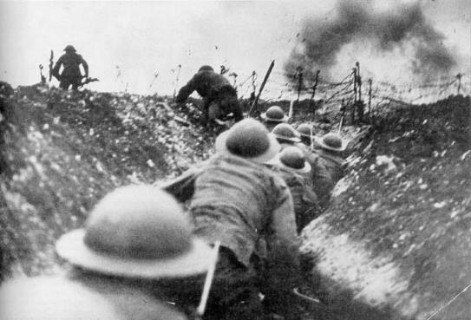
From Neutrality to War

Slide 2
What were long term Causes of WWI?
Militarism: Who could have the biggest and baddest military
Alliances:
Allied Powers → GB, France, Italy (1915), & Russia
Central Powers → Germany, Austria-Hungary, Italy (pre 1915), and the Ottoman Empire
Imperialism: Competition for military size and strength to protect colonies
Nationalism: European nations wanted to prove their superiority. Competition for colonies became and issue of national pride.
M.A.I.N.

Slide 3
What Chain of Events led to the outbreak of WWI?
June 28, 1914: Austrian Archduke Ferdinand (heir to throne) was assassinated by Serbian nationalist in Sarajevo → sets off a domino effect
https://www.youtube.com/watch?v=IIK9Lkf02TE
July 27, 1914: Austria invades Serbia causing Russia (secret ally of Serbia) to mobilize for war
August 1, 1914: Germany (ally of Austria) declared war on Russia

Slide 4
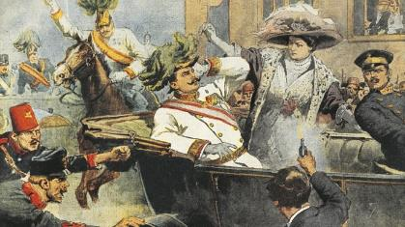
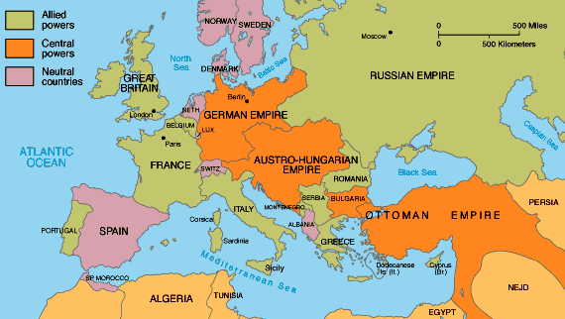
August 3, 1914: German declared war on France and invades Belgium (quickest way to Paris)
August 4, 1914: Great Britain (ally of France) declared war on Germany

Slide 5
What was different about WWI than other wars?
New inventions → barbed wire & machine guns
Switched the advantage from offensive to defensive
Trench Warfare → troops dug into the ground
Defense from new weapons and created stalemates
https://www.youtube.com/watch?v=_G4ZY66BG38
Large artillery guns for bombarding enemy troops
Submarines (U-boats), Poison gas, Airplanes, Tanks

Slide 6
How did the U.S. Become involved in WWI?
The U.S. took a stance of isolation when it came to European conflict
President Wilson issued a declaration of neutrality and asked the American people to avoid choosing sides
By 1914, 1/3 of all Americans were foreign born, with many coming from Europe
Hard to keep a neutral position as an individual
Many choose sides → majority sided with Allies

Slide 7
Germany made it difficult for the U.S. to remain neutral
German invasion of neutral Belgium
Unrestricted submarine warfare
Any nation’s ship who entered German blockade of Britain “War Zone” were threatened to be attack
Sinking of the Lusitania
May 7, 1915: German U-boats sunk a British passenger line killing 128 Americans
Wilson warned Germany to stop unrestricted submarine warfare or they would be held “strictly accountable”
Total War-a war that is unrestricted in terms of the weapons used, the territory or combatants involved, or the objectives pursued.

Slide 8
Election of 1916: Wilson was re-elected based off of keeping the U.S. out of war
Events of March 1917 lead the U.S. to declare war:
Resumption of unrestricted submarine warfare
Wilson buts off diplomatic relations with Germany
German U-boats sank 5 unarmed U.S. merchant ships
The Zimmerman Telegram
March 1, 1917: U.S. newspapers print a telegram intercepted by British Intelligence
It was Germany to Mexico proposing an alliance against the U.S.
Germany would assist Mexico in reclaiming Texas, NM, and Arizona

Slide 9
3. The Russian Revolution
March 15, 1917 → Russian Tzar was overthrown and Russia proclaimed itself a republic (November 1917 → Bolsheviks/Communists overthrew the republic)
Russia withdraws from the war after Bolshevik takeover
President Wilson asks Congress to declare war on Germany by condemning Germany’s unrestricted warfare
April 6, 1917 → Congress declares war on the Central Powers
United States Now Enters WWI
WWI: Jul 28, 1914 – Nov 11, 1918

