Slide 1
Bell Ringer #4 2/21/19
What does the term Muckraker refer to in regards to the Progressive Era?
What was the main goal of the Progressive Movement?
To encourage big businesses by allowing more monopolies
To ease radical tensions that existed throughout the United States
To correct political and economic injustices that resulted from industrialization
What law halted the sale of contaminated foods or drugs and called for truth in labeling?

Slide 2
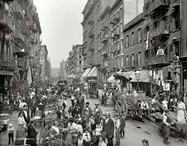
Groups Pushing for Reform during the Progressive Era.

Slide 3
Did Progressivism Help Minorities?
Prejudice and discrimination against minorities continued
African-Americans, Latinos, Catholics, Jews, and new immigrant groups worked to help themselves
The efforts of these groups help create a foundation for the civil rights movements of the 1950’s and 60’s
Most Progressives were white Anglo-Saxon Protestant- shared the same prejudice against non-whites held by other white Americans
Plessy v. Ferguson (1896)
African American man sat in white train car and refused to move
States North & South, passed segregation laws
By 1910, segregation was the norm across the nation

Slide 4
Booker T. Washington
Dominant leader in African American community
Believed African Americans had to achieve economic independence before civil rights
Black people must tolerate discrimination while they worked hard to gradually win white Americans’ respect → eventually lead to equal civil rights

Slide 5
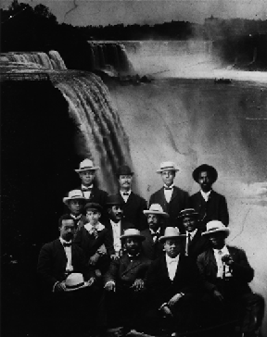
Niagara Movement
1905, Leading black American thinkers met at Niagara Falls to discuss the concern over black men being denied the right to vote
Not enough of a voice and never grew more than a few hundred members

Slide 6
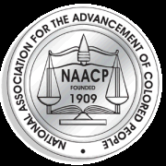
Minority Movements
NAACP (National Association for the Advancement of Colored People):
Founder: W.E.B. DuBois
Founder of the NAACP-1909 as a bi-racial endeavor to advance justice for African Americans
Believed that black Americans had to demand their social and civil rights or else become permanent victims of racism
Aimed to help African Americans be “physically free from peonage, mentally free from ignorance, politically free from disfranchisement, and socially free from insult.”
https://www.youtube.com/watch?v=K54VMAmjNSk
You can’t Stop the Beat!

Slide 7
Urban League
Unlike the NAACP, who helped middle-class blacks, the Urban League focused on lower-class and poor workers
Helped African Americans find employment, buy clothes and food for their families, and send children to school

Slide 8
WHO ELSE FOUGHT FOR REFORM?

Slide 9
Other Reformers
Jews in NYC formed the Anti-Defamation League in 1913 → defend Jews and others against physical and verbal attacks, false statements, and secure justice for all
Mexican Americans in Arizona formed the Partido Liberal Mexicano (PLM) → similar to Urban League
Mutulistas → groups that made loans and provided legal assistance, as well as insurance programs

Slide 10
Roosevelt’s Progressive Reforms
Theodore Roosevelt
“Square Deal”
conservation of natural resources, control of corporations, and consumer protection. These three demands are often referred to as the "three C's" of Roosevelt's Square Deal.
https://www.youtube.com/watch?v=jRaJXg_B_uc
Fairness for middle-class citizens
Breaking of trusts & monopolies
Regulation of Railroads
Pure Food & Drug Act

Slide 11
Government Movements
Federal Trade Commission (FTC)
Promoted consumer protection
Prevent monopoly:
Under President Woodrow Wilson
New Amendments to US Constitution:
Amendment 16- congress can tax income

Slide 12
National Conservation Commission
Preserve nation’s natural resources
Divided into 4 sections:
1. Water
2. Forests
3. Lands
4. Minerals
Under President Theodore Roosevelt

