Slide 1
Imperialism

Slide 2
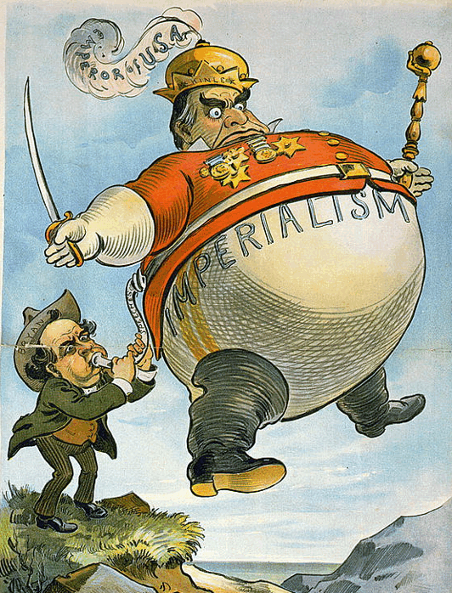
Imperialism
After the Industrial Revolution, Europeans began looking for new lands to explore and colonize this led to imperialism.
IMPERIALISM: domination by one country over the political and economic life of another country.

Slide 3
Motives of Imperialism
ECONOMIC
POLITICAL
RELIGIOUS
EXPLORATORY
IDEOLOGICAL

Slide 4
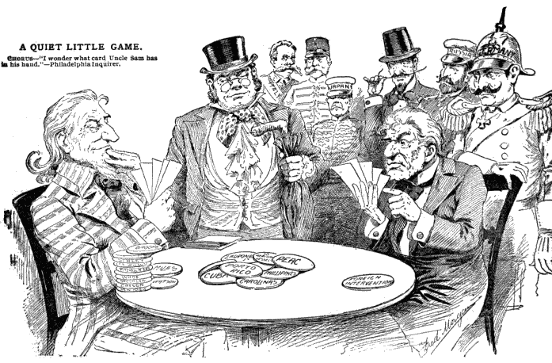
Economic Motives of Imperialism
ECONOMIC:
Make $$
Control foreign trade
New markets
Raw materials and cheap labor
Investments
Export technology.

Slide 5
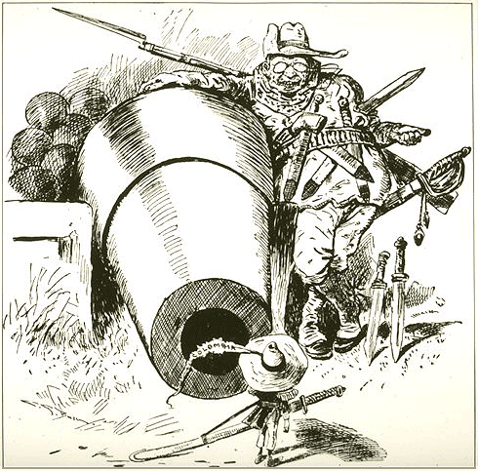
Political Motives of Imperialism
POLITICAL:
Gain power
Compete with other countries
Expand territory
Exercise military force
Gain prestige
Boost national pride &
security

Slide 6
Religious Motives of Imperialism
RELIGIOUS:
Spread Christianity
Spread American values and moral beliefs
Educate people of other cultures

Slide 7
Exploratory Motives of Imperialism
EXPLORATORY:
Explore the “unknown”
Conduct scientific research
Medical searches
Adventure
Investigate “unknown” cultures.

Slide 8
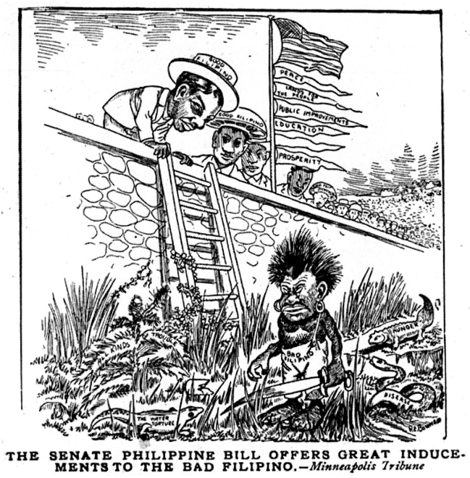
Ideological Motives of Imperialism
IDEOLOGICAL:
Cultural values
Belief in Race superiority (racism)
Belief in duty to “civilize” people in other parts of the world
Belief that all great nations should
have empires
“Survival of the Fittest”-
only the strongest nations will
survive.

Slide 9
Analyzing Motives of Imperialism
STEPS:
With your partner, examine the picture to determine which motive it reveals.
Describe what you see and write an explanation of why you chose that motive.

Slide 10
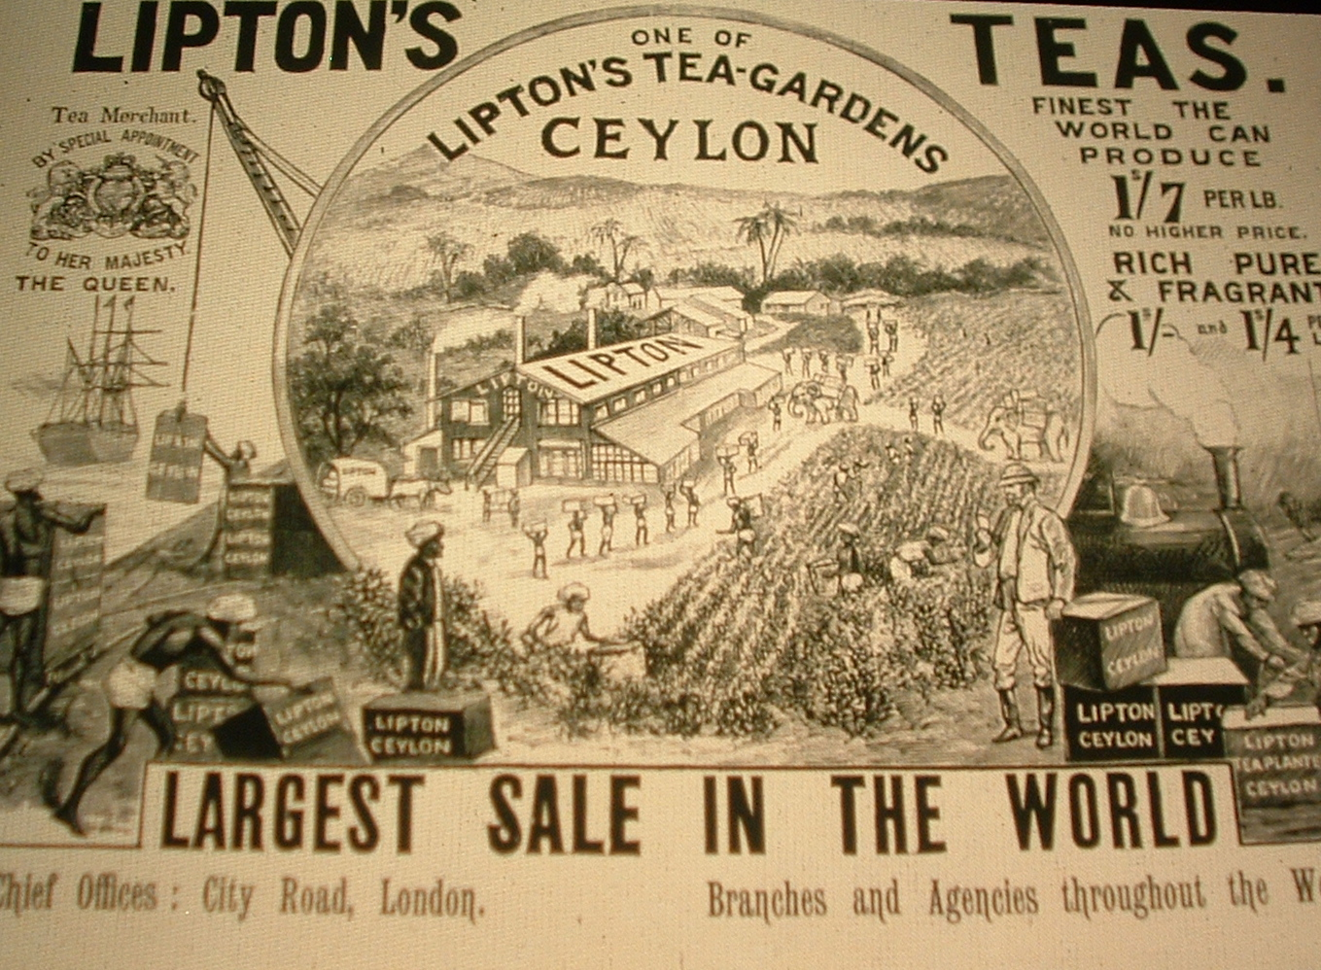
British Lipton Tea advertisement in the 1890s
Imperial motives: ECONOMIC (goods from Ceylon transported to London, use of indigenous labor and resources, exportation of industrial technology) or POLLITICAL (gaining national prestige through international trade)

Slide 11
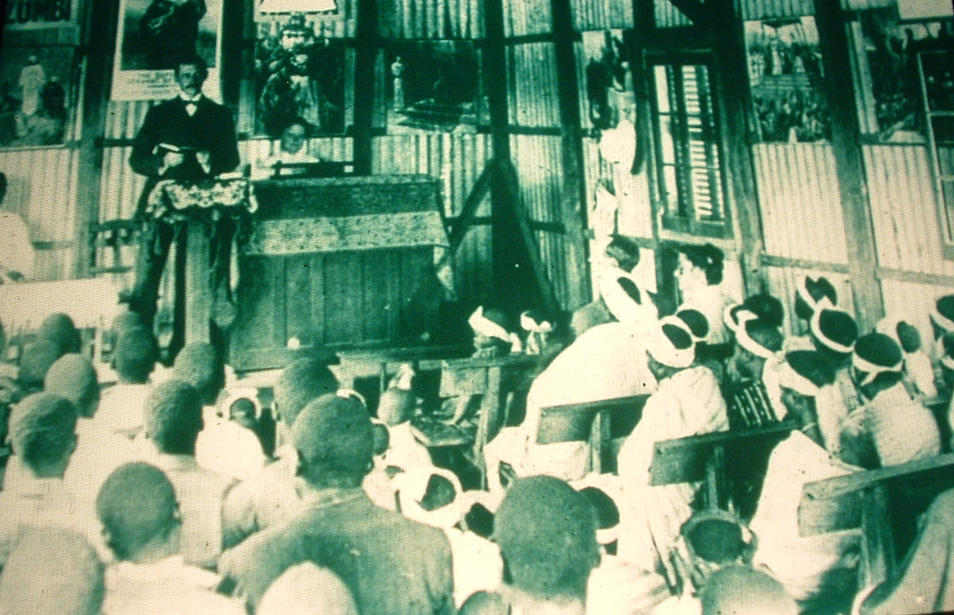
A Methodist Sunday School at Guiongua, Angola, 1925
Imperial motives: RELIGIOUS (Europeans spreading Christian values & education) or IDEOLOGICAL (teaching European customs & beliefs)

Slide 12
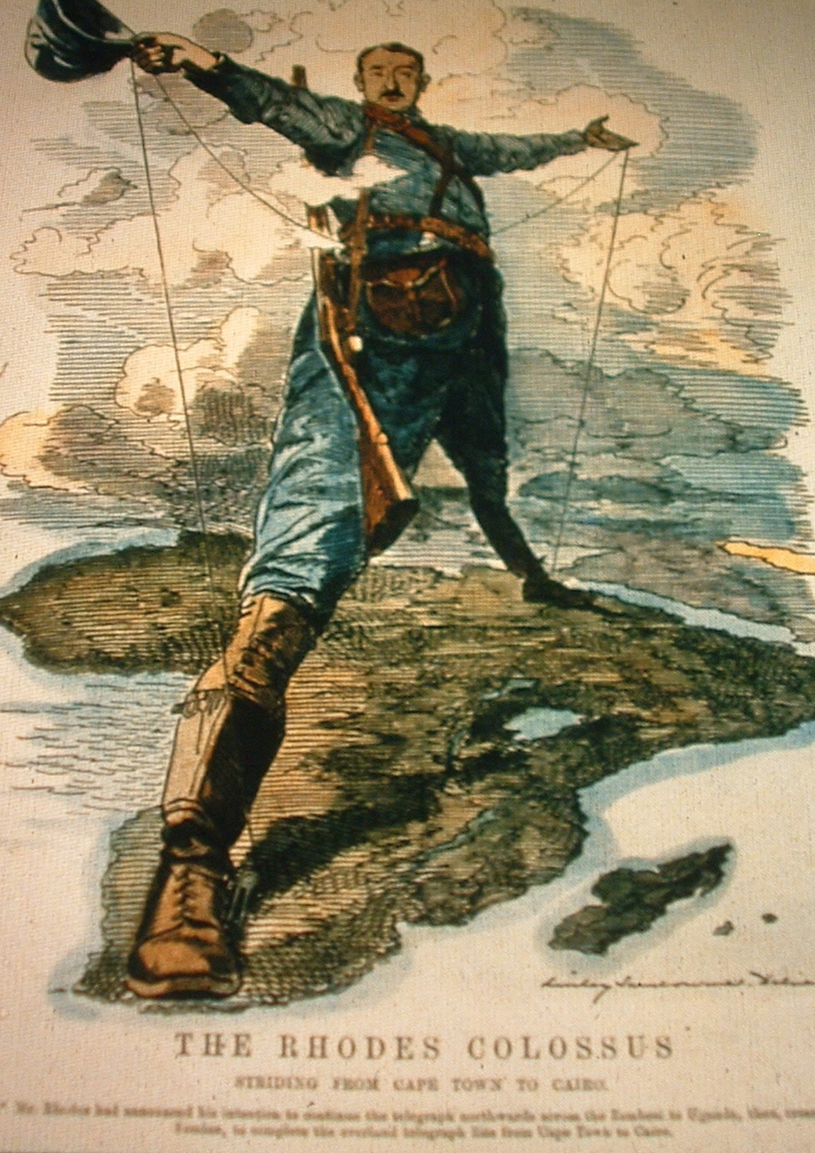
British cartoon “The Rhodes Colossus” showing Cecil Rhodes’ vision of making Africa “all British from Cape to Cairo” 1892
Imperial motives:
POLITICAL (desire to control African territory, desire to boost national pride and gain power by winning colonies, desire to have military presence) or
EXPLORATORY (exploring or venturing into unknown territory)

Slide 13
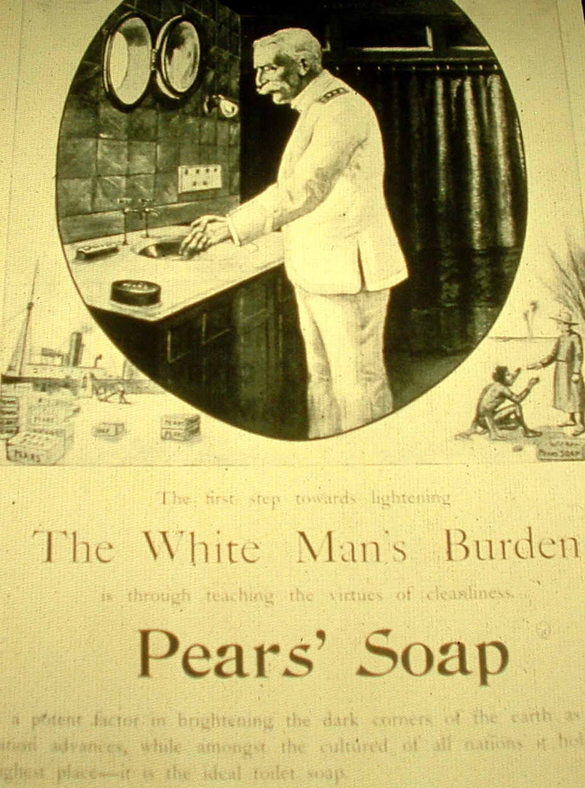
An advertisement for Pears’ Soap from the 1890s, and one stanza of the British poet Rudyard Kipling’s poem, The White Man’s Burden, written in 1899
Imperial motives:
IDEOLOGICAL (belief in European superiority, need to “civilize” captive peoples, need to cleanse “dark corners of the earth”) or
ECONOMIC (boats transporting goods to colonies, advertisement to sell product)

Slide 14
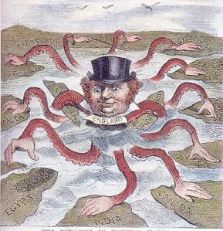
Spread of Imperialism
From 1870 to 1914, imperialist nations gained control over most of the world.
The European powers gained lands in Africa, Asia, and the Middle East with very little trouble. The United States gained lands in the Americas.

