Slide 1
Intro to the UN
EQ: How is the national economy regulated? How is the welfare of other nations regulated?

Slide 2
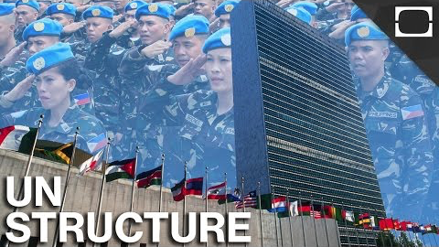
https://www.youtube.com/watch?v=tlmYtJiUK00

Slide 3
What is the UN?
United Nations
Establishment: The United Nations came into being in 1945, following the devastation of WWII with one central mission: the maintenance of international peace and security.
The UN does this by working to prevent conflict; helping parties in conflict make peace; peacekeeping; and creating the conditions to allow peace to hold and flourish.
Goals :
Protect Basic Human Rights
Deliver Humanitarian Aid
Promote Sustainable Development
Uphold International Law
Countries: 193
The United Nations member states are the 193 sovereign states that are members of the United Nations (UN) and have equal representation in the UN General Assembly.

Slide 4
6 bodies of the UN
General Assembly
All member nations have equal representation, and the main deliberative, policy-making, and representative organ of the UN
Security Council
Charged with ensuring international peace and security, accepting new members to the United Nations and approving any changes to its charter
Economic & Social Council
Works to Improve Standard of living and Promote Human Rights
International Court of Justice (AKA World Court)
Functions are to settle international legal disputes submitted by states and give advisory opinions on legal issues referred to it by the UN
The Trustee Council
Established to help ensure that trust territories were administered in the best interests of their inhabitants and of international peace and security.
Secretariat
Role is to set the agenda for UN's deliberative and decision making bodies (the General Assembly, Economic and Social Council, and Security Council), and the implementation of the decision of these bodies.

Slide 5
UN Charter
The UN Charter
The Charter of the United Nations was signed on 26 June 1945, in San Francisco, at the conclusion of the United Nations Conference on International Organization, and came into force on 24 October 1945. The Statute of the International Court of Justice is an integral part of the Charter.
https://www.un.org/en/charter-united-nations/

Slide 6
helpful links
https://www.un.org/en/index.html
https://unfoundation.org/
https://www.youtube.com/unitednations

