Slide 1
Bell Ringer #4 2/7/19
Which concept BEST describes the belief that the strongest and best businesses will survive by accumulating property, wealth, and social status?
Vertical integration
Social Darwinism
Horizontal integration
How did John Rockefeller win control over much of the oil industry?
3. This cartoon was published when coal companies raised the price of coal one dollar per ton. What is the message of this cartoon?
- Coal companies did not care that higher prices meant that poor people could no longer afford coal.

Slide 2
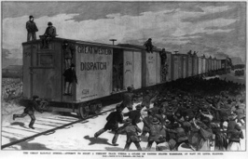
The Organized Labor Movement

Slide 3
Labor Hardships
With the rise of industrialization, the American economy started to heavily rely on workers to succeed
Even though the economy was booming and the American society was improving, laborers struggled to survive
By the 1880’s and 1890’s, business owners produced great wealth but took advantage of their labor force (especially immigrants) by…
Paying workers low wages ($6 a week/$3 a week)
Poor and unsafe working conditions
Long workdays (12hrs/day 6 day/week)
= sweatshop

Slide 4
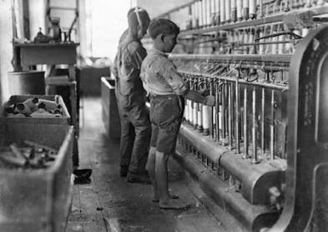
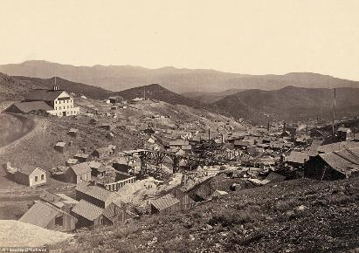
As industrialization grew, more jobs became available for women.
Due to extremely low wages, parents brought their children to work in order to earn an extra wage
By the end of the 19th century, almost 1 in 5 children between 10-16 worked instead of attending school
Many laborers were forced to live in isolated communities near their work called company towns
Owned by businesses and rented out to employees
Popular with mine workers
“company store” : workers forced to buy from

Slide 5
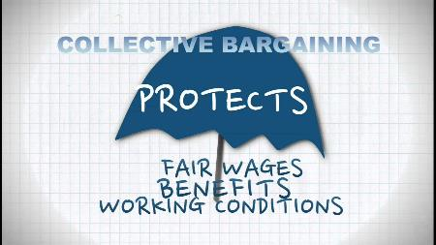
Rise of Labor Unions
As early as the 1820’s, factory workers tried to gain more power against their employers through collective bargaining
Socialism began to spread in Europe by the 1830’s
Many labor activists borrowed ideas from socialism to support their goals for social reform

Slide 6
Uriah Smith Stephens founded the Knights of Labor in 1869
Included skilled and unskilled workers alike
Grand Master Terence V. Powderly (1879-1893) increased membership from under 10,000 in 1879 to 730,000 in 1886
Sought cooperative society - alliances between employer & employee, producer & consumer - as well as gov’t ownership of utilities, trust reform, & ban on child labor
In 1886, Samuel Gompers formed the American Federation of Labor (AFL)
Only included skill laborers that paid high membership dues from craft unions
Focused on very specific workers’ issues such as wages, working hours, and working conditions
Pushed for “closed shops”- meaning that companies could only hire union workers.

Slide 7
Laborers strike
The Great Railroad Strike of 1877
Baltimore & Ohio Railroad Co. (B&O) cut workers’ wages for the third time in a year
Started in Baltimore then quickly expanded to Pennsylvania and the mid-west.
No labor unions were involved, just a bunch of workers fed up with their treatment
Resulted in violent conflict between workers and local militia’s
Finally put down 45 days later by federal troops sent by President Rutherford B. Hayes

Slide 8
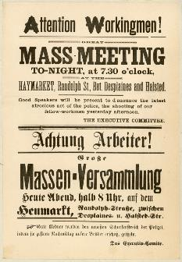
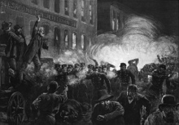
Haymarket Riot (May 1886)
A national strike was planned and over 340,000 workers participated in 12,000 companies in order to reduce workday hours from 12 to 8
On May 4th, during a protest at Haymarket Square in Chicago, a bomb exploded killing dozens
Left a bad image for unions
Decreased Knights of Labor #’s

Slide 9
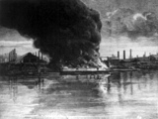
The Homestead Strike (1892)
Steel plant workers went on strike after wages were cut
Andrew Carnegie’s partner, Henry Fick, brought in a private police force known as the Pinkertons
Ended in November after loss of momentum due to an un-backed assassination attempt on Fick
Part of a larger epidemic of steelworkers’ and miners’ strikes due to economic downturn spreading across the nation
Lockout: the exclusion of employees by their employer from their place of work until certain terms are agreed to.
https://www.youtube.com/watch?v=njBIcYa4F6M

Slide 10
The Pullman Strike (1894)
In Pullman Palace Car Co. laid off workers and reduced wages by 25%
Required workers to live in the company town near Chicago
Workers then turned to the American Railway Union (A.R.U), led by Eugene V. Debs who called for a national strike (300,000 by June 1894)
Railroad owners cited the Sherman Antitrust Act in their attempt to end the strike
President Cleveland sent in federal troops to end the strike

Slide 11
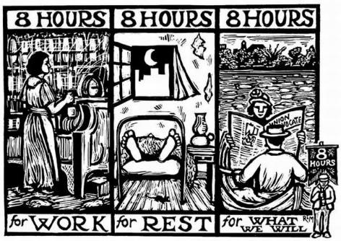
The outcome of the Pullman Strike set a precedent about how employers dealt with unions
Employers frequently appealed for court orders against unions, citing the Sherman Antitrust Act
Federal gov’t regularly approved these appeals, denying unions to be recognized as legally protected organizations
For the next 30 years, contract negotiations, strikes, and legislation would be a way of life for American industry

