Slide 1
Bell Ringer #5 3/11/19
What role do political parties play in American politics?
How did America become a two-party system?
Give examples of how laws have been influenced by political parties

Slide 2
OTHER WAYS TO INFLUENCE THE GOVERNMENT
EQ:Beyond voting and joining political parties, how else can citizens have their voices heard?

Slide 3
PUBLIC OPINION
The general view of most people regarding the government or an elected official
Allows elected officials to know whether the people approve of the job they are doing or not.
Allows elected officials to know when the public is ready for a change or something new

Slide 4
Where does your opinion come from?
Personal background
Mass media: how information is presented can have a major effect on opinion
Public officials: speeches and written statements are intended to convince people of thinking a certain way
Interest groups: groups of people with similar views who try to persuade the government to do certain things

Slide 5
How is Public Opinion Measured
Look at elections
Public opinion polls: pollsters must question at least 1,500 people for the poll to be legitimate
Legitimate sample

Slide 6
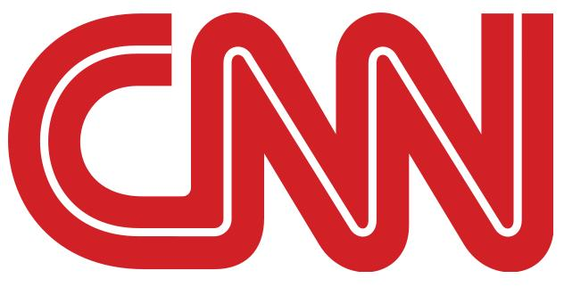
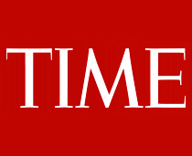
MASS MEDIA
Types:
- Print- newspapers and magazines
- Electronic- TV, radio, internet
Most mass media outlets are for-profit businesses. This means they present stories and info to make money, rather than simply to inform

Slide 7
IMPACT OF MASS MEDIA
Set public agenda: stories presented by the media help decide what the public thinks is important
Celebrities often use their fame to get involved in politics. Ex: Oprah and Arnold Schwarzenegger.
Elected officials want the media to present them as hard-working and honest
Watchdog: expose govt. corruption
National Security: the media is not supposed to release information that could endanger national security

Slide 8
Celebrity Activism
https://www.c-span.org/classroom/document/?8817

Slide 9
Limits on the Media
The first amendment guarantees freedom of the press, except for libel
The Federal Communications Commission (FCC) regulates the media

Slide 10
INTEREST GROUPS
A group of people working together for a very specific issue or group of people
- Economic Interest Groups (Only write a couple)
Chamber of Commerce: enforce high standards for businesses and work for government help for businesses
Tobacco Institute: supports the major tobacco companies
American Federation of Labor and Congress of International Organizations (AFL-CIO): represents many labor unions
National Education Association (NEA): works for better pay and working conditions for teachers
- People Interest Groups (Only Write a couple)
National Organization for Women (NOW)
National Association for the Advancement of Colored People (NAACP)
American Civil Liberties Union (ACLU): worked to ensure civil liberties
American Association of Retired Persons (AARP)

Slide 11
EFFECTS OF INTEREST GROUPS
Support Candidates: campaigning and donating money through Political Action Committees (PAC)→ special piece of an interest group that can donate unlimited amounts of money to candidates.
Going to court: help members in disputes with other people or the government
Lobbying: speaking directly to lawmakers to convince them to support or oppose a bill
Protests and Petitions
Commercials

