Slide 1
Bell Ringer
1. Which set represents the correct order in which each section appears in the Constitution?
A. Powers of the president, Bill of Rights, powers of the courts
B. Powers of Congress, powers of the courts, Bill of Rights, powers of the president
C. The Preamble, powers of the 3 branches, Bill of Rights
D. Bill of Rights, Articles I-III, the Preamble
2. What does the term “preamble” mean?
3. What do you know about the Preamble to the U.S. Constitution?

Slide 2
Preamble To US Constitution
Unit 2: U.S. Constitution
EQ: How does the Constitution create a plan of government that is strong enough to be effective, but also protects the citizens’ rights?

Slide 3
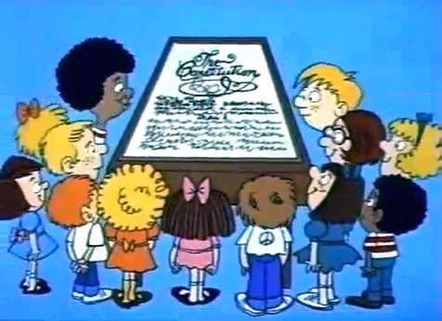
SCHOOL HOUSE ROCK
https://vimeo.com/29159978

Slide 4
We the People of the United States, in Order to form a more perfect Union, establish Justice, insure domestic Tranquility, provide for the common defense, promote the general Welfare, and secure the Blessings of Liberty to ourselves and our Posterity, do ordain and establish this Constitution for the United States of America.

Slide 5
Preamble Breakdown:
1. “To form a more perfect Union”– to unite the states so they can operate as a single nation, for the good of all.
2. “To establish justice” – To make certain that all citizens are treated fairly
3. “To ensure domestic Tranquility” – to maintain peace and order, keeping citizens and their property safe from harm.
4. “To provide for the common defense” -- to be ready militarily to protect the country and its citizens from attack.
5. “To promote the general Welfare” – to help people live healthy, happy, and prosperous lives.
6. “To secure the Blessings of Liberty to ourselves and our Posterity” -- to guarantee the basic rights of all Americans, including future generations.

Slide 6
Preamble Grading Activity
You will be assigned a group of 5-6
Discuss and grade all 6 principles of the Preamble
Use past and present examples to back up your standpoint
This should be done in the chart provided to you. Each person is in charge of turning in his or her own chart.
Each group will present one of the principles and its grade to the class (I will assign those at random)
A participation, as well as, a completion grade will be given to each group. If one person is not participating, it will effect the overall group grade. NO SOCIAL LOAFING!

Slide 7
Ex: Common Defense
F
A
-Should have joined WWI sooner
-Give a lot of funding to defense

