Slide 1
The Rise of Big Business

Slide 2
Development of corporations
Up until the mid-1800’s, most businesses were owned by one person or a single family
No businesses grew larger than what the owner’s ability was to invest in it
Most businesses were local, buying and selling to customers who lived nearby
Railroads provided businesses with access to raw materials and customers farther away
With markets expanding, investors would team up to form ownership groups known as corporations

Slide 3
Corporations
Number of people invest in a business and share ownership with other investors
Helped navigate the challenge of expanding businesses
Access to large amount of capital and geographical markets
Corporations gained competitive edges by…
Decreasing cost of raw materials and production
Obtaining monopolies → complete control of a product or service
Corporations increased dramatically after 1870 as they became more important to industrial capitalism

Slide 4
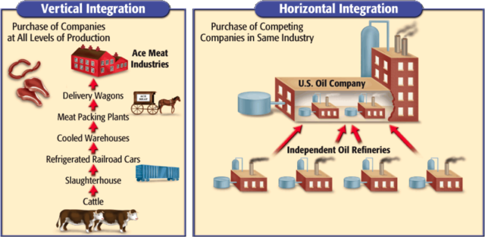
Horizontal integration → the system of consolidating many firms in the same business
Vertical integration → the system of gaining control of all the phases of a product’s development

Slide 5
Who were some of the major players?
John D Rockefeller → oil tycoon that created U.S. Standard Oil
Used profits from his refineries to buy up other oil companies
Slashed his prices enough to force other companies out of business
Used a trust to create a monopoly (Standard Oil Trust)
A legal entity that acts as an agent or trustee on behalf of a person or business entity for the purpose of administration, management and the eventual transfer of assets to a beneficial party
Formed the Standard Oil Trust and controlled 95% of the industry

Slide 6
Cornelius Vanderbilt (1794-1877)
Vanderbilt started buying out smaller railroad companies
Bought up most of the track headed out west
If a company would refuse to sell to him, he would refuse to let passengers from their trains use his trains to head out west – took away all their customers
Andrew Carnegie (1835-1919)
Sold STEEL – necessary to make a railroad!
Started buying steel mines, and railroad companies
__________ integration?
By the time of his death he had donated 90% of his wealth to charities and universities (~$350mil = $13.7bil [2015])

Slide 7
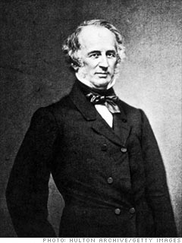
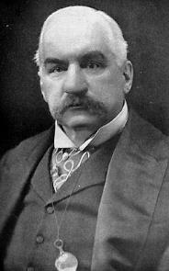
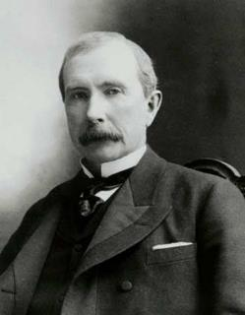
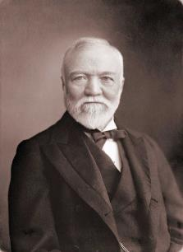
J.P. Morgan (1837-1913)
Began gaining power in banking industry when he began reorganizing railroads
Was involved in reorganizing General Electric and US Steel
John D. Rockefeller
Andrew Carnegie
J.P. Morgan
Cornelius Vanderbilt

Slide 9
Was Big Business Good?
These business tycoons came to be viewed in different ways
Captains of Industry → created jobs, increased production, provided cheap products, and gave back to community through philanthropy
Robber Barons → exploited customers, corrupted government, pushed out small business, greedy
William Sumner coined the term Social Darwinism → wealth was a measure of one’s inherent value and those who had it were declared the most “fit.”
Based off of Charles Darwin’s natural selection or “survival of the fittest” theory

Slide 10
Government Steps in
Big Businesses started using Social Darwinism to justify all sorts of beliefs and conditions
Supporters of BB argued that the government should stay out of the private sector as it would disrupt natural order
Social Darwinism was used to discriminate against minorities and the lower class as these groups were seen as ‘unfit’
In 1887, the US Senate created the Interstate Commerce Commission (ICC) that would oversee railroads to halt corruption in the railroad industry
This is one example of gov’t setting up federal bodies to regulate American businesses

Slide 11
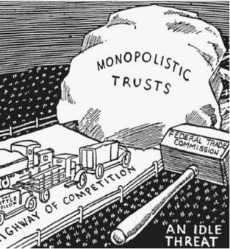
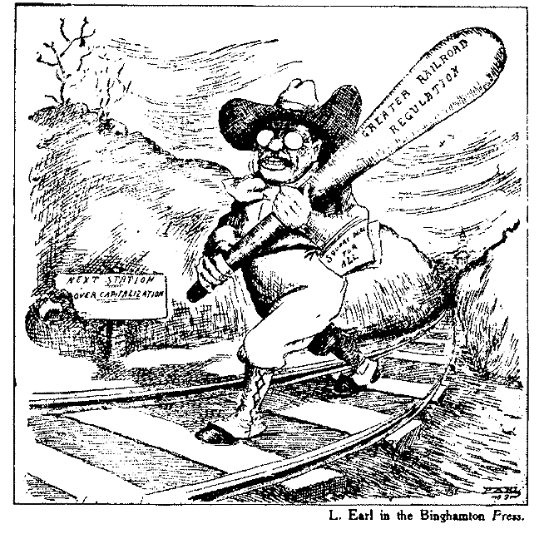
In 1890, the Senate passed the Sherman Antitrust Act, which authorized federal action against any "combination in the form of trusts or otherwise, or conspiracy, in restraint of trade.”
Big Business trusts were seen as eliminating competition and manipulating prices
First federal antitrust law
Not heavily enforced in the first decade, but along with the ICC, a trend began towards federal limitations of corporations’ power

