Slide 1
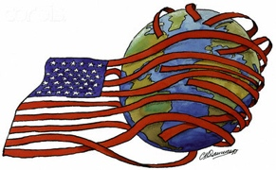
The Roots of Imperialism
EQ: What is imperialism and hoe did it start in the United States?

Slide 2
What were the Reasons behind U.S. Imperialism?
Imperialism: taking over (or controlling) other countries/territories by force
Economic benefits
Need for new markets to sell industrial and agricultural goods
Need for new sources of raw materials
U.S. and other imperialist nations established “Spheres of Influence” in which those nations controlled trade

Slide 3
Social Darwinism: expansion of Darwin’s idea of survival of the fittest to justify a strong nation taking control of a weak nation
Extension of manifest destiny to all parts of the world
Jingoism: extreme form of nationalism calling for an aggressive foreign policy
Competition with Britain, France, Germany, and Russia

Slide 4
Who were the major advocates of US Imperialism?
Josiah Strong: wrote Our Country: Our Possible Future and Present Crisis
Example of Missionary influence on Imperialism
Believed protestant Americans were the “fittest to survive” and had a Christian duty to spread Christianity and western civilization (white man’s burden)
Politicians: Pro-business Republicans wanted to expand U.S. markets and access raw materials

Slide 5
Alfred T. Mahan
U.S. Naval Captain
Influence of Sea Power Upon History (1890)
Argued that a strong navy was essential to becoming a world power
Advocated:
Modern ships (steel hull steamships)
A two ocean navy
Naval bases in Pacific & Caribbean
Canal connecting Atlantic Ocean to the Pacific Ocean
By 1900 the U.S. had the 3rd largest navy in the world

Slide 6
Mass Media: newspapers and magazines tried to increase sales by printing stories about distant and exotic places
Frederick Jackson Turner’s “frontier thesis”:
In 1890 the US Census Bureau declared that the entire frontier had been settled
Turner argued that the frontier:
Shaped American society
Promoted individualism and independence
Acted as a social leveler by providing economic opportunity for those who moved west
Required Americans to be inventive

Slide 7
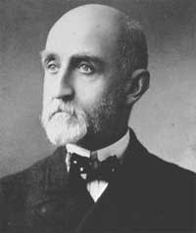
Turner argued that the closing of the frontier:
Took away a “safety valve” for those discontent with American society
Would lead to class divisions and social conflict seen in Europe
Alfred T. Mahan

Slide 8
What were the first steps for the U.S. to become a world Power?
Japan
1853, Commodore Matthew Perry sailed into Tokyo Bay, Japan with a fleet of American warships
Opened trade between the U.S. and Japan
Alaska
Secretary of State William Seward convinced Congress to buy Alaska from Russia for $7.2 million in 1865
Unpopular at the time → “Seward’s Folly” “Seward’s Icebox”
Seen as America’s first step in imperialism

Slide 9
Hawaii
U.S. missionaries settled in Hawaii before the Civil War
In 1893, U.S. settlers overthrew the Hawaiian monarch, Queen Lili’uokalani, and requested to be annexed by the U.S.
President Cleveland refused to annex the island
President McKinley annexed Hawaii in 1898 after the Spanish-American War made imperialism cool
Became U.S. territory in 1900
Became 50th U.S. state in 1959

Slide 10
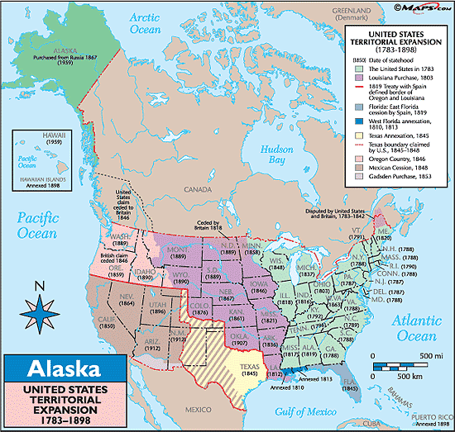
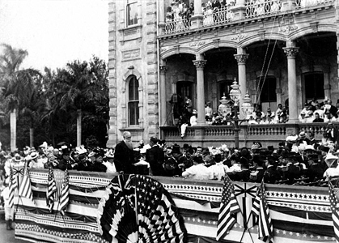
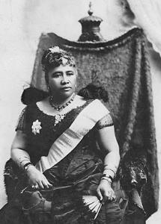
https://www.youtube.com/watch?v=BShvYeyMm_Y

