Slide 1
Bell Ringer #4
4/8/19
How can a consumer avoid interest charges when using credit cards?
Which of these practices can help build a higher credit score for a consumer?
  Using one credit card to pay off another
  Getting as many loans and credit cards in your name as possible
  Making your monthly payments on time
What are the benefits to having a credit card? What are the drawbacks?

Slide 2
Bell Ringer #5
4/9/10
Which of these statements is true regarding debt?
  there is no such thing as good debt
  the more debt you have, the higher your overall worth
  debt can be useful for building your credit score when managed properly
Which of the following statements most accurately defines the term “interest rate”?
  Discounts on purchases made with a credit card
  Money paid by banks and financial institutions to the US gov.
  Money paid by a borrower to a lender in exchange for the use of money
Which of these is not associated with BORROWING money?
  mortgage
  auto loan
  debit card

Slide 3
Unit 7
Saving and Investing
EQ: What factors should someone consider when they are making decisions about investments?

Slide 4
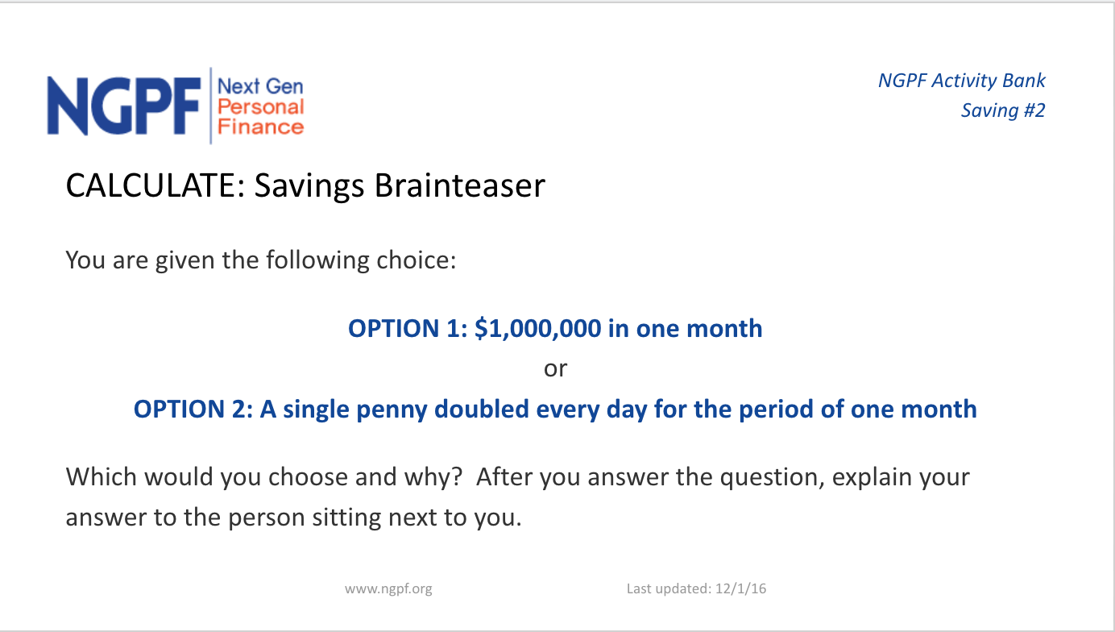
Would You Rather…

Slide 5
If you said option 2…
Option B would make you better off with 5 million dollars– the power of saving!

Slide 6
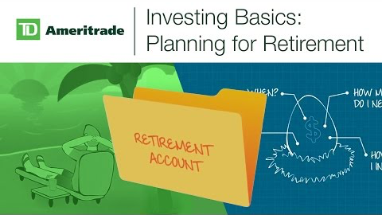
Investing Basics

Slide 7
Saving for the Future
One way to reach long-term purchasing goals is to save
Save – set aside income for a time so you have it to use later
Saving money can be a difficult habit but is good to do for your future
Most people cannot make major purchases (i.e. car or house) without saving money first

Slide 8
Saving also helps a person to not be financially burdened when having an emergency that requires expenditures
Some employers will withhold a fixed amount from employees’ paychecks and is automatically deposited into an employee’s savings account
Many people will take on the responsibility of saving themselves when budgeting for the week/month/year

Slide 9
One of the main attractions to putting their funds in a savings account at a bank is that the funds are easily available
  ATM card can allow a person to withdraw funds from savings account
Savings accounts can also earn interest (albeit a small % rate)
Interest – payment people receive when they lend money, or allow someone to use their money
Principal- amount you initially deposit

Slide 10
Types of Savings
Saving accounts at a bank or credit union
  Accepts people’s money and pays them interest based on how much they have deposited
Checking accounts at a banking institution
  Similar to savings accounts in that you can deposit money directly into it
  You can write checks from your checking account
  If you write a check or use debit card when you do not have enough funds in account → bounced check or declined card
  Usually does not come with interest rate from bank, but does usually require a minimum amount be kept in account

Slide 12
Money market accounts are similar to checking accounts and savings accounts
  Can write checks and account pays a higher interest than regular savings account
  Usually for larger amounts
Certificates of Deposit (CDs) is another way to save
  Agree to deposit a sum of money with a financial institution for a certain amount of time in return for a set interest rate to be paid on the account at time of maturation
  Cannot withdraw money easily
  The longer the CD usually means a higher interest rate

Slide 13
Investments
The return, or profit earned by investing, is usually low for savings accounts, money market accounts, and CDs
Investors usually turn to stocks and bonds which have higher return potential → higher risk
Stock – a portion of ownership in a company
  Value of stock is based on how well the company is doing
  Capital gain: money gained
Dividend - Some companies pay shareholders (stock buyers) a portion of company earnings at regular intervals

Slide 14
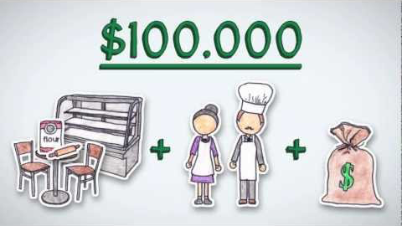
Stocks Made Easy

Slide 15
Sample Question
Trent invests $3000 in a company at the beginning of the year. Fortunately, the company does well. At the end of the year, Trent receives notice that the stock he bought for $3,000 is now worth $3,700. Which of the following statements is true?
  His actual value of the stock is now $700
  The stock is most likely going to lose its value soon
  His capital gain is $700 and if he sells the stock he will make a profit
  He is only allowed to remove his original $3,000 from the account

Slide 16
Stocks generally earn a higher return than any other investment because they carry greater risk → no guarantee of profit and no bailout if you lose money
Bonds – lending money to a company or government in which is to be paid back at a specified time with interest
  Bond-holders do not own a percentage of the company
  Bonds do carry some risk → government bonds much safer than company bonds

Slide 17
Mutual Funds – pools of money from many people and is invested in a selection of stocks and/or bonds chosen by financial experts
  Considered less risky because od diversification of portfolio
  People can be tracked through a government regulated index → The Dow Jones Industrial Average (DJIA) and the Standard and Poor’s (S&P)
  Real Estate- investing money in the housing market
  usually gains significant value over time

Slide 18
Where Can I Put My Money?
Commercial banks- a bank that offers services to the general public and to companies.
Central Banks- a national bank that provides financial and banking services for country's government & commercial banking system, as well as implementing the government's monetary policy and issuing currency
Credit Unions- a nonprofit-making money cooperative whose members can borrow from pooled deposits at low interest rates.

