Slide 1
What happened when Coolidge took Office?
The height of the roaring 20’s happened under Coolidge’s presidency
Was silent on societal issues such as struggling farmers, labor wages, discrimination against blacks, and Mexican Americans being taken advantage of
Coolidge did not trust the use of legislation to achieve social change and that “the business of America is business”

Slide 2
How did America’s role in the World Change after WWI?
America emerged out of WWI as a world leader in business and trade, but largely returned to isolationism
America played a large role in trying to avoid another war like WWI
The Washington Naval Disarmament aimed to reduce arms race and size of navies

Slide 3
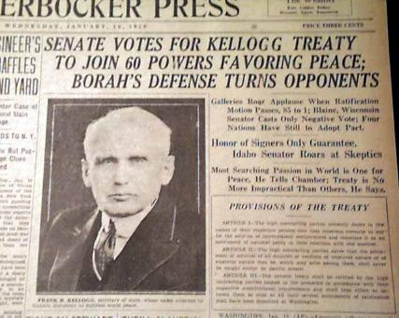
In 1928, in a ceremonial attempt at ending war all together, 62 nations ratified the Kellogg-Briand Pact which outlawed war
It was obvious from the beginning that it could not be enforced
War debt became a huge issue

Slide 4
Germany owed reparations to Britain and France as part of the Treaty of Versailles → Britain and France had to repay huge war debts to the U.S.
In the end, the U.S. financed Germany and in turn helped Britain and France repay the US.
This was called the Dawes Plan
Fell apart after the stock market crash in 1929
Created negative image towards America that would be repaired after WWII

Slide 5
Germany owed reparations to Britain and France as part of the Treaty of Versailles → Britain and France had to repay huge war debts to the U.S.
In the end, the U.S. financed Germany and in turn helped Britain and France repay the US.
This was called the Dawes Plan
Fell apart after the stock market crash in 1929
Created negative image towards America that would be repaired after WWII

Slide 6
Social and Cultural Tensions

Slide 7
How did modernism and traditionalism mix?
By the 1920’s, education became more of a fixture for American children → increased high school graduation by 1930
Fundamentalism is the belief in a literal interpretation of the Bible
Fundamentalists questioned scientific discoveries and theories as they create contradictions with their beliefs
Rejected Darwin’s theory of evolution

Slide 8
Tennessee passed a law in 1925 banning the teaching of Darwin’s theory of evolution in the state’s public schools
John Scopes challenged the law by teaching evolution in class → was arrested
The American Civil Liberties Union hired Charles Darrow to defend Scopes while William Jennings Bryan (fundamentalist) acted as prosecutor
Scopes was found guilty and fined $100
The Scopes Trial was about the role of science and religion in public schools and in society
Showed major flaws in fundamentalism

Slide 9
How did immigration change in the 1920’s?
Anti-immigrant sentiments grew during the 20’s and especially during and immediately following the Red Scare
A quota system was placed on immigration via the Emergency Quota Act of 1921 and National Origins Act of 1924
Severely limited not only European immigrants but Asian immigrants as well
The quota system did not apply to Mexicans and other Latin-American immigrants

Slide 10
The New KKK
The Red Scare and extreme anti-immigrant sentiment led to the revival of the Ku Klux Klan
Despised anything not white American
Membership reached 4.5 million by 1924
Targeted Jews, Catholics, blacks, and immigrants
Organizations like the NAACP and the Jewish Anti-Defamation League battled against the KKK

Slide 11
How did the banning of alcohol change society?
Temperance reformers had tried to impose an alcohol ban since the earl 1800’s
Support increased heavily after WWI
Many rural areas were dry unlike urban areas
With religious groups speaking out against alcohol and reformers thinking government should protect public health, the 18th Amendment was ratified in 1919
The federal government could not enforce the new law

Slide 12
Underground saloons and speakeasies opened to continue providing alcohol to those who wanted it → illegal
Speakeasies were special clubs with membership (password or showing of an item)
Bootleggers illegally transported alcohol from hidden stills
Consumption of alcohol did decrease
People started breaking the law in order to obtain alcohol
Rise of criminals and gangs → Al Capone
21st Amendment (1933) repealed prohibition
https://www.youtube.com/watch?v=f5Eexh3jFjw

