Slide 1
Annexation of Alaska
https://www.youtube.com/watch?v=OY9E2lo2jpQ

Slide 2
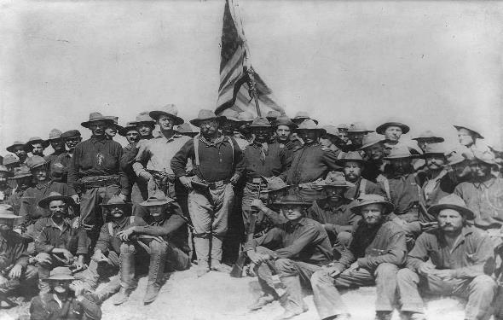
The Spanish-American War
EQ: How did the Spanish-American War contribute to U.S. Imperialism?

Slide 3
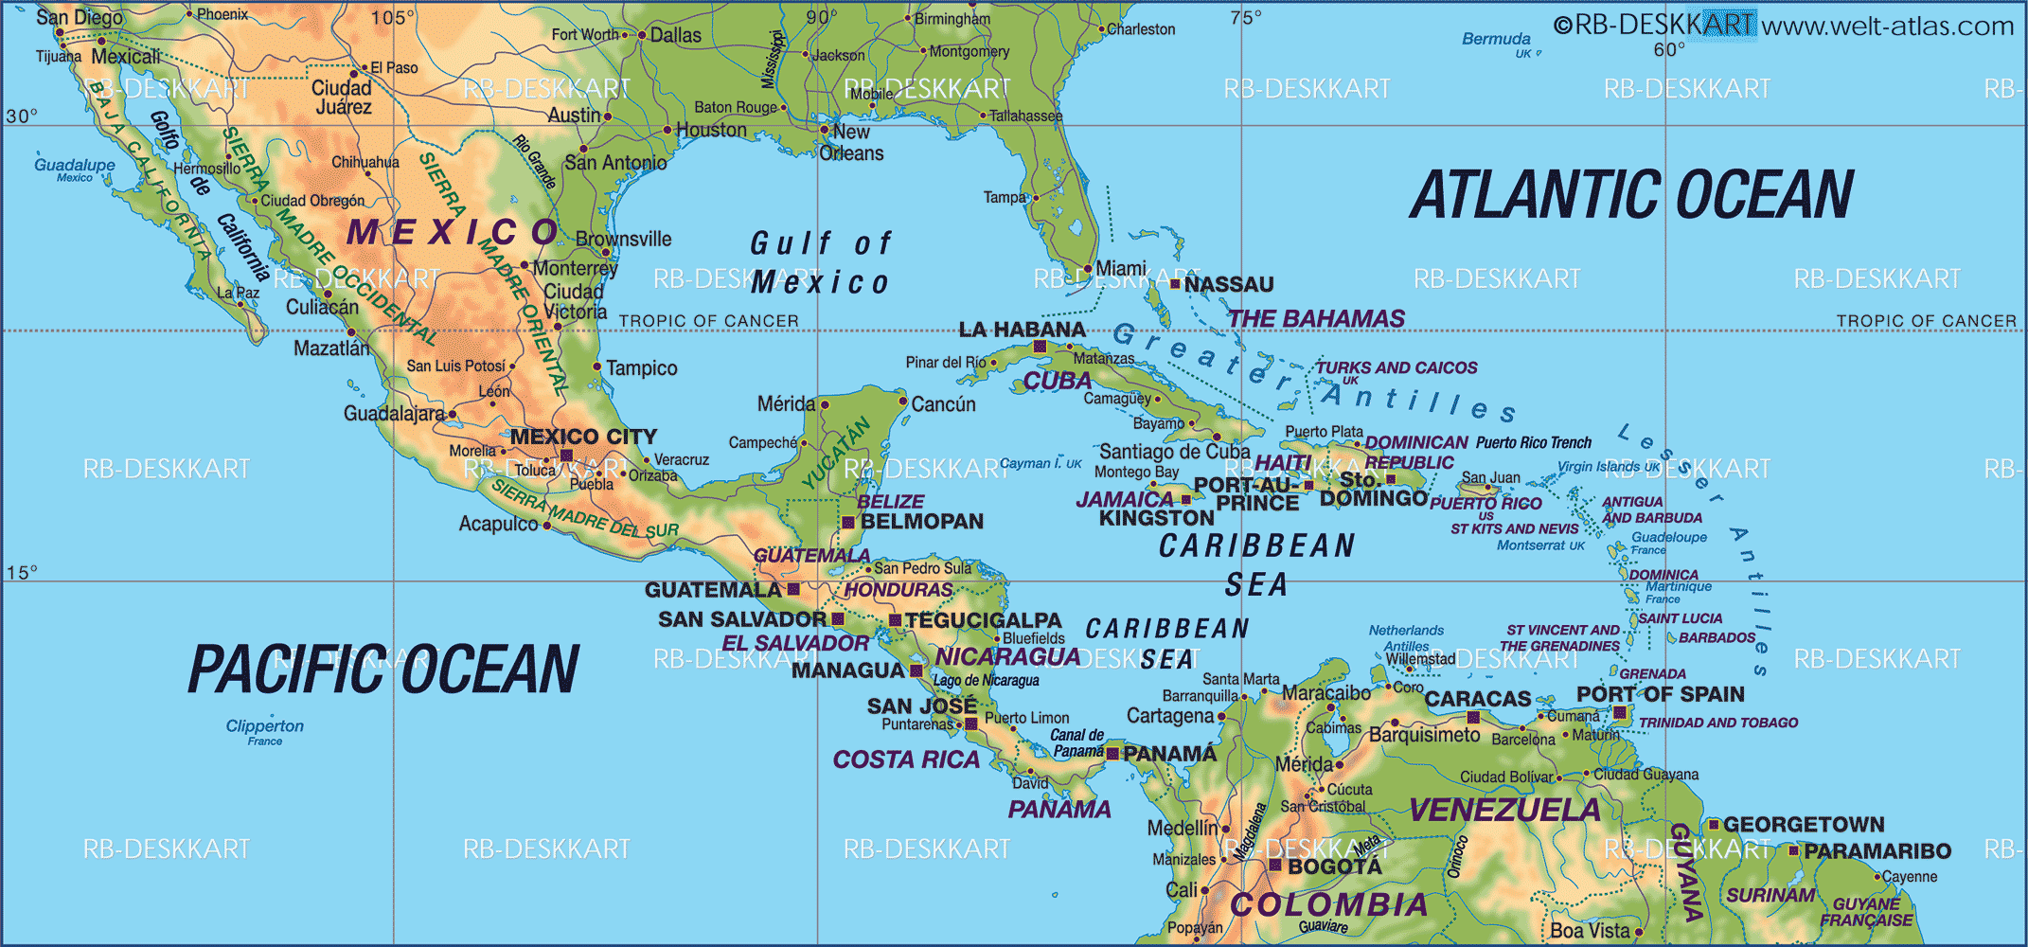
Why were Americans interested in Cuba?
Cuba was a Spanish colony
American desire to annex (incorporate/take over) Cuba dating back to Jefferson
Large American investment in the Cuban sugar industry in the 1890’s

Slide 4
How did the U.S. get involved in the Spanish-American War?
Cuban nationals, lead by José Martí, rebelled against Spain
In 1895 Spain sent 100,000 troops to Cuba to put down the rebellion
Yellow Press/Yellow Journalism
Using sensational headlines and stories to sell newspapers
Joseph Pulitzer’s NY World and William Hearst’s NY Journal printed exaggerated and often false stories about Spanish slaughter of Cuba
Many American readers urged Congress and POTUS to intervene

Slide 5
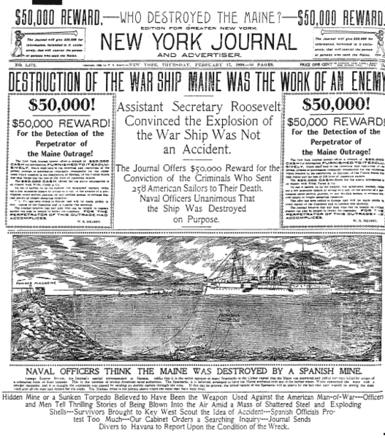
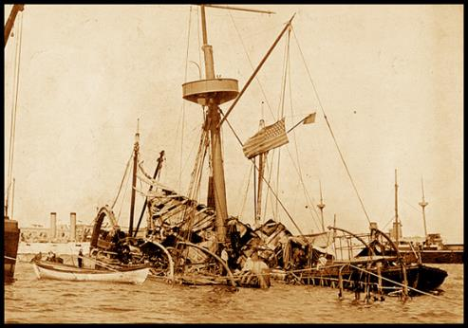
Sinking of the Maine
Feb 15, 1898 the US battleship Maine exploded in the port of Havana killing 260 Americans
The yellow press blamed the explosion on the Spanish

Slide 6
How Was the Spanish-American War fought?
Quickly → referred to as “a splendid little war” by Secretary of State John Hay
The U.S. declared war April 20 of 1898
The Philippines and the capture of Manila
The Philippines had been a Spanish colony since the 1500’s
May 1, 1989: six U.S. ships led by Commodore George Dewey opened fire on Spanish fleet in Manila Bay, Philippines → easy victory for U.S. due to modern warships
Filipino nationalists led by Emilio Aguinaldo took on the Spanish army

Slide 7
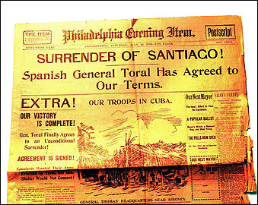
American forces in Cuba
By June 1898 U.S. forces landed in Cuba
U.S. soldiers were mostly volunteer, poorly trained, and poorly supplied
5,000 U.S. soldiers died from malaria, typhoid, and dysentery
Less than 500 died in battle

Slide 8
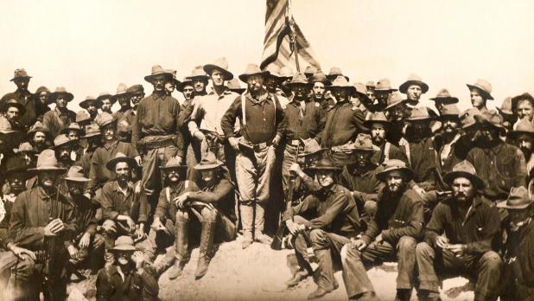
The Battle of San Juan Hill
Teddy Roosevelt put together a volunteer cavalry unit consisting of rugged westerners and upper-class easterners who relished the “strenuous life” → called Rough Riders
Played important roles in key battles for Kettle and San Juan Hill → led to the capture of Santiago

Slide 9
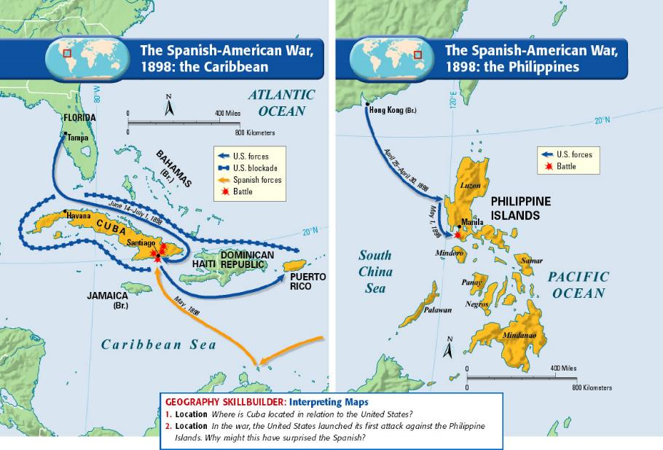

Slide 10
What treaty ended the Spanish-American War?
Treaty of Paris 1898
Recognition of Cuban independence
The U.S. got Puerto Rico and Guam from Spain
Spain gave up the Philippines to the U.S. in exchange for $20 million
Why was this treaty controversial?

Slide 11
The “Anti-Imperialists League” opposed the acquisition of the Philippines
They believed imperialism was “un-American”
Violation of American principles → depriving Filipinos of “life, liberty, and pursuit of happiness”
Feb 6, 1899 the Senate ratified the treaty 57 to 27 (passed by 1 vote)
The Spanish-American War gave the U.S. an empire and marked a turning point in the history of American foreign policy
Teller Amendment: Assured Cuba and the rest of the world that the U.S. did not intend to make Cuba an imperial possession after the Spanish-American War

