Slide 1
Bell Ringer #3: 5/16/19
1. During a recession, fiscal policy might call for the government to increase spending and reduce taxes, which could lead to which of these situations?
A) a lowering of government debt
B) the enactment of a progressive federal income tax
C) an increase in the federal debt
2. Which of these have the purpose of eliminating tariffs and other economic barriers? A) internationalism B) globalization
D) free trade
3. How could a national economy achieve a favorable balance of trade?
A) By increasing its money supply to surpass a trade deficit
B) By meeting its trade quotas with its industrial output
C) By importing goods equal in value to its exports

Slide 2
International Trade & the Stock Market EQ: How does the government work to ensure that free markets are free and that consumers benefit from competition?

Slide 3
International Trade
Economic Interdependence: No person or nation is truly self-sufficient. We must rely on each other to produce all of the things we want and need
EFFECT of Interdependence
Environmental and political problems in one country can cause economic problems in many other countries
Governments must enact policies that allow their citizens to access to products made in other countries

Slide 4
International Trade Policies
Free Trade Agreements: Nations can legally agree that they will limit or prevent trade between two nations
NAFTA- North American Free Trade Agreement
EU- European Union
Free trade issues:
Companies can more easily move their factories to another country (outsourcing)
Countries with less resources can lose out
Domestic businesses may be hindered by increased trade with foreign companies
EX: US goods are more competitive in domestic markets when the cost of foreign goods increases
Protectionist Trade Policies: many nations limit imports to protect domestic producers of the same product
TARIFFS: Taxes on imports--make prices for the imported goods more expensive
QUOTAS: Limits on number of specific goods that can be imported (example: Japanese Cars)

Slide 5
Terms to keep in mind…
Protectionism
Quotas
Tariffs
Global Interdependence
Trade Deficit
NAFTA
Balancing of Trade

Slide 6
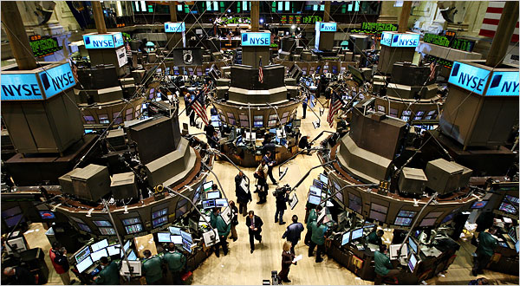
Stock Market (Consumer Side)
Individuals buy pieces of ownership in corporations called stocks
Stockholders make money in two ways
Receive a portion of the company’s profits based on their percentage of ownerships→ Dividends
Sell stocks at higher price than they were bought for→ Capital gains
Stocks go up or down in price because people are willing to pay more or less money for them
This decision is based on assumption about how well business will do in the future
Stock indexes: look at general trends of many stocks
Stock indexes tend to be good indicators of how confident people are in the economy
Stock Holders can elect a board of director to make decisions for them and act on their behalf

Slide 7
Stock Market: (Business Side)
Federal Exchange Commission
All companies on the stock exchange are regulated by the FEC
GOAL: protect investors, maintain fair, orderly, and efficient markets
Companies collect funds from willing investors to help their business
What is the primary goal of business owners in our economy?
EARN PROFITS!
https://www.youtube.com/watch?v=p7HKvqRI_Bo

Slide 8
Debate: Apple v. Pepper
DIRECTIONS: you will have ten minutes to prepare an argument for the side you are assigned to support. At least 4 reps from each team will present their argument for 5 minutes and will be able to give a 2 minute rebuttal.
Sides:
1) Pro Apple- App store is not a monopoly
2)Anti Apple- App store is a monopoly
Sources
BBC: https://www.bbc.com/news/technology-48255541
NY TIMES: https://nyti.ms/2YwAd54
NPR: https://n.pr/2JpaKaq
CNBC: https://cnb.cx/2YpGpvQ
THE VERGE: http://bit.ly/2Ea2Z40

