Slide 1
Amendments After The Bill Of Rights
EQ: Why are amendments added to the Constitution? What is the purpose of the Amendments?

Slide 2
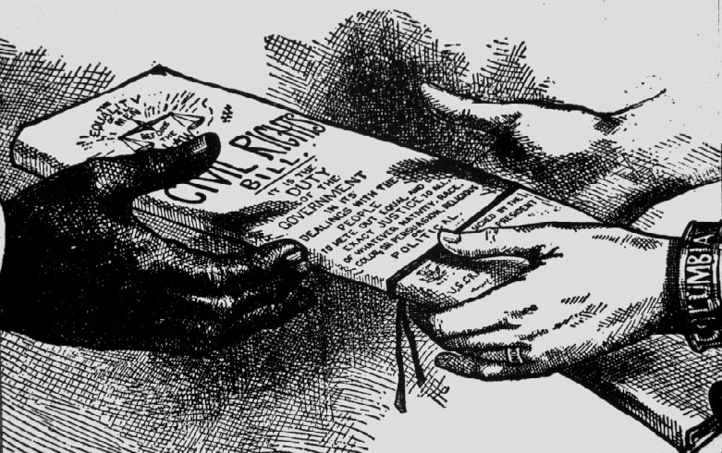
Civil War Amendments
After the civil war, amendments were added to the constitution in order to protect African Americans.
They were not upheld until 100 years later.

Slide 3
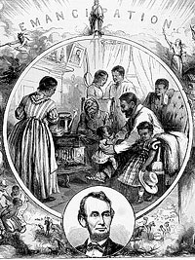
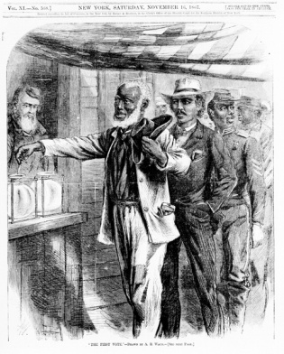
Civil War Amendments
Amendment 13:
Outlawed slavery in the US
Outlawed forced labor unless punishment for a crime
Amendment 14:
Defined citizens as anyone born or naturalized in the US
Granted equal rights to all citizens including due process
Amendment 15:
No state can take away voting rights based on race, color, or previous enslavement

Slide 4
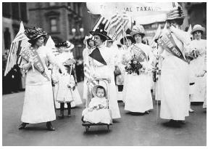
Suffrage Amendments
Suffrage: the right to vote
Amendment 19 (August 1920):
Women granted the right to vote
Supporters are called suffragettes
Amendment 23:
Gave Washington DC residents the right to vote
Amendment 24:
Eliminates Poll Tax
Amendment 26:
Lowered voting age from 21 to 18 due to Vietnam War

Slide 5
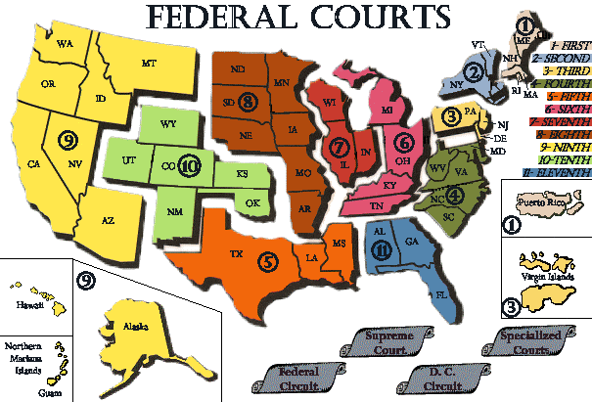
Additional Amendments
Amendment 11: Sets the official jurisdiction of the Federal courts
Amendment 12: Changes voting procedures of the Electoral College. President and Vice President run for office together.

Slide 6
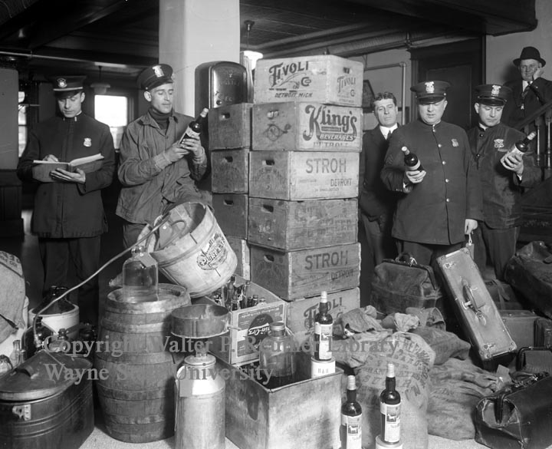
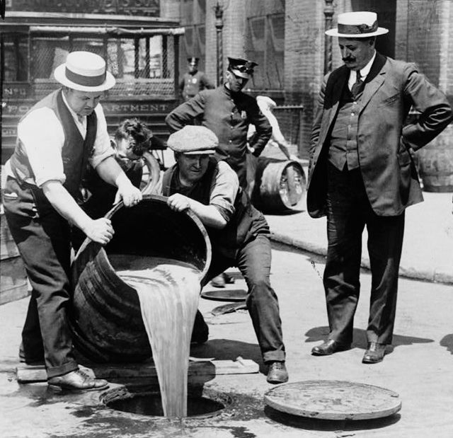
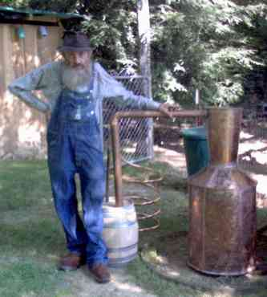
Additional Amendments
Amendment 16:
Congress can tax income
Amendment 17:
Direct election of senators by the people of each state
Amendment 18: Prohibition of alcohol in 1919

Slide 7
Additional Amendments
Amendment 20:
“Lame duck amendment” moved the beginning and ending of the terms of from March 4th to January 20th.
Amendment 21:
repealed Prohibition in 1933
Amendment 22:
The President can only serve two consecutive terms or 10 consecutive years

Slide 8
Additional Ammendments
Amendment 25:
Sets Presidential succession (Who becomes President if the President dies/leaves office?)
Amendment 27:
Congress cannot pass a pay raise for themselves that will take effect in the same session as its passage

Slide 9
Helpful to Remember!
https://youtu.be/epuwfzEJ4PU

Slide 10
Foldable Instructions
Directions:
Using the power point from my website entitled “Amendments 11-27” and a textbook, complete a foldable for the last 17 amendments to the Constitution.
Requirements:
It must contain:
All 27 amendments
A summary of the amendment
A picture
A written explanation of how you will remember it
Due: Tuesday 2/12/19

