Slide 1
Bell Ringer #1
How did you feel about the test?
2. Could you have prepared better for the test?
3. What are some activities you like to do to front load information instead of note taking?

Slide 2
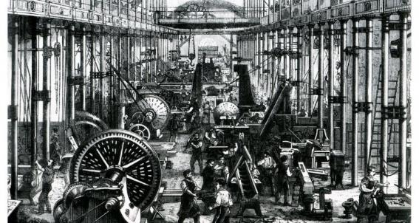
Technology & Industrial Growth

Slide 3
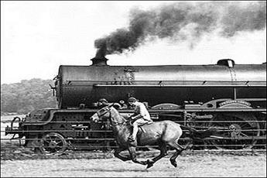
What was going on in the US?
Although the Industrial Revolution began in the US in the early 1800’s, the US was still primarily an agrarian nation at the start of the Civil War
By 1860, only 1.3 million out of 30 million worked in the industrial sector
By 1900, the US had developed into the world’s leading industrial nation

Slide 4
Why now?
The Civil War challenged industries to make products more quickly and efficiently than was done before
New tools and methods produced guns, ammunition, medical supplies, and uniforms in large numbers
Railroads expanded and thus transformed industries such as food and transportation → mass production
The US was prime for an industrial boom…
Natural Resources such as coal, lumber, and navigable waterways provided means to expand industry

Slide 5
By the late 1800’s, millions of Europeans and Asians immigrated to the United States
Political upheaval, religious discrimination, and crop failures were factors for immigration
This heavily increased the workforce → high competition for jobs
Immigrants were willing to work for low wages
Rise of Capitalism encouraged businesses and industries to grow
Horatio Alger created “rags to riches” in his book Street Life in New York (1868)

Slide 6
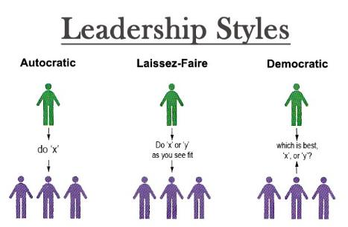
Entrepreneurs invested in products and businesses
Congress enacted protective tariffs, taxes that would make imported goods costs more than local goods, to help encourage buying of American goods
The gov’t also promoted laissez-faire policies to support industrial and business growths

Slide 7
How did the nation make a drastic leap in Industrial Growth?
New innovations led to an increase of new industries as well as expanding old ones
Alexander Graham Bell patented the telephone in 1876 linking cities across the Northeast and Midwest
Thomas Edison invented the electric light bulb in 1880 extending work days
Henry Bessemer develops the Bessemer process for producing steel
By 1890, the US produces the most steel in the world → skyscrapers, suspension bridges

Slide 8
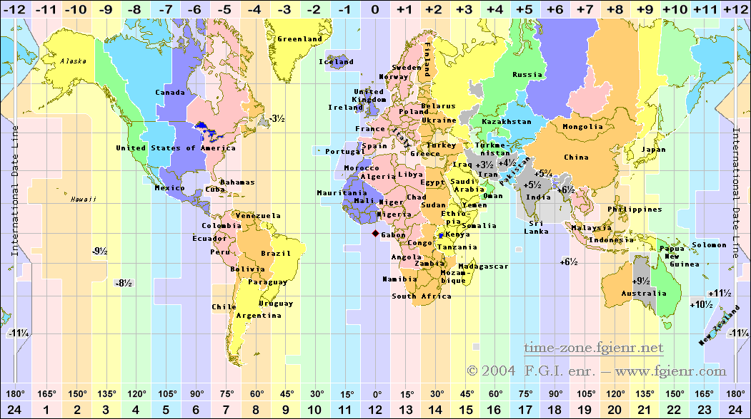
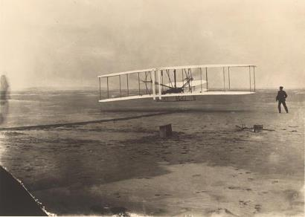
In 1884, the globe was divided into 24 time zones, a system that was adopted by the railroads, and eventually airlines.
Orville and Wilbur Wright completed first sustained airplane flight in 1903

Slide 9
Why was industrialization Important?
Due to the massive expansion of railroads, the US was able to expand it’s economy
The US contained almost as many miles of railroad track as the rest of the world combined by the late 19th century
American society would change
Massive changes in industry mechanized a lot of businesses, including farms → less need for human labor
Occurred mostly in the North and larger cities
South remained primarily agrarian

Slide 10
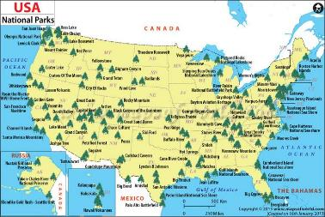
By the end of the 19th century, environmental concern about the negative effects of industry rose
Increase in industrial waste and land erosion from mining
Congress set aside protected lands → National Park Service

