Slide 1
Bell Ringer #5 2/22/19
Describe two amendments that came out of the Progressive movement.
What is a bill that is originated by the people rather than lawmakers?
Direct primary
recall
Initiative
Which statement best describes laws influenced by the Progressive movement?
They protected the American consumer and worker
They increased taxes on imports
Reduce the power of labor unions

Slide 2
Prohibition
https://www.youtube.com/watch?v=4n-s77FFgX4

Slide 3
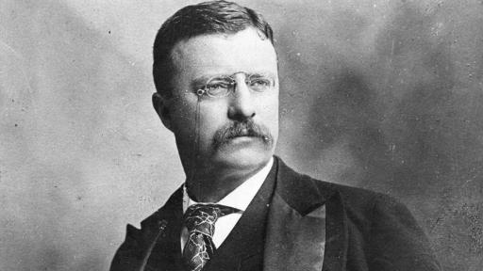
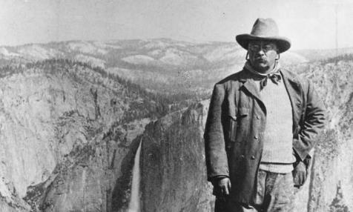
Theodore Roosevelt and the Square Deal

Slide 4
How did Theodore Roosevelt Become President?
Appointed Assistant Secretary of the Navy by President William McKinley
Resigned at the outbreak of the Spanish-American War in 1898 to form the Rough Riders (a nickname given to the 1st United States Volunteer Cavalry)
Returned as a war her- was elected governor of New York where he pushed for Progressive reforms
Became Vice President for President McKinley’s 2nd term in office in 1900
William McKinley was assassinated in September 1901 and Teddy Roosevelt became the POTUS
First of the Progressive Presidents
Theodore Roosevelt: Republican (1901-1909)
William H. Taft: Republican (1909-1913)
Woodrow Wilson: Democrat (1913-1917)

Slide 5
Spanish American WAR
Spanish-American War (1898)- The US blamed a Spanish mine. McKinley gave the OK for war, both the US and Spain had declared war. In order to assure the world that it was fighting only for the good of Cuba and not for colonial gain, the US promised to make Cuba independent after the war was over.
USS Main- American battleship that exploded off the coast of Cuba (a Spanish territory)
Yellow Journalism- Exaggerated news or articles that use eye catching headlines and images to fabricate the truth. Typically not backed by factual evidence

Slide 6
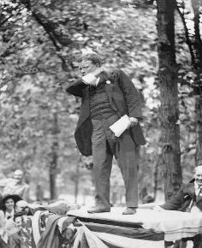
How was Teddy Roosevelt a Progressive President?
Used his office and its powers to convince Americans of the need for change and to push through his reform proposals
Called his agenda the Square Deal
Keep the wealthy and powerful from taking advantage of small business owners and laborers

Slide 7
Railroad Regulation
RR companies could charge whatever they wanted as they were monopolies → hurt western farmers
1887, Congress created the Interstate Commerce Commission (ICC) to oversee railroad charges for shipments traveling through more than one state
TR pushed Congress to pass two laws that strengthened the ICC
The Mann Elkins Act (1903): imposed fines on railroads that gave special rates to favored shippers

Slide 8
Trust-busting
TR was the first president to enforce the Sherman Anti-Trust Act
TR made a distinction between “good trusts” and “bad trusts”
Bad trusts: harmed consumers by raising prices and eliminating competition
Good trusts: dominated the market through efficiency and low prices

Slide 9
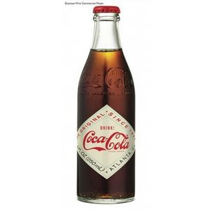
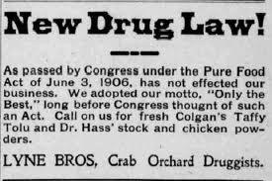
Consumer protection
Upton Sinclair’s novel The Jungle motivated Roosevelt and Congress to enact two regulatory laws
Meat Inspection Act
Pure Food and Drug Act and drugs
FDA enforces those laws today

Slide 10
Environmental Conservation
Nature lover
Wanted to continue the conservation effort after the establishment of Yellowstone National Park (1872) and Yosemite National Park (1890)
Good friends with California naturalist John Muir
Unlike Muir, TR thought that forests should be both conserved and used, as they provided valuable resources
Adopted Gifford Pinchot’s ideas for the use of national forests → forests be preserved for public use
This idea came to dominate American policies toward natural resources

Slide 11
Struggle over who had rights to control the water systems came to a head as mining companies, famers, and private irrigation companies began populating arid lands
TR pushed Congress to pass the National Reclamation Act (1902) → gave federal government the power to decide where and how water would be manages
Built and managed dams that would create reservoirs, generate power, and direct water flow
Salt Valley Project (AZ), Roosevelt Dam and Hoover Dam on the Colorado River

Slide 12
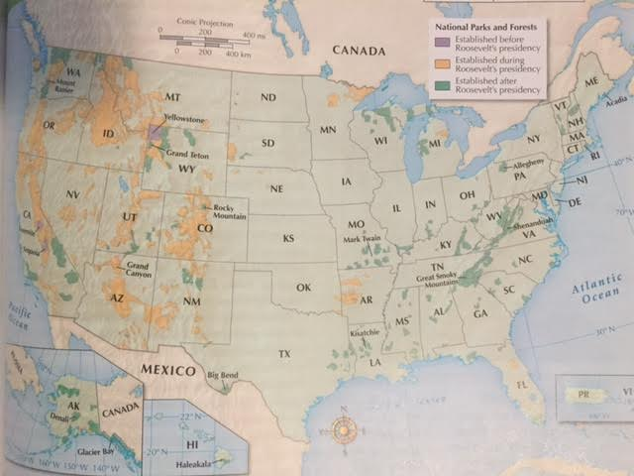

Slide 13
Roosevelt in a nutshell
https://www.youtube.com/watch?v=jRaJXg_B_uc

Slide 14
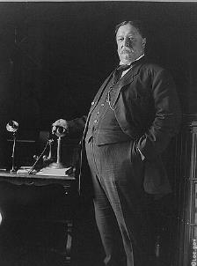
President William Taft
TR decided not to run for a third term
Still a strong force in the Republican Party
Backed his Secretary of War, William Taft, to be elected president 1908
TR hoped Taft would continue his Square Deal Policies

Slide 15
Taft had his own agenda
Taft was even more aggressive in “Trust Busting”
No more difference between “bad trusts” and “good trusts”
Twice as many lawsuits against corporations as TR
1911 → Standard Oil Company “busted”
Created hypocrisy when he supported SCOTUS’s “rule of reason” → relaxed the harshness of the Sherman Anti-Trust Act
Allowed big monopolies as long as they did not “unreasonably” force out smaller businesses
Pushed Congress to propose an income tax
Sixteenth Amendment (1913) →Authorized the federal government to collect an income tax

Slide 16
TR was mad about Taft’s agendas and programs he put in place
TR decided to run for a third term which ended up splitting the Republican Party → Conservatives and Progressives
TR’s New Nationalism → a program to restore the federal government’s “trust busting” power
Progressives set up the Progressive Party with TR as its nominee
Set up a crazy presidential election in 1912

Slide 17
Wilson’s New Freedom

Slide 18
Election of 1912
The Republican Party fought with itself over reform and eventually split in 1912
The Republicans who wanted a more involved federal government formed the Progressive Party and nominated TR as their candidate for President
The traditional Republicans nominated President Taft as their candidate for the Presidential election
Democrats nominated Woodrow Wilson as their candidate for POTUS

Slide 19
His campaign platform was called the New Freedom → very similar to TR’s New Nationalism
Wanted strict government control on corporations
Wanted more opportunities or “freedom” for small businesses
Won the Presidential election by a landslide without gaining majority of popular vote

Slide 20
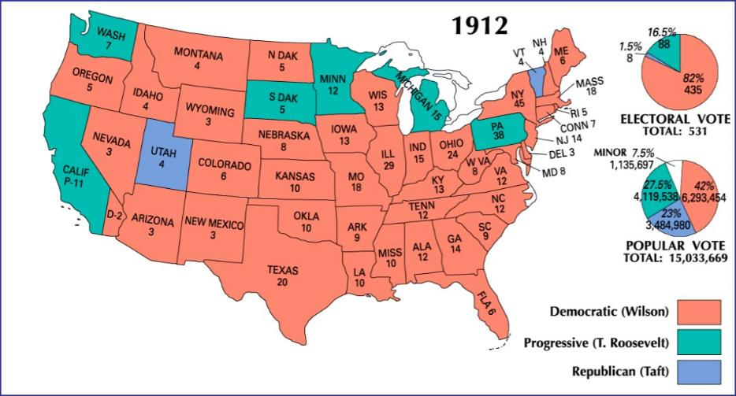

Slide 21
How Did Wilson Regulate the Economy?
Wilson thought that businesses were being held back by the “triple wall of privilege” → the tariffs, the banks, and the trusts

Slide 22
Having taken care of tariffs, Wilson turned his attention to reforming the banking system
The country had no central authority to supervise the banks.
Wilson pushed Congress to pass the Federal Reserve Act (1913).
This law put national banks under the control of a Federal Reserve Board, which set up regional banks to hold reserve funds from commercial banks
Protects the American economy from having too much money in the hands of one person, bank, or region
Supervises banks so that they well administered

Slide 23
Under Wilson’s presidency, workers received more protection under the Workingman’s Compensation Act (1916) → gave wages to temporarily disabled civil service employees
19th Amendment was ratified under Wilson’s presidency → Women helped with the war effort so Congress gave them a right to vote

