Slide 1
The North American Colonies
EQ: WHY DID PEOPLE MOVE TO THE COLONIES AND WHAT DID THEY FIND WHEN THEY ARRIVED?

Slide 2
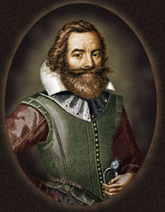
Jamestown, Virginia 1607
Jamestown: First successful English settlement in the New World, 1607. Set up as a joint-stock company: one in which investors own a piece of the company.
After a very difficult first year, John Smith takes over and makes the colony successful.
Success came due to the fact John Smith discovers tobacco as a cash crop.
Virginia House of Burgesses: First legislative body in American colonies. Representative Democracy

Slide 3
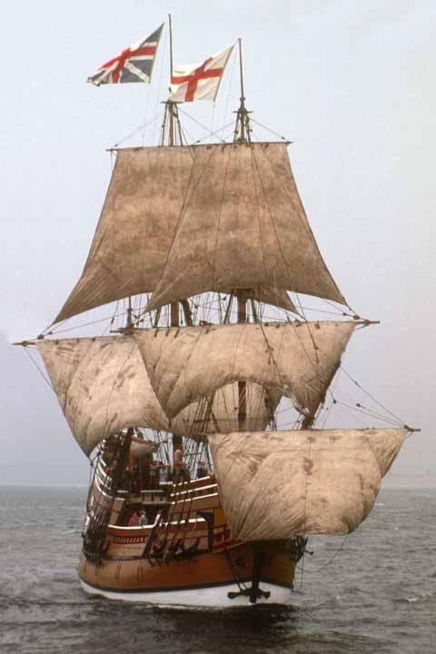
Plymouth Massachusetts
Plymouth: The second English colony in the New World was in Massachusetts at Plymouth. The colony was founded by the Pilgrims who arrived on the Mayflower.
A pilgrim is a person who journeys, especially a long distance for religion
Mayflower Compact: set-up the government of the new Plymouth Colony.
Direct Democracy for men only.
People met at town meetings to discuss issues and vote on solutions.
Resulted in majority rule.

Slide 4
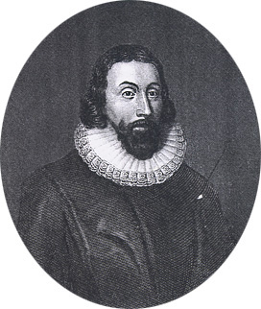
Massachusetts Bay
Settled by Puritans who were also seeking religious freedom.
Puritans were members of a group of Protestants that arose in the 16th century within the Church of England. They demanded the simplification of doctrine and worship, and greater strictness in religious discipline.
The first governor of this colony was John Winthrop who wanted to set up a city upon a hill.

Slide 5
The rest of the Colonies
Other colonies were set up and thirteen had been created by 1733. Most colonies set up governments similar to the one in Virginia.
- Why Immigrate? Many people were persecuted for their religious beliefs, while others came to the New World to make a better life for themselves.
- Salutary Neglect: From the founding of these colonies to the mid 1700s, the King left the colonies alone and basically allowed them to govern themselves.

Slide 6
Region Difference among the Colonies
Differences in the colonies:
As a result of the differing geographic resources , three distinct regions developed in the English colonies.
Northern Colonies: focused on shipping and manufacturing (New Hampshire, Massachusetts, Connecticut, Rhode Island)
Middle Colonies: focused on food crops such as wheat (New York, New Jersey, Pennsylvania, Delaware, Maryland)
Southern Colonies: focused on cash crops like cotton and tobacco (Virginia, North Carolina, South Carolina, Georgia) slavery became much more important in the southern colonies than any other colonial region.

Slide 7
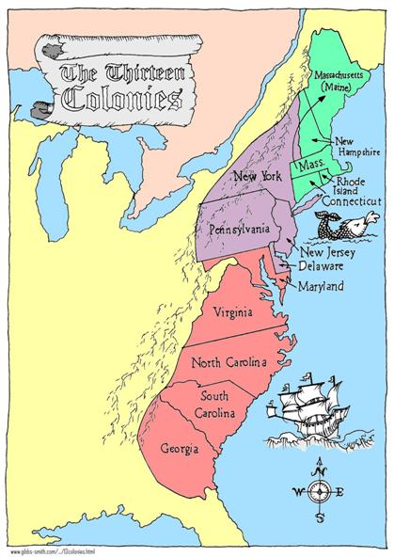

Slide 8
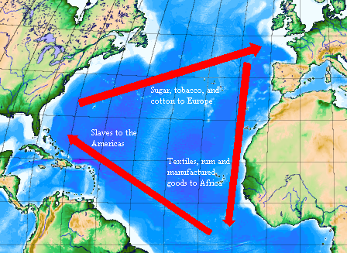
Triangle Trade Routes
- Mercantilism: Most European countries followed this economic theory which said that a nation should export more than they import, and should create colonies for natural resources.
Power depends on wealth
- Triangle Trade: Based on mercantilism, European countries set up a trading system where they
1) traded for slaves in West Africa
2) Traded the slaves for natural resources and crops in North and South America
3) took these natural resources back to Europe to be made into finished goods.

Slide 9
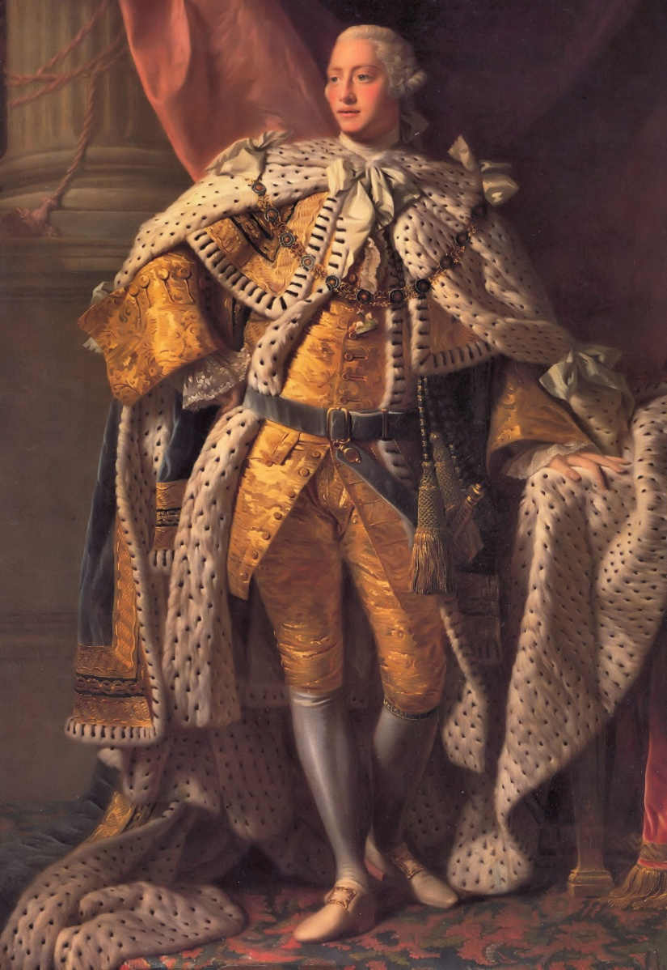
The Colonists
English People in America:
the residents of the 13 colonies were officially English citizens and
They believed they should receive the same rights and privileges as those people living in England.
The King appointed the leaders in the colonies.
Notes:
This should be a very quick overview

