Slide 1
Bell Ringer
What was the overall reason for the failure of the Articles of Confederation?
In your own words, explain the phrase ”No Taxation Without Representation.”
Each od the following helped lay a foundation for the form of government that was adopted by the US EXCEPT:
Magna Carta
Totalitarianism
The Enlightenment
The Roman Republic

Slide 2
The Constitution
EQ: How did delegates to the Constitutional Convention plan to fix the problems that arose with the Articles of Confederation

Slide 3
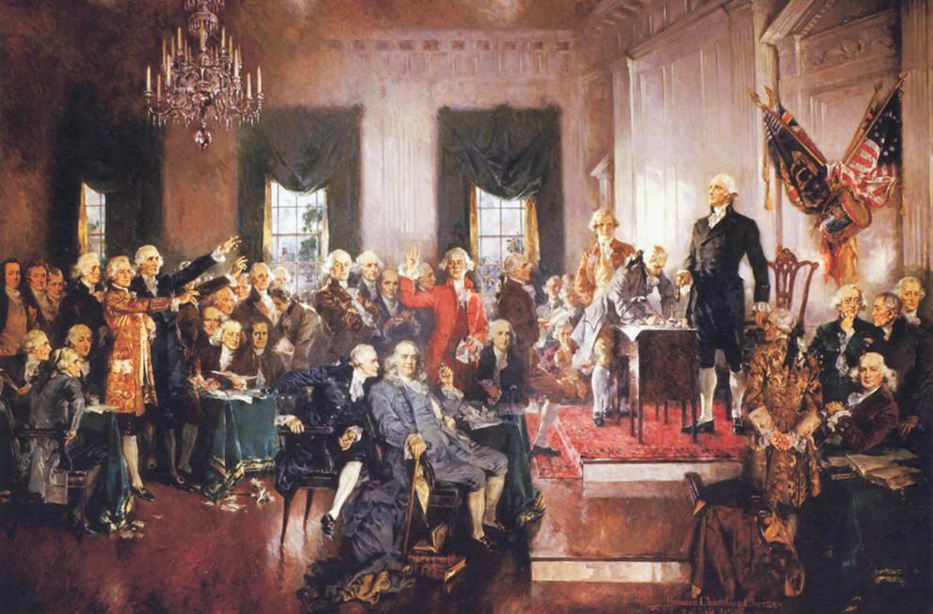
Constitutional Convention 1787
Delegates from 12 states meet in Philadelphia to revise the Articles of Confederation. They quickly decide to throw out the Articles and start over.
They made George Washington the head of the convention
They decided to keep everything they were doing secret during the convention.

Slide 4
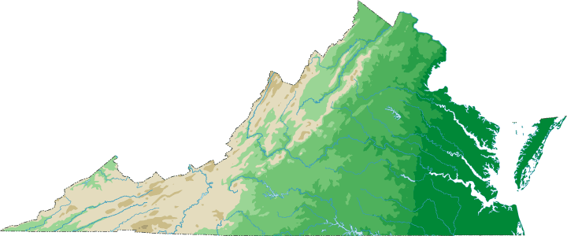
Two Competing Plans For Government
VIRGINIA PLAN
NEW JERSEY PLAN
Written by James Madison
Supported by states with a large population
Bicameral legislature (2 houses)
Representation based on population: large states have more representatives and more power.
Written by William Patterson
Supported by states with a small population
Unicameral Legislature (1 house)
Equal Representation: 1 state, 1 vote

Slide 5
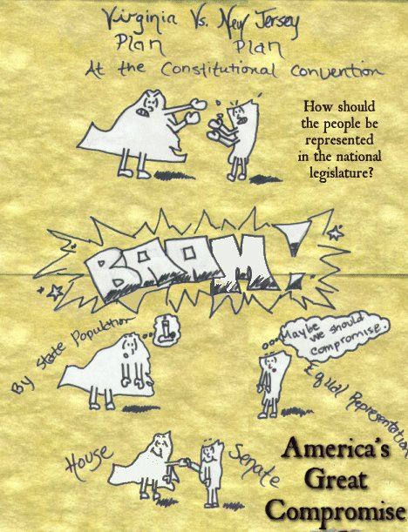
The Great Compromise
Delegates from the small states threaten to leave the convention
Roger Sherman comes up with an answer
Great Compromise/Connecticut Compromise
1. Bicameral Legislature
2. Senate with equal representation→ 2 per state
3. House of Representatives with representation based on population

Slide 6
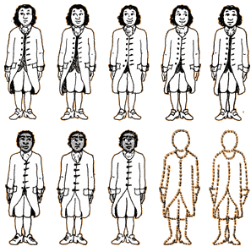
Three-Fifths Compromise
Set out to deal with the dispute of representation in congress
Southern states want slaves to be counted as part of their population. Northern states opposed to this because it makes slave states more powerful
Decide that three out of every five slaves will count in a state’s population

Slide 7
Slave Trade/Commerce Compromise
Set up to deal with taxation of slave trade
Northern states want the national government to be able to regulate trade. Southern states concerned that this regulation will include taxes on exports and laws against the slave trade
National govt. given the power to regulate trade, but cannot put a tax on exports. Also cannot pass new laws about the slave trade for 20 years.

Slide 8
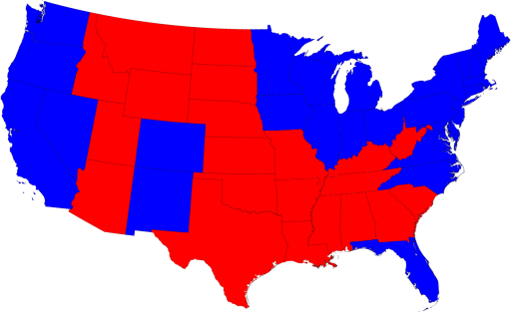
Presidential Compromise
Who will choose the President?
Constitution writers do not trust common people to make an educated choice about the Presidency
Answer the question with the Electoral College→ State legislatures choose electors who meet together to decide the President (Electoral College).
https://www.youtube.com/watch?v=V6s7jB6-GoU

Slide 9
Federalist Vs. Antifederalists
https://www.youtube.com/watch?v=XbaQ56nL19Y

Slide 10
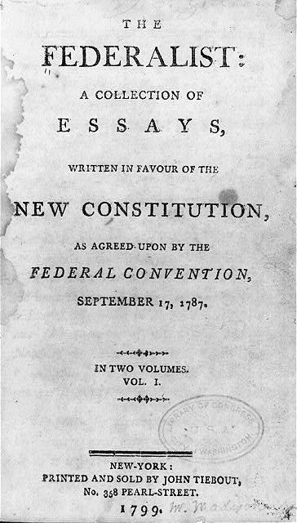
Ratification of the Constitution
Ratify=Approve
¾ of states (9 out of 13) must ratify the Constitution before it will take effect
Delaware is the first to ratify and therefore is the 1st state
Federalists: Group that supports ratification. Named for the concept of Federalism→ a system of government where the national a state governments share power
Anti-Federalists: Group that opposes the Constitution. Anti-Federalists believe the Constitution makes the national government too powerful and does not adequately protect citizens.

Slide 11
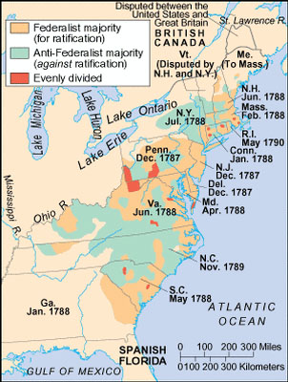
Ratification Occurs
After two years of arguing, the Federalists agree to add a Bill of Rights to the Constitution if the Anti-Federalists will support ratification
July 21, 1788: New Hampshire becomes the 9th state to ratify the Constitution and it becomes the official plan of government for the United States.
NC did not ratify until over a year later. We are the next to last of the original states to ratify.

Slide 12
On your own, (not with a partner today)
Directions: Apply your knowledge of history by creating two campaign buttons or posters (done on 8 ½ x11 paper) of the differences between the Federalists and Anti-Federalists in the struggle for the passage of the US Constitution. Your work should include a symbol to represent both parties and important information about each
Requirements:
Visually appealing
Includes at least 3 key arguments in support per button/poster (at least 6 all together)
One Symbol per party
Complete thoughts/ideas

