Slide 1
Bell Ringer #2 4/10/19
1. Which nations came to be known as the Axis Powers after they signed a mutual defense treaty in 1940?
Germany, Japan, and Italy
Germany, Japan, and Spain
Germany, Italy, and Austria
2. All of the following WWII leaders are correctly paired with the nation they led EXCEPT:
Benito Mussolini – Italy
Adolf Hitler – Germany
Hirohito - Spain
Joseph Stalin – Soviet Union
3. What event led to the declaration of war by French and Britain in Europe?
The German invasion of Poland
The Allied invasion of Normandy
The Japanese invasion of Manchuria

Slide 2
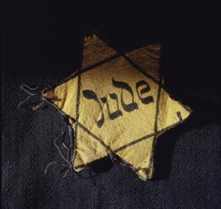
The Holocaust

Slide 3
What Was the Holocaust?
Of the 60 million World War II deaths, 11 million people died in German death camps including 3.5 million Russians, and 6 million Jews (2/3rds of all European Jews)
The word Holocaust was given to the killing of the 6 million Jews because it was a war of extermination designed to wipe out an entire group of people.
“Holocaust”- burn offering
Direct result of a racist Nazi ideology that considered Aryans superior to other people

Slide 4
What were the roots of the holocaust?
The Nazi movement always pronounced Anti-Semitic rhetoric → the blamed Jews for all the ills that had fallen on Germany
Anti-Semitism (dislike of Jews) grew even stronger when Hitler became chancellor of Germany in 1933

Slide 5
Hitler’s rise to power:

Slide 6
Hitler first began persecuting Jews as soon as he came to power and began with an economic focus → urged Germans to boycott Jewish-owned businesses, barred Jews from jobs in civil service, banking, law, journalism, and medicine
Nuremberg Laws: Hitler’s legal persecution of Jews
Denied German citizenship to Jews
Banned marriage between Jews and non-Jews
Segregated Jews at every level of society

Slide 7
Aryans
The Nazis believed that the Aryans had the most "pure blood" of all the people on earth. The ideal Aryan had pale skin, blond hair and blue eyes. ... The Nazis linked he word 'Aryan' with the German word 'Ehre', which means 'honour' and said Aryan meant 'the honourable people

Slide 8
Used the power of the state to go on an Anti-Semitic campaign → newspapers, schools, comic books
Kristallnacht “Night of the Broken Glass”
November 9, 1938
Retaliation after a Jewish refugee killed a German diplomat in Paris
Nazis officials ordered attacks on Jews in Germany, Austria, and Sudetenland
More than 1,500 synagogues, 7,500 Jewish-owned businesses were destroyed
More than 200 Jews were killed and thousands arrested

Slide 9
What was Hitler’s “Final Solution”?
Hitler’s “Final Solution” → nothing short of extermination of all Jews living in the regions controlled by the Third Reich (genocide)
Hitler began opening concentration camps in 1933 → confined areas to hold specially designated groups
Not only Jews, but political opponents, socialists, communists, Gypsies, and others

Slide 10
Prisoners of the camps were administered tattooed numbers and given vertically striped uniforms with specified sign → Jews wore yellow
Many died from starvation, disease, and fatigue
Medical experiments were conducted on prisoners at camps such as Dachau
When Germany gained control of Poland and part of the Soviet Union, he forced millions of Jews to live in crowded walled areas known as ghettos → Warsaw

Slide 11
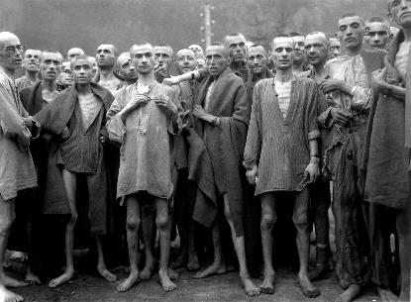
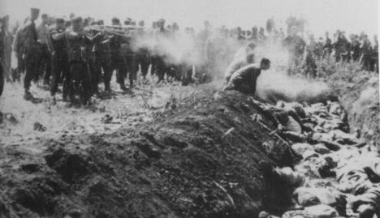
In 1942, Reinhard Heydrich outlined a plan to complete Hitler’s “Final Solution” that would exterminate about 11 million Jews
Many concentration camps became death camps where prisoners were exterminated in gas chambers or firing squads then cremated in large ovens

Slide 12
How did the Allies Intervene?
At first they refused entry to Jewish refugees due to multiple factors → Great Depression and underestimation of Hitler’s plans
This led to a lot of criticism by saying that the Allies could have done more to stop the Holocaust
By 1943, the Allies discussed the possibility of rescuing the surviving Jewish refugees from Europe after understanding the full extent of the mass killings → War Refugee Board (1944)

Slide 13
As American forces began to seize Nazi controlled territories they began to liberate the concentration camps
The liberation of the camps allowed Americans to understand the enormity of what the Nazis were doing
In 1948, the large Jewish community in Palestine proclaimed the State of Israel → President Truman immediately recognized the new nation

