Slide 1
Bell ringer #5 4/1/19
"Houses were shut tight, and cloth wedged around doors and windows, but the dust came in so thinly that it could not be seen in the air, and it settled like pollen on the chairs and tables, on the dishes." – John Steinbeck, The Grapes of Wrath
What event of the early 1930s is described in the above quote?
The period of drought, dust storms, and high winds on the Great Plains, known as the Dust Bowl
The poor living conditions of urban immigrants in northeastern cities
The prosperity experienced by growers in the valleys of California
Which of the following is a cause of the severe downturn in the stock market in 1929?
Immigration restrictions and a lack of skilled workers
High taxation and overspending on social welfare
Overproduction and the excessive use of buying on margin
What does the term “Black Tuesday” refer to? Why is this significant?

Slide 2
The New Deal

Slide 3
What impact did the depression have on the election of 1932?
1932 was the worst year of the Depression and an election year
Democrats nominate NY Governor Franklin D. Roosevelt (FDR)
FDR promised a “new deal” for Americans, the repeal of prohibition, and aid for the unemployed, and cuts in government spending
60% of Americans voted FDR over Hoover
Democrats also won control of House & Senate

Slide 4
Roosevelt was elected November, 1932 but was not sworn in until March, 1933
Later in 1933 the 20th Amendment (lame-duck amendment) shortened the time between the election and when the president took office
Appointed the first female cabinet member → Frances Perkins (Secretary of Labor)

Slide 5
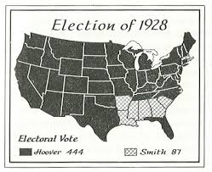
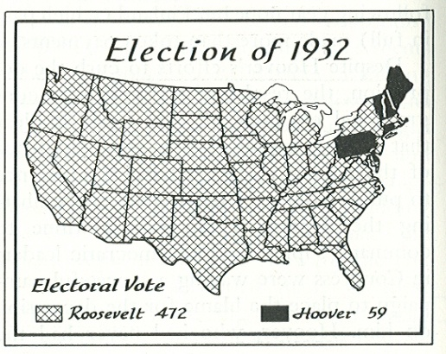
ELections
Hoover (Rep)
Smith (Dem)
Hoover (Rep)
Roosevelt (Dem)
Which conclusion is most clearly supported by the information provided by these maps?
The Democratic Party lost support in the Northeast between the two elections
The Great Depression altered American political preferences
Most voters believed in the theory of trickle-down economics to revive the economy

Slide 6
What do you need to know about FDR?
Drastically increased the size and powers of the federal government and the presidency
Elected to four terms in office (12 years 2 months)
Distant cousin of Teddy Roosevelt (married TR’s niece Eleanor Roosevelt)
Contracted polio in 1921
Eleanor was one of the most active first ladies in U.S. history

Slide 7
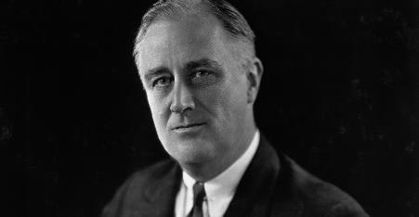
What did the New Deal Include?
The Three R’s: relief, recovery, and reform
Relief: relief/aid for victims of the Depression
Recovery: bringing the nation out of depression
Reform: reforming American economic institutions to prevent future depressions

Slide 8
Deficit Spending: government spent more money than it actually had as a means of stimulating growth
The First New Deal was enacted during FDR’s first two years in office
The Second New Deal was enacted during FDR’s second two years

Slide 9
What was Significance of FDR’s “first hundred Days” ?
After being sworn in as President on March 4, 1933, FDR called Congress into a 100 day long special session
During the 100 days Congress passed 15 bills
Enacted more laws than and Congress in history
The new laws and agencies were so numerous that they were commonly referred to by their initials (alphabet soup)

Slide 10
What did the “first hundred days” include?
Repeal of prohibition
Repealed prohibition with the 21st Amendment (1933)
Enacted a tax on beer and wine
The Bank Holiday
To restore confidence in banks, FDR closed all banks for a 4-day bank holiday → gave banks time to regroup
Explained to Americans via radio, that only safe banks would be reopened → start of fireside chats

Slide 11
Financial recovery program
The Emergency Banking Relief Act: allowed the government to examine finances of banks during the bank holiday and reopen those judged to be sound
The Federal Deposit Insurance Corporation (FDIC): the federal government insured bank deposits up to $5,000
The Agricultural Adjustment Administration (AAA) (1932)
Designed to raise crop prices and create demand by reducing production
The federal government provided subsidies to farmers to not grow crops
Declared unconstitutional by SCOTUS in 1935

Slide 12
Relief programs for the unemployed
Pump priming: the federal gov’t provides people with jobs and $ → people spend $ → creating demands for goods increasing economic production
The Public Works Administration (PWA): allotted money to state and local governments to create jobs building roads, bridges, dams, and other public works
The Civil Conservation Corps (CCC): federal gov’t employed young men on public works projects and paid their families small monthly wages
The Tennessee Valley Authority (TVA)
Huge experiment in regional development and public planning
Government corporation that hired thousands of people in the Tennessee Valley area → public works, flood relief, hydroelectric power

Slide 13
The National Industrial Recovery Administration (NIRA) (1933)
Designed to provide reasonable profits for business and fair wages/hours for labor
Could set codes for wages, hours, levels of production, and prices of finished goods
Gave workers the right to organize and to collective bargaining
Schechter v. U.S: The administration was declared unconstitutional by SCOTUS in 1935

Slide 14
What other programs were enacted during the New Deal?
After the first 100 days, during late 1933 and early 1934
The Securities and Exchange Commission (SEC)
Designed to regulate stock market
Put limits on the types of speculative buying that led to the crash on Wall Street
Congress took the U.S. off the gold standard in an attempt to halt deflation

