Slide 1
Bell Ringer #5 2/8/19

Slide 2
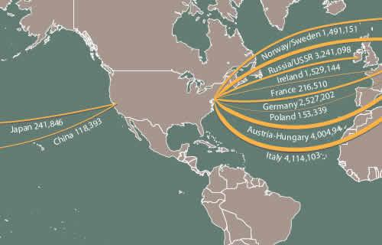
The New Immigrants

Slide 3
Bell ringer #5 Immigrants 2/8/19
“Immigrant”
What is the first thing that comes to your mind when you hear this term?
Do you associate this with positive or negative thoughts?
What events or ideas have shaped your opinion on immigration?

Slide 4
Who are these new Immigrants?
Prior to the 1870’s, most immigrants were from western and northern Europe (ex. Germany and Ireland)
Beginning in the 1870’s a wave of “new” immigrants from southern and eastern Europe starting arriving in the US
“New” immigrants were often unskilled, poor, Catholic or Jewish, and moved to cities rather than farms
Italy, Greece, Poland, Hungary, Russia (1900 = 70% of all immigrants in the US)
Chinese immigrants came in smaller numbers to the west coast

Slide 5
Why the New Wave of Immigrants?
Two types of factors lead to immigration: Push factors and Pull factors
Push factors
Land reform and low prices in eastern Europe and China forced many farmers off their land
War and religious persecution in Russia and eastern Europe forced many to flee and seek better lives in the US
Pull factors
The United States offered plentiful land and employment
The 1862 Homestead Act made western farmland cheap
Earlier immigrants often “recruited” their families to immigrate with the promise of religious and political freedom

Slide 6
How Did they get to America?
Most immigrants only brought what they could carry; clothes, photo, tools of their trade, or even a musical instrument
They made the trip across the Atlantic or Pacific by steamships
Most traveled in extremely cramped and dirty accommodations
By 1892, European immigrants were brought to New York Harbor and processed at Ellis Island within hours
Chinese and other Asian immigrants arrived in the San Francisco Bay, and were processed at Angel Island (open from 1910-1940).
Opposite of Ellis Island - immigrants were often detained for weeks or even months
Backed by the Chinese Exclusion Act (1882) – prohibited immigration by Chinese laborers → First time federal government restricted immigration

Slide 7
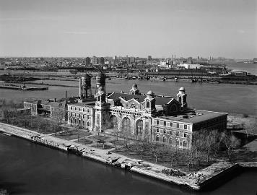
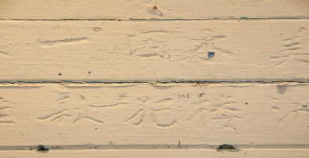
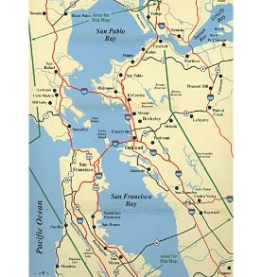
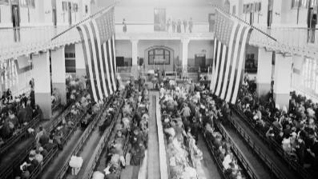
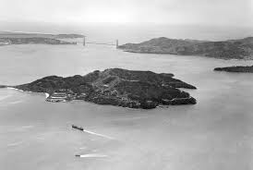
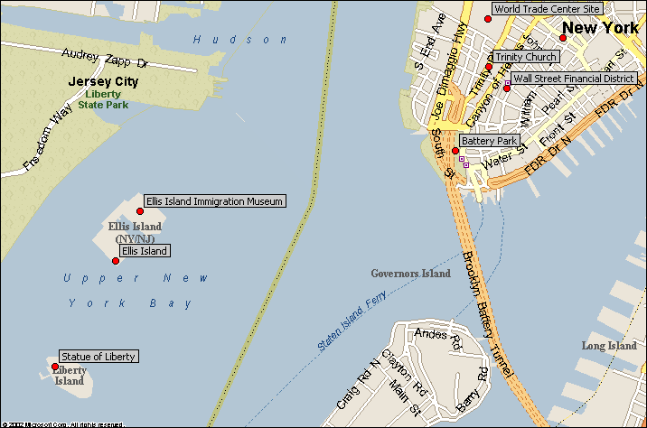

Slide 8
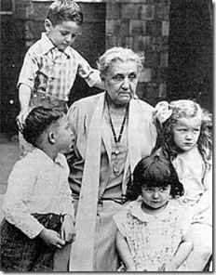
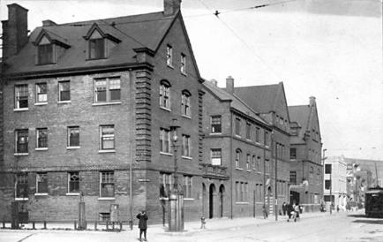
What was Life like for new immigrants?
New immigrants tried to assimilate to new life in the United States
Most immigrants stayed in cities and lived in ethnic neighborhoods called ghettos
Social reformers founded settlement houses in these poor neighborhoods in order to relieve terrible living conditions
Jane Addams founded Hull-House in Chicago (1889)

Slide 9
Many new immigrants were introduced to Americanization programs that helped them learn English and adopt an “American” lifestyle
By 1890 many cities had a huge immigrant population. 4/5 people in NYC were immigrants
The idea of the “melting pot” in which white people of all different nationalities blended to create a single culture became popular among settlement workers and immigrants
Immigrants usually held on to their traditions after arriving in the US. They established gathering places and religious institutions that made them feel more at home.
Ex: Catholic churches and schools, Jewish synagogues
Many of their children became more Americanized

Slide 10
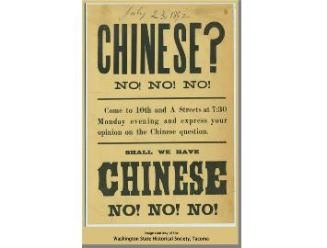
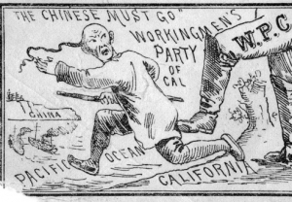
Many immigrants had trouble being accepted into American society
They often faced nativism – the belief that native-born white Americans were superior to immigrants.
Religion also created suspicion between Protestants, Catholics, and Jews
One of the most discriminated groups were the Chinese and other Asian immigrants → Chinese Exclusion Act
Gentlemen’s Agreement of 1907-1908 repealed the San Francisco segregation order against the Japanese

Slide 11
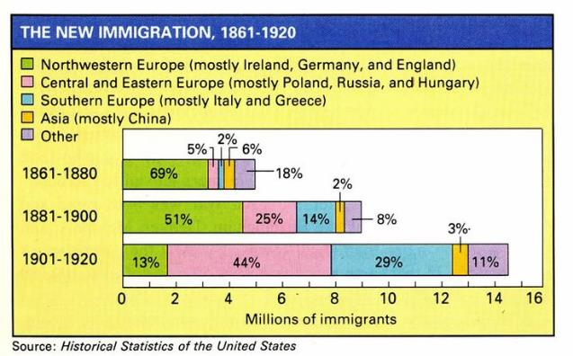
So What?
Despite opposition, immigrants transformed American society by expanding the meaning of what is was to be an ‘American’
Immigrants fueled industrial growth, acquired citizenship, elected politicians, incorporated traditions into part of American culture
Immigrants’ labor helped the US become a world power

