Slide 1
Bell ringer #6
What is the “White Man’s Burden” and how does it relate to Filipinos in the early 1900’s?
Describe the Boxer Rebellion.
What was the significance of the
Philippine-American conflict after the
Spanish-American War?

Slide 2
The United States and Latin America

Slide 3
What was the Platt Amendment?
After the Spanish-American War, Americans called for a more prominent role in Latin America
Seen as the nation’s backyard and a sphere of influence in which other great powers should be excluded
The Platt Amendment (1901) → made Cuba a US protectorate, allowing the U.S. to control Cuban foreign policy

Slide 4
The U.S. required Cuba to accept the terms of the Platt Amendment before removing U.S. troops
Prohibited treaties with foreign powers that would impair Cuban independence
Prohibited any excessive public debt
Permitted the U.S. to intervene in Cuban affairs to protect liberty and maintain law & order
Allowed the U.S. to maintain military bases in Cuba (Guantanamo Bay)
In a nutshell: the U.S. has the right to intervene with troops & maintain a military base in Cuba

Slide 5
Cuba Today
Cuba Today: https://www.youtube.com/watch?v=chYBlArm9Ao

Slide 6
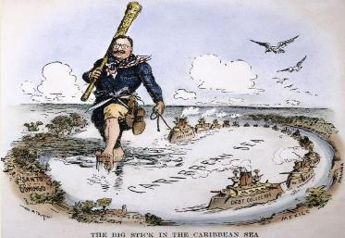
What was Teddy Roosevelt’s “Big Stick Diplomacy”?
1901 → Roosevelt succeeded McKinley as POTUS
Roosevelt’s foreign policy motto was “speak softly and carry a big stick”
What do you think this means?
Use Caution when dealing with others but always have the military power to back it up
The press labeled Roosevelt’s aggressive foreign policy “big stick” diplomacy

Slide 7
The Panama Canal
Roosevelt wanted to build a canal through Panama
Columbia controlled Panama and refused to allow U.S. to build it
The U.S. encouraged and supported a Panamanian revolution against Colombia in 1903
The new Panamanian government signed a treaty granting the U.S. long-term control of the canal zone
Canal building began in 1904 and was completed in 1914
Critics claimed that Roosevelt was following the policy of imperialism

Slide 8
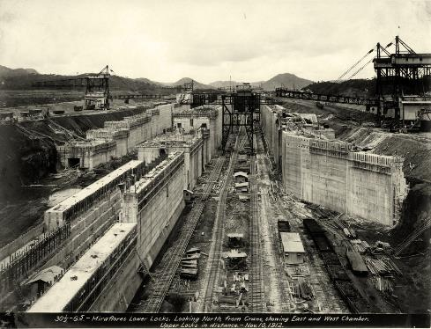
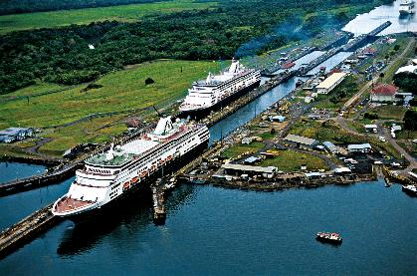
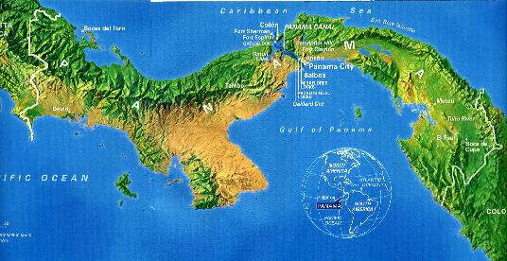

Slide 9
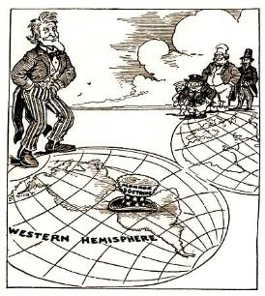
What was the Roosevelt Corollary to the Monroe Doctrine?
European intervention in Latin America
Roosevelt feared that Latin American nations that could not pay off debts to European nations might fall under European control
European control of Latin American nationals would violate the Monroe Doctrine
Monroe Doctrine: demanded that European countries stay out of the affairs of Latin America

Slide 10
Rather than allow Europeans to intervene to collect debts, Roosevelt declared in 1904 that the U.S. would instead intervene for Europe
The U.S. would send gunboats to Latin American nations that were delinquent in paying their European debts
U.S. troops would occupy the country’s major ports until debts were paid
Over the next 20 years, U.S. Presidents used the Roosevelt Corollary to justify sending U.S. forces into Latin America
International Police Power
Was not popular with many Latin Americans who thought that they could police themselves

Slide 11
What was Taft’s “Dollar Diplomacy”?
President Taft succeeded Teddy as POTUS
Dollar Diplomacy → Taft’s use of U.S. investment dollars (instead of battleships) to expand U.S. influence
Guarantee loans made to foreign countries by American business people

Slide 12
What Was Woodrow Wilson’s “Moral Diplomacy”?
President Wilson succeeded Taft as POTUS
Moral Diplomacy → Wilson’s foreign policy to “promote human rights, national integrity, and opportunity” instead of military force
Opposed imperialism, big stick diplomacy, and dollar diplomacy
Failed miserably

Slide 13
What were Failures of Wilson’s Moral Diplomacy?
He used U.S. military to straighten out financial problems in Central America and the Caribbean
Used U.S. military in Nicaragua, Haiti, and the Dominican Republic
Argued the use of force was necessary to maintain “stability in the region”

