Slide 1
Unit 3 review
Unit 3 Middle Ages

Slide 2
1. Describe European Feudalism:

Slide 3
2. Which type of political system and social order is shown in this diagram?
3. What was be the European counterpart to the Samurai in Japanese society?

Slide 4
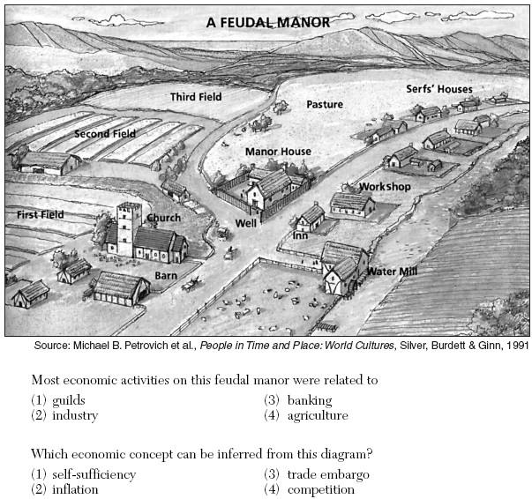
4. Which of the following economic terms best describes a feudal manor?
a. Guilds. c. Agriculture
b. Banking

Slide 5
Church v. Monarch
“The pope is the only person whose feet are kissed by all princes. His title is unique in the world. He may depose [remove] emperors.” – Pope Gregory VII
“An emperor is subject to no one by to God and justice.” - Frederick Barbarossa, Holy Roman Emperor (12th C.)
5. What do the ideas expressed in the quotations show about Medieval Europe?

Slide 6
“. . Your brethren who live in the [Middle] East are in urgent need of your help.... For, as most of you have heard, the Turks and the Arabs have attacked them and have conquered the territory of Romania [the Byzantine Empire] .... They have occupied more and more of the lands of those Christians .... They have killed and captured many, and have destroyed the churches and devastated the Empire .... All who die by the way, whether by land or sea, or in battle against the pagans, shall have immediate remission (forgiveness) of sins.” – Pope Urban II, 1095
6. What event is Pope Urban II referring to?
7. What accusation does Pope Urban make against the Arabs and Turks?

Slide 7
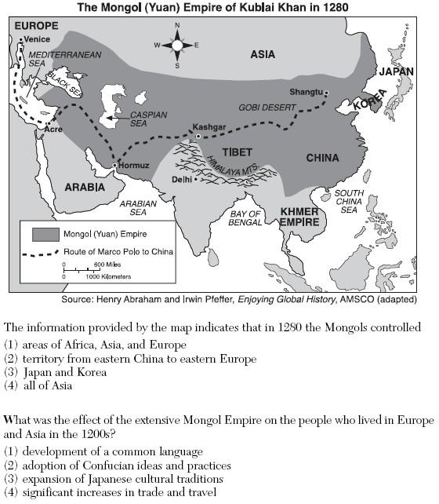

Slide 8
“Man’s highest joy is in victory: to conquer one’s enemy, to pursue them; to deprive them of their possessions; to make their beloved weep; to ride on their horses; and to embrace their wives and daughters” -Genghis Khan
8. What does this quote suggest about the way the Mongols built their vast empire?
They were interested in gaining wealth for Asia.
They enjoyed a lavish lifestyle filled with luxury.
Their main goal was to conquer lands and defeat their enemies.

Slide 9
. . . Merchants were carriers of Islam rather than agents of Islamization. They opened routes and exposed isolated societies to external influences, but they were not themselves engaged in the propagation [spread] of Islam, which was the work of religious leaders. The leaders became integrated into African societies by playing religious, social, and political roles similar to those of traditional priests.. . . . – John L. Esposito, ed., The Oxford History of Islam, Oxford University Press
9. According to this passage, how did Islam spread from the Middle East to Africa?

