Slide 1
Bell ringer #5
What Significance does Jamestown hold in the development of this country?
What was the first representative assembly in the English Colonies?
Which statement is a valid socioeconomic description of the Middle Colonies?
They were mostly English and dependent on shipping
They had abundant natural resources such as wheat and forests
They thrived on plantation slavery

Slide 2
Colonial Problems
EQ: WHAT EVENTS LED THE COLONISTS TO TRY TO BREAK FREE FROM ENGLISH RULE?

Slide 3
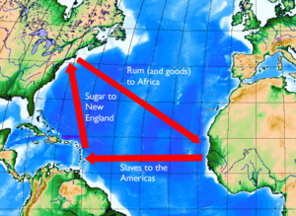
Mercantilism
Britain used the economic theory of mercantilism to
1. build up a supply of gold
2. have a favorable balance of trade-sell more than you buy
3. set up the colonies to benefit the mother country
4. colonies became economically independent

Slide 4
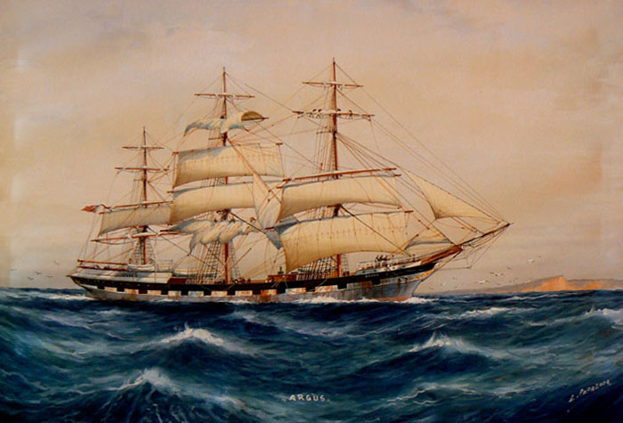
Navigation Acts
Certain goods such as sugar, tobacco, and furs could only be sold to Great Britain
Colonists must use British ships to transport goods
How does this benefit Britain?
How does this hurt the economy of the colonies?

Slide 5
The French and Indian War
In the late 1750s, and early 1760s, England and the American colonists fought against the French and Indians in America. This conflict was called the French and Indian War.
Proclamation of 1763: colonists forbidden from settling west of the Appalachian Mountains to avoid conflict with Native Americans.
England created a huge debt for themselves to pay for the war. They decided to pay off the debt by taxing the colonists.

Slide 6
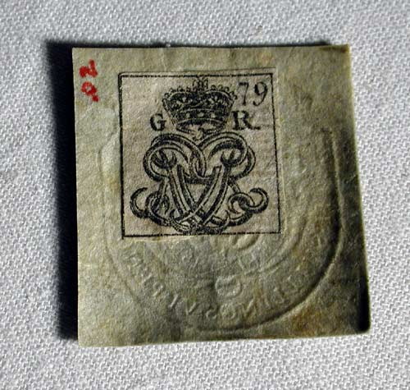
British Taxes
Sugar Act (1764): Extended earlier act from 1733 on molasses
Stamp Act (1765): All printed documents (newspapers, fliers, mail, playing cards, etc.) had to have a stamp
The colonists responded to the stamp act by boycotting British goods→ they refuse to buy goods made in England
As a result of the boycott, the stamp act was repealed
Parliament then passes the Declaratory act stating they had the power to pass laws for the colonies “in all cases whatsoever”

Slide 7
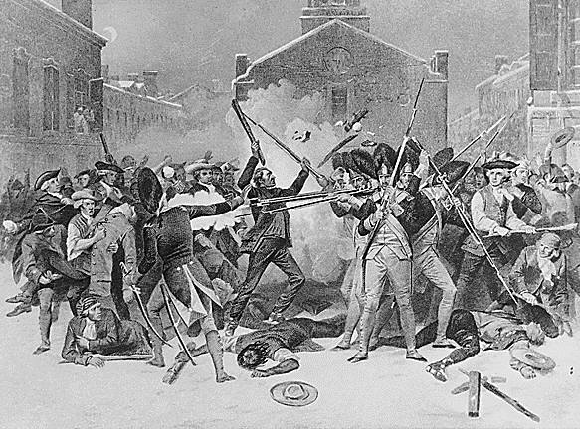
More Taxes…
Townshend Acts (1767): A new tax placed on necessary goods (glass, lead, sugar)
Colonists could not boycott necessary goods, so they protested the act.
Boston Massacre: colonial protesters clashed with British troops in Boston resulting in the deaths of five colonists.

Slide 8
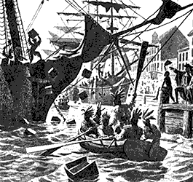
Boston Tea Party
Tea Act (1773): a new tax on tea
Boston Tea Party: A group of intellectuals in Boston called the Sons of Liberty staged a strange protest. They dressed up as Mohawk Indians, and threw hundreds of cases of tea off of British boats and into Boston Harbor

Slide 9
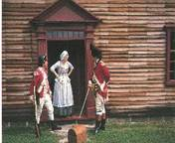
British Response to the Tea Party
Coercive/Intolerable Acts (1774): The British were very mad about the Boston Tea Party, so they instituted three new acts to punish the colonists
1. No trial by jury in the colonies
2. Quartering Act: colonists forced to house and feed English soldiers
3. Blockade of Boston: no ships allowed to enter or leave Boston harbor, resulting in terrible hardships for residents of Boston

Slide 10
American Revolution
Unit 1
EQ: How did the American colonies gain their independence AND what were their first attempts at governing themselves?

Slide 11
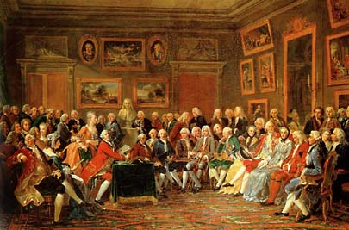
First continental congress
First Continental Congress (Sept. 1774)
Met in Philadelphia to protest Intolerable Acts
All colonies had representatives except Georgia
Divided on the issue of declaring independence
Sent Declaration of Rights and Grievances to King George III
Defended colonies’ right to run their own country
Supported the protests in Massachusetts (like the Boston Tea Party)
What is a boycott?

Slide 12
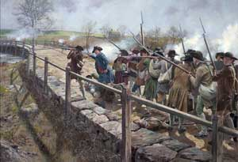
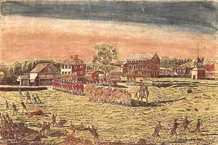
Battles of Lexington and Concord
On April 19, 1775, when British and American soldiers fired shots at each other in Lexington.
Soon after the fighting spread to Concord.
The Battles of Lexington and Concord were the first two battles of the American Revolution.
First shots of the Revolutionary War

Slide 13
Second continental congress
Second Continental Congress (1776)
Met in Philadelphia again to discuss idea of Independence
Raised an army
Appointed George Washington general
Wrote the Declaration of Independence

Slide 14
Independence or not??
Reasons TO declare independence
1. rights had been taken away through taxes and the Intolerable Acts
Thomas Pain: “Common Sense”
Pamphlet advocating independence from G.B.
Encouraged common people in the Colonies to fight for egalitarian government
2. Blood had been shed during Boston Massacre and Lexington and Concord
Reasons NOT to declare independence
1. There was no central government in the colonies
2. colonists could be executed for treason

Slide 15
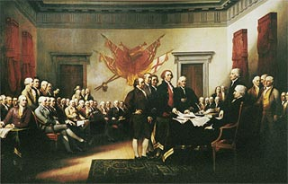
Declaration of Independence
Declaration of Independence (July 4, 1776) ~ written by Thomas Jefferson and declared the colonies separate from Great Britain.
List of Grievances to king stating his wrong doings.
Took ideas from John Locke
Enlightened thinker who believed in natural rights of man (life, liberty, property)
"life, liberty, and the pursuit of happiness."

Slide 16
important battles
Battle of Trenton (December 26, 1776)
Colonial army captured 1000 British troops
Boosted moral
Battle of Saratoga (October 17, 1777)
Turning Point of the Revolutionary War!
Convinced the French that the colonists could win
France joined the war to help the colonists
Caused the British to change their strategy

Slide 17
The War ends
Battle of Yorktown (October 19, 1781) ~ British General Cornwallis surrenders to the Americans.
Americans Win!
End marked by the Treaty of Paris
Britain recognizes the USA as an independent country, and must withdraw their troops from the colonies and the central part of the USA.

Slide 18
Why did the colonists win?
Initially, it looked like the British would win the war.
British were well-trained forces and most powerful country in world
Colonists were raggedly and poorly trained
Reasons the colonists won:
Americans were more motivated
Overconfident British generals made mistakes
Americans were on their home territory
Louis XVI of France helped the Americans
EQ: How did the American colonies gain their independence AND what were their first attempts at governing themselves?

