Slide 1
Bell Ringer #6
The Boston Tea Party caused Parliament to pass the Coercive Acts. What name did Americans give to these acts?
Most of the work of writing the Declaration of Independence fell to which famous American?
The meeting that took place in Philadelphia in 1774 to discuss concerns about Britain’s Intolerable Acts was known as what?

Slide 2
Early state government
Unit 1
EQ: How did the new States unite to form a governing body?

Slide 3
The Patriot
Before the Revolutionary war… Debate over independence or no independence…
https://www.youtube.com/watch?v=EGgaXXBkE8A

Slide 4
New nation
After the revolution, the Americans formed a republic or Representative Democracy
Republic = form of representative democracy where people elect representatives for government.
Articles of Confederation ~ 1st government of the United States.
Did not have a president, no power to tax, no military
TOO WEAK!
Constitutional Convention of 1787 ~ called to create a new government.
Wrote the Constitution
Added the Bill of Rights
Protect rights of people

Slide 5
Difference in legal documents
https://www.youtube.com/watch?v=bO7FQsCcbD8
US Constitution
The Declaration of Independence
In this document, America declared to Britain (England) that they were free.
All men are created equal
Written by Thomas Jefferson
The Bill of Rights
First 10 Amendments to the United States Constitution
United States Constitution
Tells us how our government should work
Three branches of government
Can be changed peacefully, through amendments

Slide 6
State Governments
New Hampshire was the first state to write their own constitution with the other states following soon after
Most state governments have:
A bicameral (two house) legislature
A governor to carry out laws
A court system
A Bill of Rights to protect citizens from the government

Slide 7
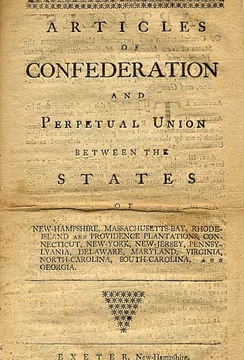
The articles of confederation
Set up the first national government of the United States
Est. 1777 as a “League of Friendship”
The Articles of Confederation set up a loose alliance of 13 independent states
Only real power is to raise and direct the military
https://www.youtube.com/watch?v=lBWs9LpCg8I

Slide 8
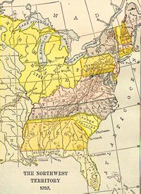
Success of the Articles of Confederation
There are only two main successes of the Articles
1. Set up an Army to defend the new nation
2. Northwest Ordinance: opened the way for settlement of the Northwest Territory and stated how new states would be admitted to the union.

Slide 9
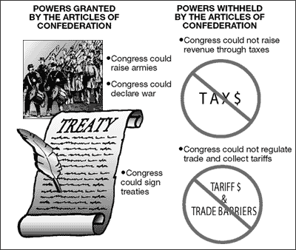
Weaknesses of the articles
No taxation
No regulation of trade
Cannot enforce laws
No single leader to direct policy (No President)
No national courts
9 of 13 states must agree to any new law
All 13 states must agree to change the Articles
Virtually not enough power given to Federal Government .

Slide 10
Problems facing the new nation
Just like the British in the French & Indian War, the United States acquired debt due to the Revolutionary War
The national government could not impose taxes (due to bad experience with Britain), so the individual states placed high taxes on their citizens.
This caused many businesses to fail, and many people lost their property because they could not pay back their loans.

Slide 11
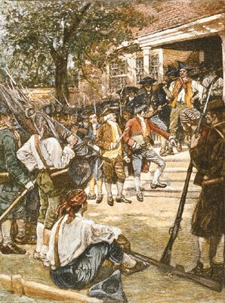
Shays rebellion
Daniel Shays lost his farm in Massachusetts due to debt.
He then raised an army to prevent farms from being seized by the courts.
The national government had a very difficult time stopping the rebellion due to lack of power.
This event showed that the Articles were not affective and that Americans were in need of a stronger central government.

Slide 12
Articles fail.. What next?
To be continued…

Slide 13
Closer
Your exit slip today will be three potential test questions based on the material covered in class today.
Please be sure to include the answer.
Questions can be Short-Answer or Multiple Choice.

