Slide 1
Bell ringer #2
What were two factors that drive Americans West?
What was the significance of barbed wire in the Great Plains?
Which battle marked the last major resistance against the US government by Native Americans if the Great Plains?

Slide 2
Life in the West for the Sioux
Dances with Wolves: Buffalo Hunt
https://www.youtube.com/watch?v=O9Sz2TGXuiM

Slide 3
Starting over
The frontier represented an opportunity for people to start their lives over…
Assignment:
Directions: Using complete sentences, list five things that you would do, or do differently, if you could go to a new place and start all over (ex: college). These could be physical or mental. The way you act, how you want others to see you, things you participate in, etc. After each give a short reason why you would try to change this.
At the bottom of your paper please answer the following question using 1-2 complete sentences.
1) Do you feel given your current situation you would be:
a)running toward something (explain)
-OR-
b)running away from something (explain)

Slide 4
Bell Ringer #3
What was the primary purpose of the Dawes Act?
Which battle below represents a significant Native American victory over the American Army? (Hint: Custer’s Last Stand)
Battle of Wounded Knee
Millcreek Massacre
Battle of Little Big Horn
Which immigrant groups were primarily responsible for building the Transcontinental Rail Road?

Slide 5
Transcontinental Rail Road: the move west
Unit 1

Slide 6
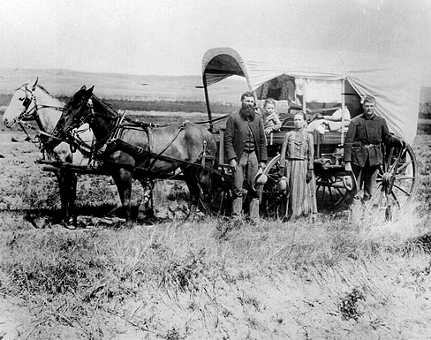
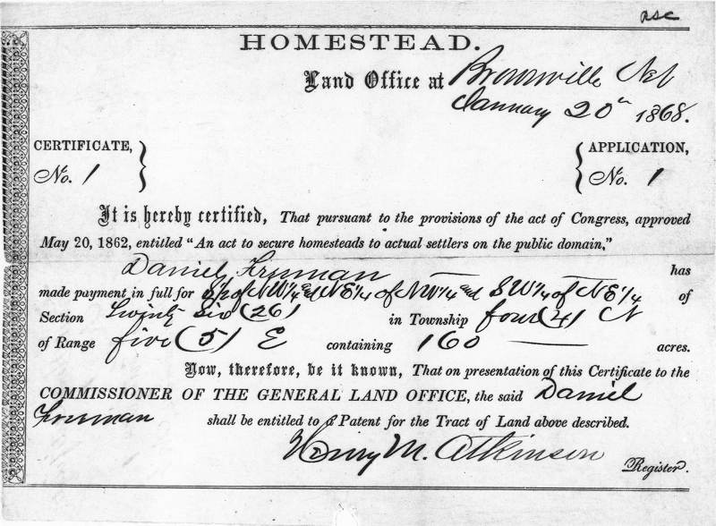
Settlers Move West: Government Supported Settlement
Homestead Act (1862) – gave 160 acres of land to any citizen over 21 who headed a household
By 1900, 600,000 families accepted land
Included exodusters – blacks who moved westward from the post-Reconstruction south
Not all families were successful – dry land, hard to enforce the 160 acre allotment against railroad companies and miners

Slide 7
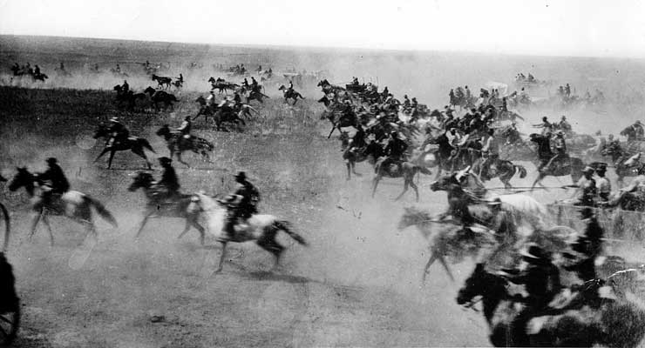
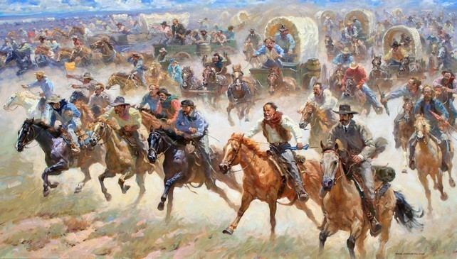
Settlers Move West: Government Supported Settlement
Oklahoma Land Rush – (April 2, 1889) - Fed gov’t gave away land in Oklahoma to settlers
First come, first serve
Gun went off, land was claimed with flag in the ground
Some settlers claimed land the night before.
“too soon” = the Sooners

Slide 8
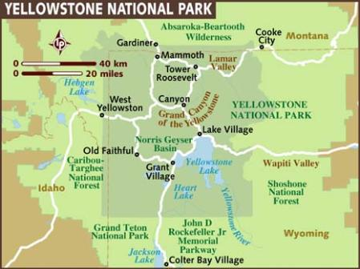
Closing the Frontier
1872 – Yellowstone National Park established by the fed gov’t
As western lands were claimed and settled so quickly, some believed that land should be protected and designated as wilderness.
By 1880, more than 19 million acres of land had been bought and settled.
By 1890, the frontier line no longer existed.

Slide 9
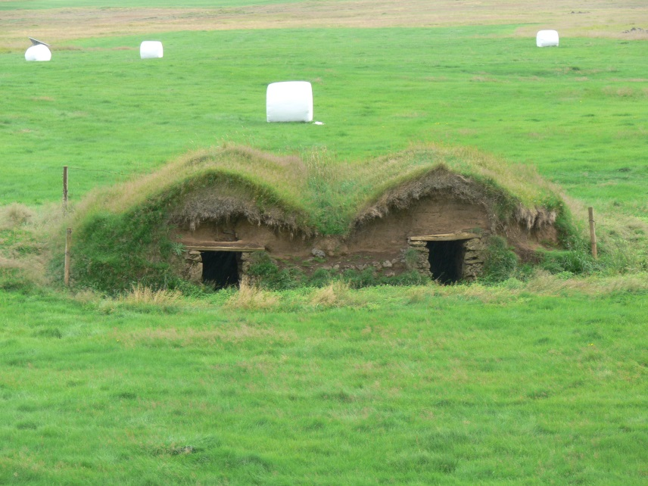
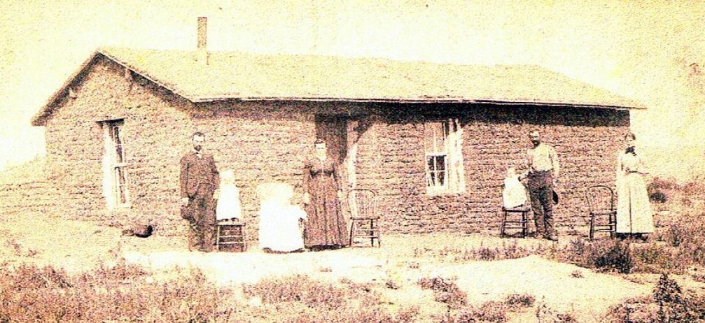
Challenges Settling the Great Plains
Terrible weather → hard to farm
Drought, floods, fire, blizzards, locust plagues, etc
Native American attacks and raids by outlaws
Few trees → hard to built homes
Built homes in the sides of hills
Soddy-home – prairie home built from blocks of hard dirt
Cavelike Cabins

Slide 10
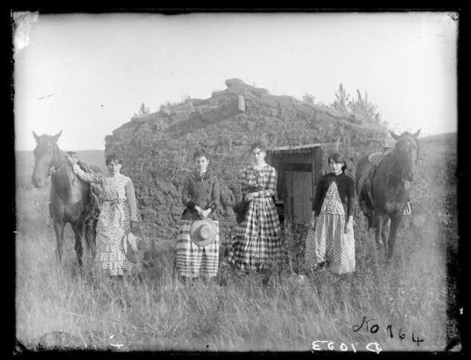
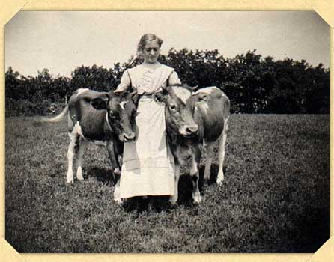
Challenges Settling the Great Plains
Women experienced very difficult conditions and had to be completely self-sufficient.
Plowed land, planted seed, and harvested wheat
Sheared sheep and cattle to make clothes for family
Helped dig wells and carry water to home
Cooked, cleaned, and raised children

Slide 11
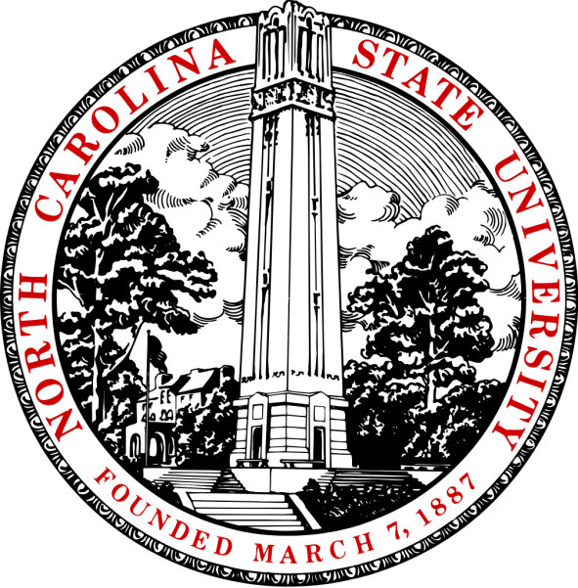
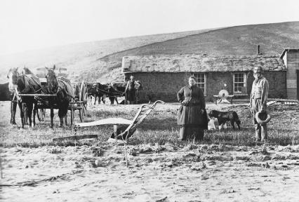
Challenges Settling the Great Plains
Morrill Act (1862) – federal land given to states to establish universities with agriculture programs
NCSU in Raleigh established in 1887 due to Morrill Act
Led to better agricultural practices and improved equipment and technology
Farmers quickly in DEBT by late 1800s!
Bad weather
Expensive machinery
Falling wheat prices
Increasing railroad shipping costs
High interest rates on loans

Slide 12
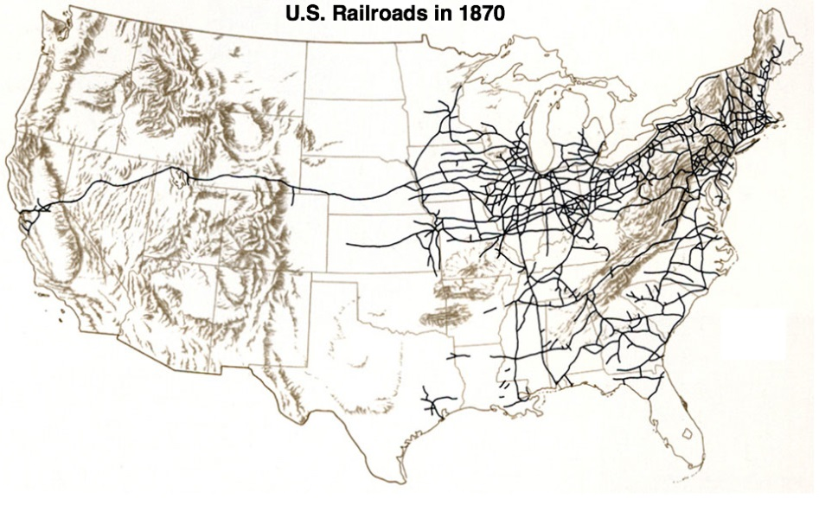
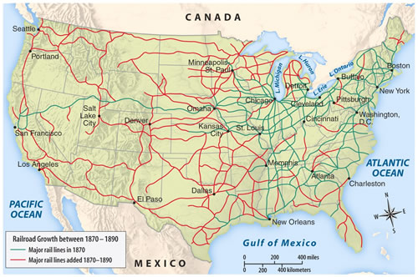
Settlers Move West: Railroad Expansion
1850-71 – Fed gov’t gave large land grants to railroad companies
Land grant = piece of land in exchange using the land how the gov’t wanted
Railroad companies sold some land to farmers
Central Pacific and Union Pacific raced to lay track to the Pacific
Used immigrant workers –Chinese, and Irish
8 miles of track/day
Very dangerous – explosives to blow through mountains
By 1890s – east and west coasts linked by many tracks

Slide 13
Transcontinental Rail Road
https://www.history.com/topics/inventions/transcontinental-railroad

Slide 14
Significance of Transcontinental RR
How did the RR help the economy?
It linked the East and the West so goods could be easily transported and sold
Promontory Point 1869
A Golden Spike was driven in to the ground to represent the completion or the Rail Road
East and West are now united!
https://www.youtube.com/watch?v=CD_jK9t02TU

Slide 15
Transcontinental R.R. vs. Social Media
https://www.history.com/topics/inventions/transcontinental-railroad
How are they similar?
How are they different?
You can’t always judge the past by the present.

