Slide 1
Bell Ringer #3 2/6/19
What is the purpose of the preamble in the US Constitution?
What part of the Constitution outlines the Legislative Branch?
First Amendment
Article 1
Preamble
What is the purpose of the constitution?
First period

Slide 2
Bell Ringer #3
What is the purpose of the preamble in the US Constitution?
What are three of the six principles outlined in the Preamble of the US Constitution?
What is the purpose of the constitution?
Second Period

Slide 3
The bill of rights
Unit 2
EQ: What are the rights included in the Bill of Rights? What is the major purpose of the Bill of Rights?

Slide 4
Amending process
Amendments: changes to the Constitution, only 27 times (the first ten are known as the Bill of Rights); purposely difficult to change (two part process)
Proposal: congressional action by 2/3 vote or 2/3 of state legislatures requesting a national convention
Ratification: vote of ¾ of the state legislatures or special convention

Slide 5
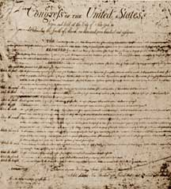
The bill of rights
The Bill of Rights was added to the Constitution in December 1791 at the request of the Anti-Federalists.
The Bill of Rights is the first 10 amendments that insure our civil liberties.
The freedoms we have to think and act without government interference or fear of unfair treatment.
The corner stone of our democracy: ensure us we can develop our own beliefs, express ourselves freely, meet openly with others, and have our view on public matters heard by the government.

Slide 6
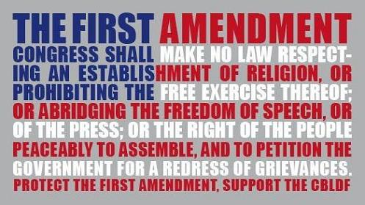
First amendment
The first amendment includes FIVE different freedoms
Freedom of religion
Freedom of speech
Freedom of press
Freedom of assembly
Freedom to petition the government

Slide 7
Freedom of religion
Reason the colonists moved to America
Prohibits congress from establishing an official religion in the US
Establishment clause: “wall of separation between church and state”

Slide 8
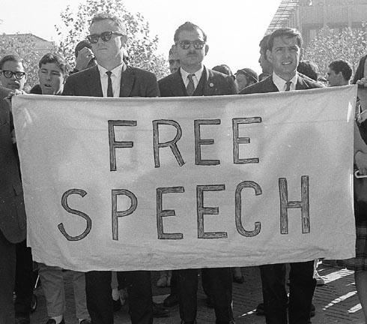
Freedom of speech
Can say what’s on our mind, in public or private, without punishment from the government
TV, radio, lectures, phone conversations, art, internet, music, clothing

Slide 9
Freedom of press
Americans can express themselves in print as well as speech
Ensures American are exposed to varying view points
Cannot censor printed materials or films before publication because they focus on sensitive issues

Slide 10
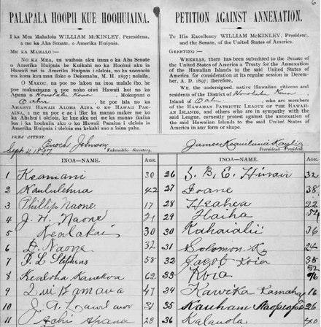
Freedom of assembly/freedom of petition
Allows Americans to gather so long as they are peaceful
Governments can make rules about when and where, but they cannot ban events
Have the right to join social groups
A written document signed by people who agree with a certain statement
Basically the right expresses our opinions to the government

Slide 11
First amendment limits
The first amendment allows for the expression of thoughts, however it does not mean absolute freedom!
Speech can’t endanger the government or lead to illegal activities
Can’t interfere with the rights of others
Cannot spread lies when speaking freely
Slander: spoken untruths
Libel: written untruths

Slide 12
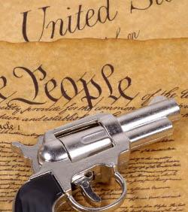
Amendments 2 & 3
Amendment two: The right to bear arms
an individual's right to possess a firearm, unconnected to service in a militia and to use that arm for traditionally lawful purposes.
Amendment three: No quartering
Prohibits, in peacetime, the quartering of soldiers in private homes without the owner's consent. It makes quartering legally permissible in wartime only, and then only according to law.

Slide 13
Amendments 4 & 5
Amendment four: no illegal search and seizure.
Law enforcement must have a search warrant or probable cause.
Amendment five: Protects rights of the accused
Indictment: formal charge
Self-incrimination
Double jeopardy: can’t be tried for the same crime twice
Due process: following legal procedures
Eminent domain: taking land for public use

Slide 14
Amendments 6 & 7
Amendment six: Rights of people on trial
Trial by jury
Speedy and public trial
Right to confront witnesses/accusers
Right to an attorney
Amendment seven: Civil Cases over the value of $20 are awarded a jury trial

Slide 15
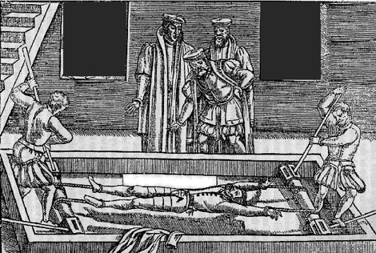
Amendments 8, 9, & 10
Amendment eight: no cruel and unusual punishment and no excessive bail
Amendment nine: Rights not specifically taken away from the people by the Constitution are automatically given to the people
Rights reserved to the people
Amendment ten: Powers not specifically given to the Federal govt. are given to state governments
Rights reserved to the states

Slide 16
Hand signals
https://www.youtube.com/watch?v=XgD1E3gBTWU
This is for you kinesthetic learners!

Slide 17
BoR rap/song/Poem Assignment
Directions:
You will be responsible for incorporating the Bill of Rights (first 10 amendments) into an original rap/song or poem. This will help you to recall the Bill of Rights for future reference, inside and outside of class.
Requirements:
Include all 10 amendments
Must be original ( I will know if you copy another rap/poem)
Make it rhyme
Use proper poem/song formatting
Include a chorus (if you do a rap/song)
2 Extra points will be given to raps and songs preformed in front of the class (this does not include poem reading)

