Slide 1
Bell Ringer #6 2/25/19
Roosevelt in a nutshell:
https://www.youtube.com/watch?v=jRaJXg_B_uc
After we watch this short clip, answer the following question (Answer must be at least 2 COMPLETE sentences):
“What is one thing you find interesting about the life or actions of T.R. and why??

Slide 2
Progressive Presidents pt. 2
Unit 2
EQ: Who were the Progressive Presidents and what made them progressive?

Slide 3
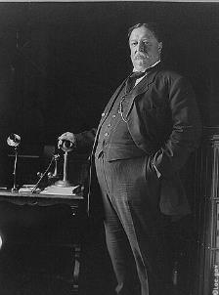
President William Taft
TR decided not to run for a third term
Still a strong force in the Republican Party
Backed his Secretary of War, William Taft, to be elected president 1908
TR hoped Taft would continue his Square Deal Policies

Slide 4
Taft had his own agenda
Taft was even more aggressive in “Trust Busting”
No more difference between “bad trusts” and “good trusts”
Twice as many lawsuits against corporations as TR
1911 → Standard Oil Company “busted”
Created hypocrisy when he supported SCOTUS’s “rule of reason” → relaxed the harshness of the Sherman Anti-Trust Act
Allowed big monopolies as long as they did not “unreasonably” force out smaller businesses
Pushed Congress to propose an income tax
Sixteenth Amendment (1913) →Authorized the federal government to collect an income tax

Slide 5
TR was mad about Taft’s agendas and programs he put in place
TR decided to run for a third term which ended up splitting the Republican Party → Conservatives and Progressives
TR’s New Nationalism → a program to restore the federal government’s “trust busting” power
Progressives set up the Progressive Party with TR as its nominee
Set up a crazy presidential election in 1912

Slide 6
Woodrow Wilson

Slide 7
Election of 1912
The Republican Party fought with itself over reform and eventually split in 1912
The Republicans who wanted a more involved federal government formed the Progressive Party and nominated TR as their candidate for President
The traditional Republicans nominated President Taft as their candidate for the Presidential election
Democrats nominated Woodrow Wilson as their candidate for POTUS

Slide 8
His campaign platform was called the New Freedom → very similar to TR’s New Nationalism
Wanted strict government control on corporations
Wanted more opportunities or “freedom” for small businesses
Won the Presidential election by a landslide without gaining majority of popular vote
Due to the Split Republican Party!

Slide 9
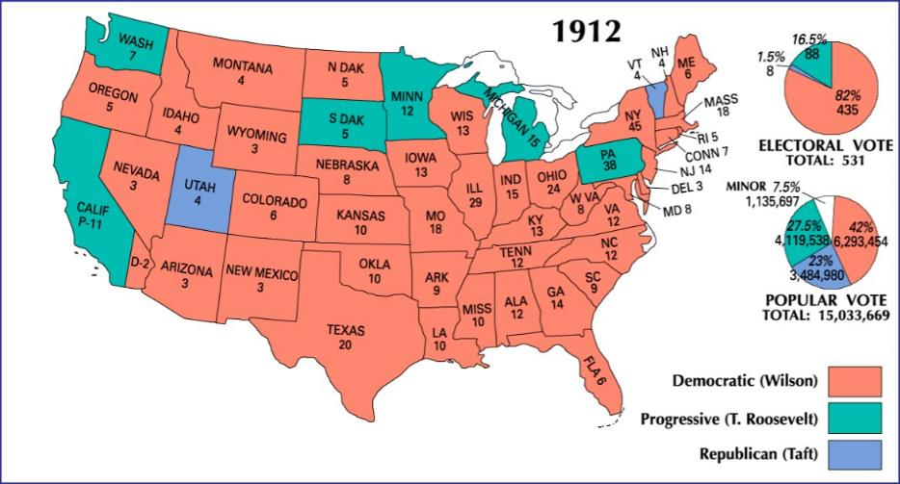

Slide 10
Banking Policy: Federal Reserve Act
Having taken care of tariffs, Wilson turned his attention to reforming the banking system
The country had no central authority to supervise the banks.
Wilson pushed Congress to pass the Federal Reserve Act (1913).
Established economic stability in the U.S. by introducing the Central Bank to oversee monetary policy.
Protects the American economy from having too much money in the hands of one person, bank, or region
The Federal Reserve Act is perhaps one of the most influential laws concerning the U.S. financial system.

Slide 11
Under Wilson’s presidency, workers received more protection under the Workingman’s Compensation Act (1916) → gave wages to temporarily disabled civil service employees
19th Amendment was ratified under Wilson’s presidency → Women helped with the war effort so Congress gave them a right to vote

