Slide 1
Am II Bell Ringer #3 2/19/19
What does the term Suffrage mean?
What is one issue or problem you feel needs more attention here at Wakefield?
What are some possible solutions for question #2?

Slide 2
The progressive Era (1890-1920)
EQ: What are the goals, beliefs and reforms of progressivism?

Slide 3
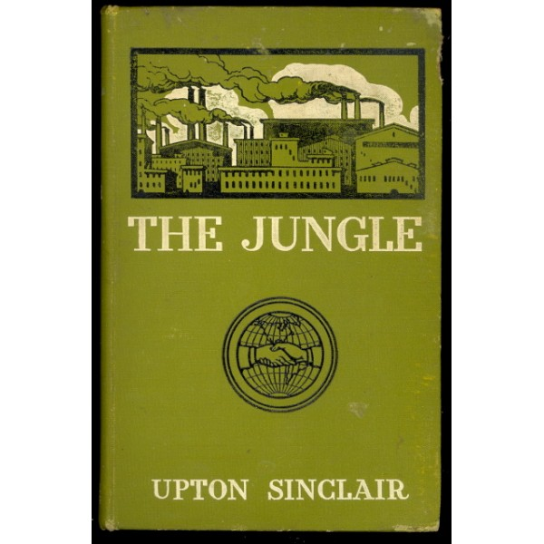
THE JUNGLE
Novel written by Upton Sinclair
Based on his investigations of the meatpacking industry at the turn-of-the-century.
Depicted:
Violent accidents
Horrible illnesses
Painful deaths
Sanitary issues
How “meat” was processed
https://www.youtube.com/watch?v=Xxe9nosWawM

Slide 4
“It seemed they must have agencies all over the country, to hunt out old and crippled and diseased cattle to be canned. There were cattle which had been fed on “whisky-malt” (the garbage of the breweries), and had been covered in what the men called ‘steerly’ – which means covered in boils… It was stuff such as this that made the ‘[preserved] beef’ that had killed several times as many United States soldiers as all the bullets of the Spaniards in the Spanish-American War.”
- Upton Sinclair, The Jungle

Slide 5
What was the impact?
Americans Outraged!
Complaints to Congress
Meat Inspection Act (1906)- law that established strict cleanliness requirements for meatpackers and created a federal meat-inspection program.
Pure Food and Drug Act (1906)- halt the sale of contaminated foods and drugs and to ensure truth of labeling.
Sinclair wanted to help the workers
Took decades to change factory working conditions
Came from within labor unions

Slide 6
MUCKRAKERS
“Journalists who played a key role in alerting the public to wrongdoings in politics and business.”
Muckrake – rake/pitchfork used to clean manure and hay out of stables.
Identified serious abuses.
Ida Tarbell- leading muckraker journalist in the early 20th century
Theodore Roosevelt
Approved of legitimate exposures
Condemned those who “earn their livelihood by telling scandalous falsehoods about honest men.”

Slide 7
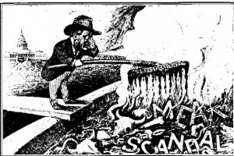
https://www.youtube.com/watch?v=YV7LRr2BO60
Remember Aladdin

Slide 8
ROOTS OF REFORM
Rapid industrialization
Workers suffered from low incomes and unemployment cycles.
Poor working conditions.
Triangle Shirtwaist Factory Fire
- killed 145 workers. ... The tragedy brought widespread attention to the dangerous sweatshop conditions of factories, and led to the development of a series of laws and regulations that better protected the safety of workers.
Immigration
Poor living conditions.
Urbanization
Slums
Overcrowding
What should be done???

Slide 9
PROGRESSIVE ERA BEGINS
1890-1920 → Plans to bring about progress.
In the 1890’s, a movement called Progressivism emerged
People leading/supporting this movement, called Progressives, believed in…
Protecting social welfare
Promoting moral improvement
Creating economic reform
Fostering government efficiency

Slide 10
Progressive Goals
Progressive goals = Social, Moral, Economic, Political
Progressives wanted to reform a number of institutions that created injustice in American society
Government/Politics → increase democracy, involve citizens more directly in government, improve efficiency
Business → regulate big business, help expand competition via small business, protect the consumer
Society → make life safer and more comfortable for the majority of Americans

Slide 11
Reforms!

Slide 12
WOMEN’S SUFFRAGE
Suffrage - the right to vote in political elections
Women began to believe that because government services were so essential to their families, they needed to be given the right to vote.

Slide 13
Key players in Women’s suffrage
Amendment 19 (August 1920):
Women granted the right to vote
Supporters are called suffragettes
Women led Temperance Movement- Social movement against the consumption of alcohol
Believed it to be the source of corruption
Amendment 18- Prohibition (made it illegal to consume or sell alcohol)
Alice Paul- one of the main leaders and strategists of the campaign for the Nineteenth Amendment

Slide 14
How was Government Reformed by Progressivism?
Government was seen as corrupted and controlled by political bosses and powerful businesses
Progressives wanted to rid government of this corruption and to give people more control over their government and make it more effective and efficient in serving the public
In 1900, Galveston, Texas was hit by a massive hurricane that left more than 8,000 people dead.
In response, new form of government, called commissions, were created to help city planning and curb political corruption

Slide 15
Progressives pushed to reform the election process
Before → party leaders picked candidates for state and local office
By 1916 → most states established direct primaries: an election in which citizens themselves vote to select nominees for upcoming elections
Introduced in Wisconsin by Governor Robert La Follette
Progressivist who believed in regulating big businesses
Progressives also introduced three other political reforms:
Initiative → citizens introduce legislation for vote
Referendum → citizens vote on legislation
Recall → special election to remove an official
1913 – The 17th Amendment of the Constitution was ratified
Establishes the direct election of US senators by the people rather than state legislature

Slide 16
By the early 1900’s, several dynamic Progressives became state leaders; governors
Robert La Follette (WI): forced railroads to lower fees and pay higher taxes; improved state education; made factories safer; and adopted the direct primary → Laboratory of Democracy

Slide 17
Recap!
What were four major outcomes of Progressivism?
Health acts- Pure Food and Drug and Meat Inspection Act
Better working conditions
Women’s Suffrage
Amendments 16-18
More representation
EQ: What is progressivism and how did this movement gain momentum in the early 1900’s?

