Slide 1
Bell ringer #2 2/5/19
What are three of the six principles outlined in the Preamble of the US Constitution?
What does the term “popular sovereignty” mean and how does it relate to the US Constitution?
Practice mini debate: Do you think we should keep daylight savings? Why or why not?

Slide 2
Bell ringer #2 2/5/19
What does the term “popular sovereignty” mean and how does it relate to the US Constitution?
Practice mini debate: Do you think we should keep daylight savings? Why or why not?
Second period

Slide 3
The us constitution
Unit 2
EQ: How does the Constitution create a plan of government that is strong enough to be effective, but also protects the citizens’ rights?

Slide 4
What is the purpose of the constitution?
Provide a framework for government:
The Constitution is the highest authority in the nation
It gives the 3 branches their powers
It has 3 parts: preamble, seven articles (outlining government power), and the amendments

Slide 5
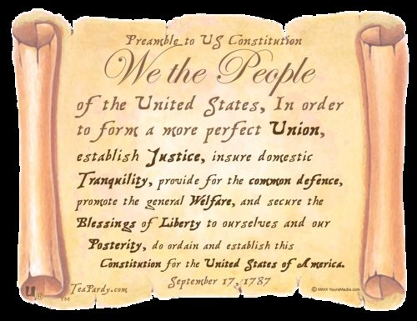
The Preamble
Opening statement of the Constitution. It defines the six purposes/goals of the US government:
To form a more perfect union
Establish justice
Insure domestic tranquility
Provide for the common defense
Promote the general welfare
Secure the blessings of liberty

Slide 6
Articles of the constitution
Article I: Legislative branch
The US Congress: Bicameral with a Senate and House of Representatives.
Census: count of the total population of the United States
Apportionment: division of members of the House of Representatives from each state based on the census numbers.
There is a set number of members of the House (435).
If one state increases its population more than another, the bigger state may gain a Representative and the smaller state may lose one.

Slide 7
Articles of the Constitution
Article II: Sets up the Executive Branch, headed by the President
Standards for the president (age, residency, job description)
Article III: Sets up the Judicial Branch, headed by the Supreme Court
Article IV: Full Faith and Credit: laws in one state are applied to all other states.
Example: If you are married in NC, you are considered to be married in VA, SC, TN, etc.

Slide 8
Articles of the Constitution
Article V: Amending the Constitution:
2/3 of both houses of Congress must approve an amendment. Then, it must be ratified by 3/4 of all states.
How many amendments are in the Constitution?
Article VI:
The US Constitution is the Supreme Law of the Land (Supremacy Clause)
If there is a conflict between state and federal gov. Doctrine of pre-emption, which says that the federal government wins.
Article VII:
When 9 of the 13 original states ratify the Constitution, it will take effect.

Slide 9
Principles of the us constitution
Popular Sovereignty: governments are created by and subject to the will of the people. People hold the power.
Rule of Law: ALL citizens must follow the same laws. No one is above the law.
Separation of Powers: powers of government are divided into three branches.
Checks and Balances: each branch of government can limit or check the power of the other two branches. This prevents any single branch from becoming too powerful.
Federalism: Sharing power of government between state governments and the Federal government.

Slide 10
How does federalism work?
Each level of government is given specific powers according to the CONSTITUTION.
Enumerated/Expressed Powers: specific powers given only to the Federal government by the Constitution.
Reserved Powers: specific powers given only to the state governments by the Constitution.
Concurrent Powers: Specific powers shared by the state and Federal governments.

Slide 11
Interpreting the constitution
Article I gives Congress the power “to make all laws which shall be necessary and proper” to carry out its duties.
Since Congress can s - t - r - e - t - c - h its powers to fit new situations this is also called the elastic clause (AKA Necessary and Proper Clause)
Example: The creation of the air force

Slide 12
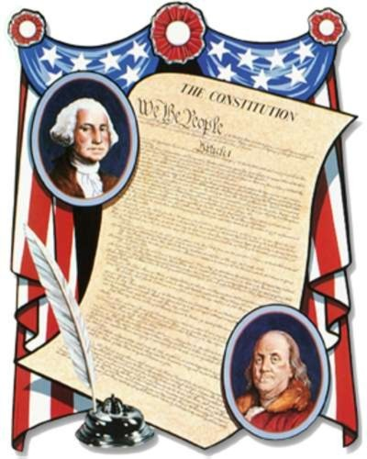
Viewpoints on interpreting the constitution
Strict Interpretation: use the specific wording to decide what to do.
Loose Interpretation: the constitution is a “living document,” so it depends on the situation/time period.
Original intent: ASK “what did the writers mean by the Constitution?”

Slide 13
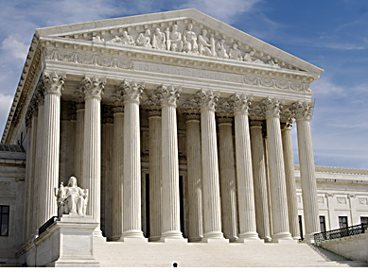
Who interprets the Constitution?
The Supreme Court has a lot of authority on the way the constitution will be interpreted
Example: Marbury v. Madison (Judicial Review review by the US Supreme Court of the constitutional validity of a legislative act.)
Congress can also cause new interpretations.
Example: the president requests legislation from Congress which is not directed by the Constitution (Patriot Act-deter and punish terrorist acts)
A change in custom can also change the interpretation of the constitution.
Example: Political Parties

