Slide 1
Bell Ringer #7 2/27/19
What is used to determine the number of electoral votes for each state?
Which is true a out executive orders?
They must be approved by the Supreme Court
They carry the weight of law
They are written by the vice president
What is the power of judicial review?

Slide 2
THE US SUPREME COURT
EQ: Who serves as Supreme Court justices? What are the powers of the Supreme Court?

Slide 3
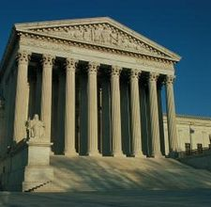
Job of the Supreme Court Justices
Their job: Decide if laws follow the constitution
Has Original Jurisdiction only in cases involving foreign Diplomats, States, or the Constitution
All other cases are appeals
The Court chooses its cases
If court refuses to hear – lower court’s ruling stands
Final authority on cases dealing w/the Constitution, acts of Congress& treaties.
After deciding a case
Issues an opinion

Slide 4
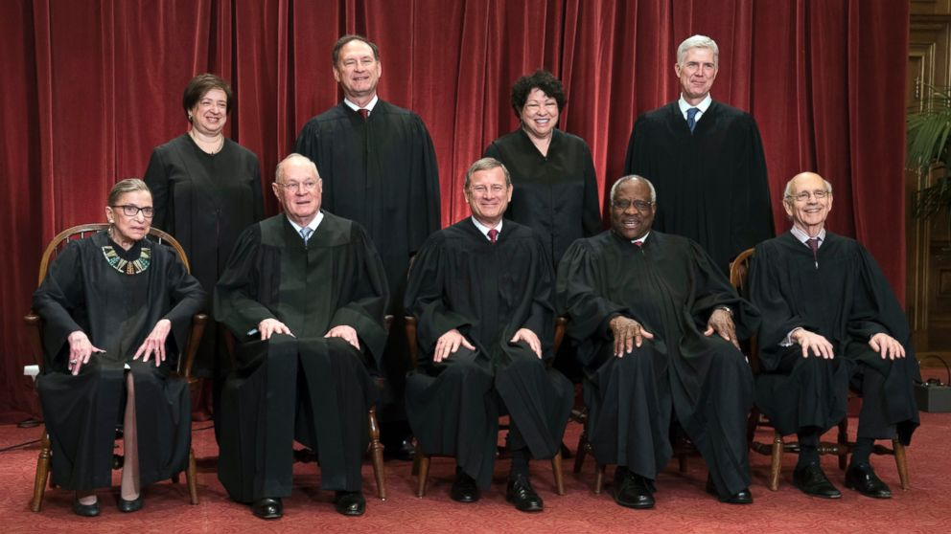
Supreme Court Justices
8 Justices & 1 Chief Justice
Serve a “life” term
President appoints justices with Senate approval
No Constitutional age or professional requirement
Presidents decision is influenced by Justice Department, American Bar Association, interest groups, & other Supreme Court justices
Have always been lawyers in the past
Successful law career, political support, & agreement w/the president’s ideas are factors in who gets appointed

Slide 5
Powers of the Supreme Court
Legislative and Executive Branches must follow Court’s rulings
The Supreme Court is removed from politics & interest groups
More likely get a fair hearing
Judicial review
Check on the legislative and executive branch
the power to say whether any law or government action goes against the Constitution
Power not given in Constitution (IMPLIED)
The court claimed the power in Marbury v. Madison
Congress’ laws are in general language
Thru rulings – Supreme Court interprets laws to help law enforcement enforce them

Slide 6
How does the Supreme Court work?
https://www.youtube.com/watch?v=KEjgAXxrkXY
Supreme Court serves primarily as an appeals court.
90% of its cases come from lower courts
Other cases heard by S. Court refer to
Disputes between 2 states
Disputes between state and federal government
How do you win an appeal to the Supreme Court?
Must write out a writ of certiorari
A written request to have your case heard by the Supreme Court.
If they say yes, your case goes on the docket (Schedule of cases for the Supreme Court to get to).

Slide 7
What steps are taken once a case is taken by the Supreme Court?
Briefs given to justices
They read privately in chambers
Oral arguments given by attorneys on case
Have timed arguments (usually 30 minutes)
Conference
Led by Chief Justice
Talk about case, new cases, and other judicial issues
Preparation of opinions
Need a majority vote for an appeal to take place. Majority Opinion
Most senior member of “Concur” votes writes the opinion
Concur = agree, but for different reasons
Most senior member of “Dissent” votes writes the opinion
Dissent = disagree
Announcement of decisions
Announcement made to public

Slide 8
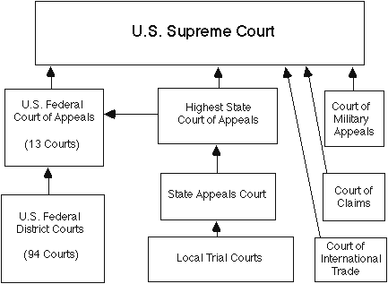
Limits on the Supreme Court
Depends on Executive branch & state/local authorities to enforce rulings
Congress can get around a ruling by passing a new law or amending the Constitution
President appoints justices
Congress approves them
Can impeach justices
Can remove them
Supreme Court cannot decide law unconstitutional unless law challenges by lower court & appealed
Supreme Court accepts cases regarding only federal issues

Slide 9
Role of Precedent & types of jurisdiction
http://jailhouselaw.org/the-importance-of-precedent/

Slide 10
The Federal Court System
EQ: HOW IS THE FEDERAL COURT SYSTEM ORGANIZED? WHAT TYPES OF CASES ARE HEARD IN FEDERAL COURT?

Slide 11
On your own...
Complete the Federal Court System graphic organizer posted on my website tlmoney.weebly.com under today’s date.

