Slide 1
Consequences of Expansion
Columbian Exchange, Slave Trade
Unit 4

Slide 2
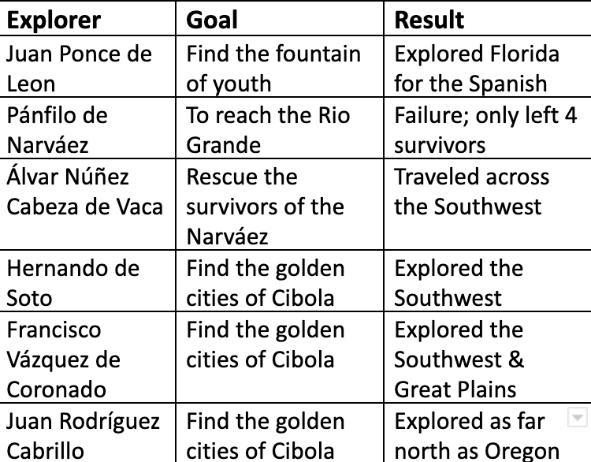
Motivations to Explore the Seas
Find new trade routes to Asia
New knowledge
Fame, Wealth, Glory
More Land
Spread Christianity

Slide 3
Compromise between Portugal and Spain
Line of Demarcation
  Line set by the pope dividing the non-European world into two zones
  Spain got a zone and Portugal got a section
Treaty of Tordesillas
  Specific terms of the Line of Demarcation
  Signed by Portugal and Spain
  How has this impacted Central and South America today??

Slide 4
Treaty of Tordesillas
Don Ferdinand and Dona Isabella, by the grace of God king and queen of [Spain] … in the treaty and compact regarding the division of the ocean sea, negotiated between ourselves and the Most Serene King of Portugal … it was agreed … drawing of the divisional line of the said sea, which must be three hundred and seventy leagues west of the Cape Verde Islands, in a straight north and south line from the Arctic to the Antarctic pole … by so doing avoiding disputes and controversies that might arise …And we therefore are pleased and consider it advantageous … in order that both our subjects and natives … be better informed henceforth as to the regions wherein they may navigate and discover.

Slide 5
Columbian Exchange
The movement of human beings, agricultural, mineral, and trade goods, as well as disease, between Europe, Africa, and the Americas is known as the Triangular Trade.
  Increased health
  Increased quality & diversity of food
Africa, Europe, Asia were all involved, increased relations between the three
Also spread disease: plague, chicken pox, pneumonic plague, cholera, diphtheria, influenza, measles, scarlet fever, smallpox, typhus, tuberculosis, and whooping cough.
Gave domestic animals, like horses, to Natives. Natives had never seen domesticated animals, and now they could ride them. This made transportation easier, but was also very intimidating to people who had never seen a horse.

Slide 6
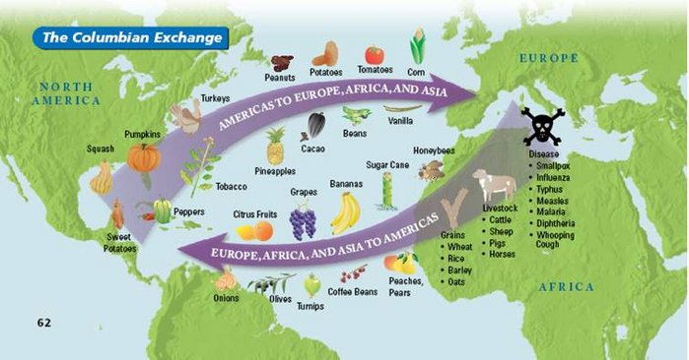
Draw this in your notes!
2 goods America to Europe
2 goods Europe to America

Slide 7
Columbian exchange and Science
https://www.youtube.com/watch?v=UC5km6-o2oM
Hard core science 7:50
https://www.youtube.com/watch?v=HhyaAqf6dz0
rap

Slide 8
Economy effects
Economic changes were the direct result of the Age of Exploration
Mercantilism
  The economic theory that trade generates wealth
  https://www.youtube.com/watch?v=aWxvfkFbKy0
Capitalism
  Economic system in which the production of goods and services done for the sake of profit in private hands
https://www.youtube.com/watch?v=azVxrMIxbJU

Slide 9
Slave Trade

Slide 10
Triangular Trade
Triangular trade
Middle passage

Slide 11
Why The Slave Trade Grew So Fast
Portugal explorers quickly engaged in the slave trade because:
  There was a lot of money involved
  Very cheap labor
Many explorers were developing plantations in the Caribbean and needed the labor force to create massive amount of their products, such as sugar and rice

Slide 12
Why did Africa “let” this happen?
Africa was very poor and run by small groups of people
African rulers brought the slaves to the coast of Africa to be sold
Slaves were captured members of other tribes
Prisoners of war
Sold in exchange for things such as textiles, metalwork, rum, tobacco, weapons, gunpowder
Most slaves were sick by the time they got to their destination

Slide 13
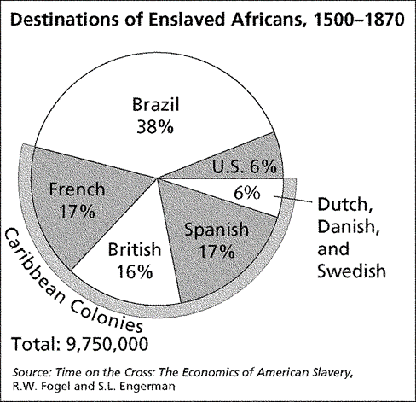
Consequences
Transition from Indentured Servitude to Slavery
This was a huge transition.
People always had servants, but usually with a brief sentence and an end goal of freedom
These enslaved Africans were enslaved for life with no hope of freedom
Extremely high death rate on plantations
Which region received the largest percentage of enslaved Africans?

Slide 14
Atlantic Slave Trade
https://www.youtube.com/watch?v=3NXC4Q_4JVg
  Slave trade TED Ed

