Slide 1
Bell Ringer #1 3/4/19
What is patriotism to you and how do you show it?
What makes a good citizen?

Slide 2
Pledge of Allegiance
Background on the Pledge of Allegiance https://www.youtube.com/watch?v=QtxJcIEmN4o
Student Perspective
https://www.youtube.com/watch?v=1aaCoLn5fEc
Pledge of allegiance controversy 2017
https://www.youtube.com/watch?v=BPizwiVshI0

Slide 3
Bell Ringer #2 3/5/19
Which of the following is a requirement for naturalization in the United States?
must fly the American flag outside his place of residence
must speak at least three languages, one of which must be English
a period of continuous residence and physical presence in the United States
What is a civic duty required by law for every male 18-years-old and above?
What is the final step in the Naturalization process?

Slide 4
Citizenship in the United States of America
Essential Questions: What does it mean to be a citizen in this country and how does a person become a citizen? Why are civic responsibilities like volunteering important?

Slide 5
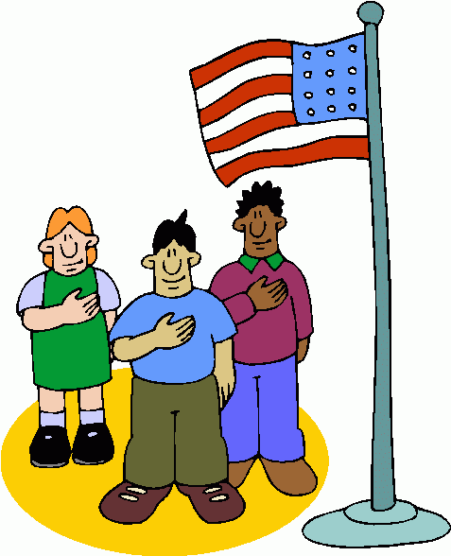
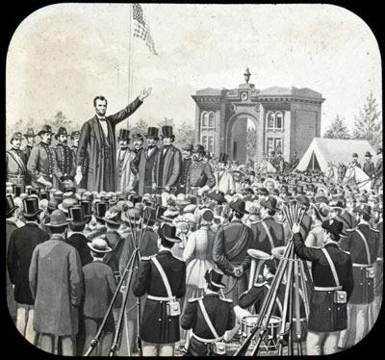
Citizens and Government
Citizens: members of a community who owe their loyalty to the government of the community and are entitled to government services.
Government: the ruling authority for a community. Allows distribution of resources and provides order in a society. Governments should help citizens meet their needs.
Abraham Lincoln – “The US government is of the people, for the people, and by the people.”
- Of the people: the government rules by consent of the governed; it gets its power from the citizens.
- For the people: the actions of the government should benefit the citizens.
- By the people: regular citizens are the people who participate in government.

Slide 6
Who are America’s Citizens?
Become a US citizen by being born in the US or being naturalized.
Alien: non-citizen living in a country for a specific period of time.
Immigrant: non-citizen who has permanently moved to a new country.
Citizenship and Immigration Services (USCIS): oversees naturalization.

Slide 7
Undocumented People
Anyone who is living in the country who is not a citizen is called an undocumented citizen.
Only about 675,000 allowed each year. People with family members already in US or with a special skill get preference.
Undocumented Residents: at least 5-6 million, get deported if caught.
Legal Undocumented people: can work, own property, attend school, receive government services, pay taxes. Can’t run for office, vote, serve on a jury, and must carry a picture ID at all times.

Slide 8
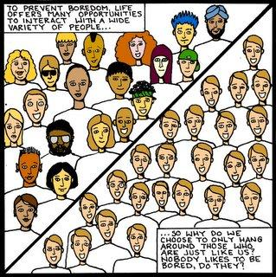
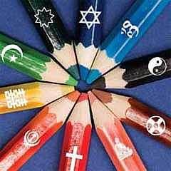
A Nation of Immigrants
Every person in the US is an immigrant or the descendant of an immigrant.
“E Pluribus Unum”: Out of many, one.
Diversity in Population: 64% non-Latino whites, 13% black, 5% Asian, 1% American Indian, 3% multiracial, 6 % other (16.3 % Latino: not a race, Latino is an ethnicity).
Diversity in Religion.

Slide 9
Responsibilities and Duties of American Citizens

Slide 10
Responsibilities
Duties
Actions that American citizens MUST take in order to contribute positively to our society and avoid going to jail
Actions that American citizens SHOULD take in order to contribute positively to our society
Examples: Voting, volunteering, picketing, petitioning government officials, running for political office, tolerance, earning a quality education, finding a job, etc.
Examples: Jury duty, Registering for the Selective Service, Paying taxes, sending children to school, following all laws,

