Slide 1
Objectives
FP.C&G.2.8 Analyze America’s two-party system in terms of the political and economic views that led to its emergence and the role that political parties play in American politics
FP.C&G.3.6 Explain ways laws have been influenced by political parties, constituents, interest groups, lobbyists, the media and public opinion

Slide 2
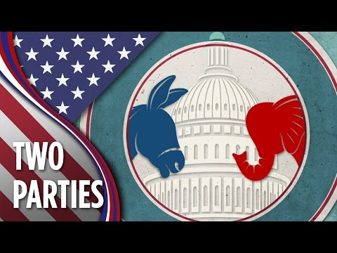
https://youtu.be/u7JBXja7SAY
https://www.youtube.com/watch?v=u7JBXja7SAY

Slide 3
Bell Ringer #4 3/7/19
What were the first two official political parties established in the United States?
In which country do voters have more than twenty major political parties to choose from? (hint: you will need to look this up on your device)
Israel
Germany
China
Canada

Slide 4
POLITICAL PARTIES AND POLITICS
EQ: How do political parties help citizens to have their voices heard in government, and how can they also hinder the government?

Slide 5
On Your Own...
Go to http://www.people-press.org/quiz/political-typology/
Free write:
what did the first one say?
Do you agree?
What did the second one say?
Do you agree?

Slide 6
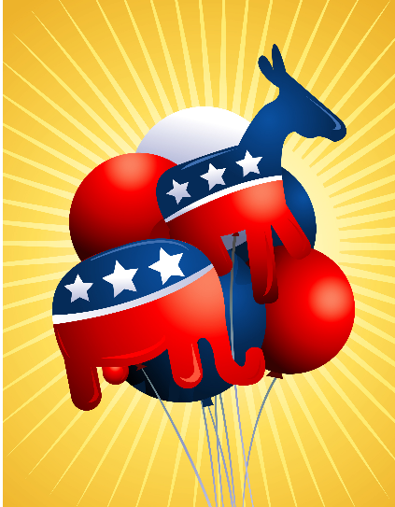
The American Two-Party System
Political Party: an association of individuals with similar political views/interests.
Purpose: to get people elected to offices who share the views of party members.
Since 1854, either a Republican or Democrat has been elected to the Presidency

Slide 7
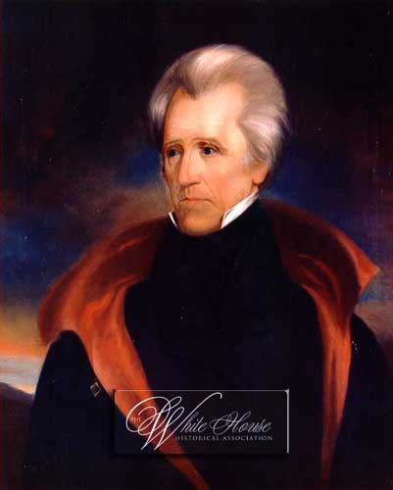
Development of Political Parties
The first two parties were the Federalists and Anti-Federalists
The Anti-Federalists became the Democratic Republicans and controlled the country until the 1820s.
Andrew Jackson was elected as a Dem-Rep, but angered many members of the party. Followers of Jackson became simply Democrats. Those opposed to Jackson formed a new party called the Whig party.

Slide 8
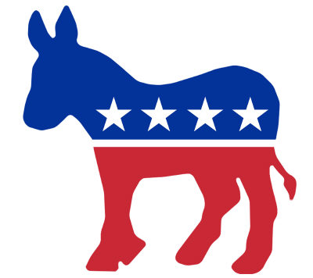
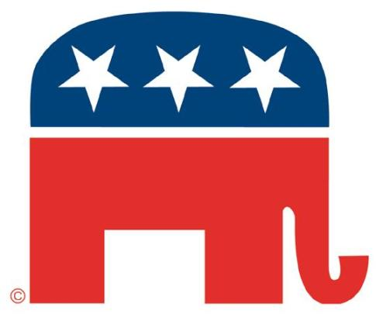
Parties Continued
The Whigs won the Presidency a few times, but the Democrats retook control of the Presidency.
In the 1850s, the Democrats split on the issue of slavery.
The anti-slavery Democrats and the Whigs joined together to form the new Republican Party.
Since then, the Democrats and Republicans have been the two dominant political parties.

Slide 9
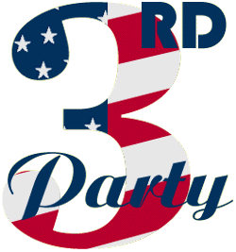
Third Parties
Third Parties: we have regularly had more than the two major parties, but no third party has ever won the Presidency; they can have an effect though
Often, the ideas/views of third parties are adopted by one of the two major parties.
Third parties can also play spoiler in an election. Example: 2000-Al Gore (D) vs. George W. Bush (R) vs. Ralph Nader (Green Party). Nader took votes away from Gore and helped Bush win the election
Problems for Third Parties:
1. Getting on the ballot
2. Winner-take-all system
3. Fundraising

Slide 10
Other Party Systems
Multi-party system: many more than two parties. Often, no single party wins a majority of seats so several parties join together to form a coalition government.
One-party system: only one political party is legally allowed to exist. Citizens vote, but only have one candidate to choose.

Slide 11
Today’s American Political Parties
The major difference between the two parties is how much the government should play a role in providing services and affecting the economy.
Democrats want government to provide more services
Republicans want individuals to provide services for themselves.
Platform: the list of positions/views of a political party. Each specific position is called a plank

Slide 12
Organization of Political Parties
Each party has leadership at the national, state and local level.
- National Level:
1. Main focus is fundraising
2. Every four years the national party provides a convention to nominate and announce the party’s candidate for the President.
https://www.gop.com/the-official-guide-to-the-2016-republican-nominating-process/
http://www.al.com/news/index.ssf/2016/02/whats_a_superdelegate_can_they.html
- State and Local Level:
1. Run primary elections to decide nominee
2. Grassroots: political ideas and movements that start at the local level
3. Registering new voters

Slide 13
Role Of Political Parties
Main job is to nominate candidates for office
Parties nominate candidates through primary elections.
Closed primary, only members of the party can vote in the election.
Open primary, any registered voter can vote in the election.
Primary winners can often be decided by a plurality (whoever gets the most votes) rather than a majority (one person wins at least 51%).

Slide 14
Other Party Role
1. Campaign: help candidate win
2. Inform citizens: parties call, send mail, and advertise to notify voters of important issues
3. Link levels of government: members of the same party at different levels of government often work together to get things done
4. Watchdog: losing party in an election will watch what the winning candidate does in office in order to recognize and point out any mistakes.

Slide 15
Comprehension Check
Please complete the following questions. This is your exit ticket for the day!
What role do political parties play in American politics?
How did America become a two-party system?
Give examples of how laws have been influenced by political parties

