Slide 1
Unit 5: Bell Ringer #1 10/28/19
1. What is the difference between an absolute Monarchy and a Limited Monarchy?
2. "The head alone has the right to deliberate and decide, and the functions of all the other members consist only in carrying out the commands given to them… The more you grant… [to the assembled people], the more it claims… The interest of the state must come first…" - King Louis XIV of France in 1660
Why does Louis XIV believe that government should not be in the hands of the people?
a) A single ruler is better able to make just decisions
b) The people don't really understand what is best for them
c) The more power you give to the people, the more they will desire to have
3. For which government did Louis XIV advocate?
a) Direct Democracy c) Representative Democracy
b) Constitutional Monarchy d) Absolute Monarchy

Slide 2
Age of Absolutism
Unit 5

Slide 3
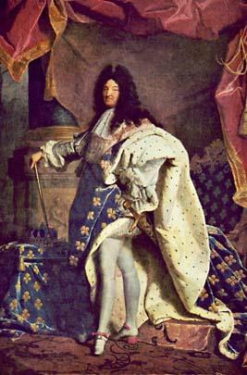
Absolute Monarchs
Absolute Monarch: ruler with complete authority over the government and lives of the people he or she governs
Absolute monarchs believed they ruled by divine right
divine right: belief that a ruler’s authority comes directly from God.
1500 through 1700s, absolute monarchs tried to impose their will across much of Europe, lands beyond
https://www.youtube.com/watch?v=TZNQDxBCC20

Slide 4
10 characteristics
Protect and expand the state
Maintain public order
Win support of Nobility
Control Nobility
Promote economic growth
Maintain independent source of income
Develop nationalism
Inspire Loyalty
Use the power of the law
Establish a sense of purpose

Slide 6
Causes of Absolutism
The 17th century was a period of great upheaval in Europe, and Kings capitalized on this chaos.
Religious and territorial conflicts between countries led to almost continuous wars.
This caused governments to build huge armies and to levy even heavier taxes on the peasants.
Monarchs tried to restore order to increasing their power and used force against anyone who did not follow their beliefs.
Regulated religious worship
Regulated social gatherings
Their goal was to free themselves from the limitations imposed by the nobility and by representative bodies like Parliament.

Slide 7
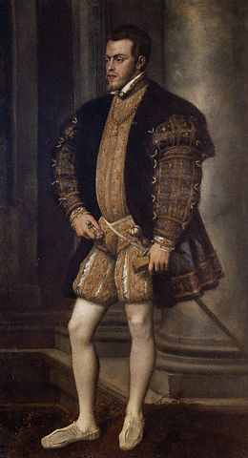
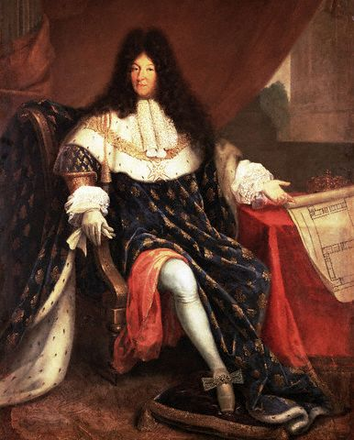
Famous Monarchs
Charles V
Ruler of Spain and Holy Roman Empire
Abdicated (stepped down) from throne to join the church
Phillip II of Spain
Took over throne from Charles
Catholicism
Louis XIV France- Versailles
Most powerful French King
Palace of Versailles
https://www.youtube.com/watch?v=W5Njjd6R6d0

Slide 8
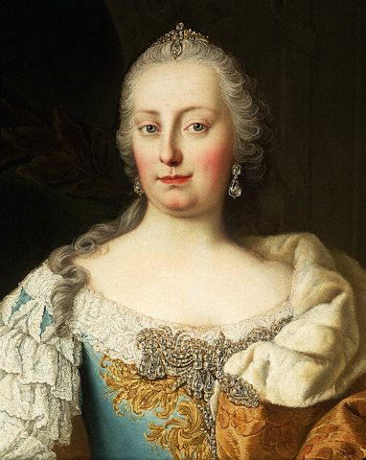
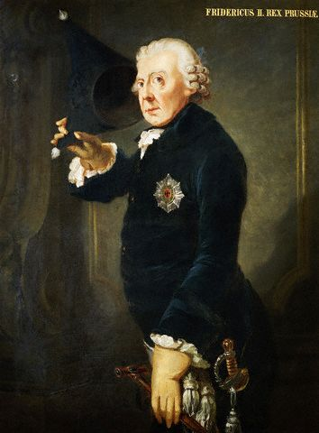
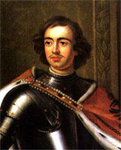
Other Monarchs
Maria Theresa (1740 - 1780)
Absolute Monarch of Austria
Frederick II (1740-1786)
Absolute Monarch of Prussia (Germany)
Started the War of Austrian Succession by attacking Austria.
Unified Prussia into one nation.
Peter the Great (1682-1785)
Absolute Monarch of Russia
Tried to “Westernize” Russia
Built St. Petersburg

