Slide 1
Bell Ringer 3/19/19
Which term best describes the study of theory, philosophy, and implementation of law?
Social contract theory
Justinian Codes
Hammurabi’s Code
Jurisprudence
2. Why do we need laws?
3. Do you feel laws are more of a restriction or a protection? Why?

Slide 2
Objectives
FP.C&G.3.2 Compare lawmaking processes of federal, state and local governments
FP.C&G.3.3 Analyze laws and policies in terms of their intended purposes, who has authority to create them and how they are enforced
FP.C&G.3.4 Explain how individual rights are protected by varieties of law

Slide 3
Development of Law & Philosophical Foundations
Essential Questions: What are the major types of law in the USA and how has the legal system developed over time? Why is it important for laws to be written down?

Slide 4
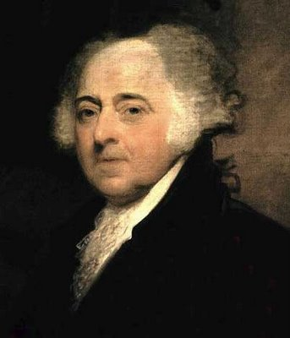
What is Law?
John Adams – “In the United States, we will have a government of laws, not of men.”
Law: a set of rules that allow peaceful living in a society.
- These rules are binding on all people (everyone must follow them).
- They are also intended to discourage people from doing bad things.
All people are equal under the law.

Slide 5
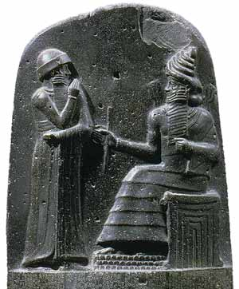
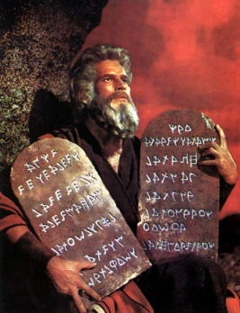
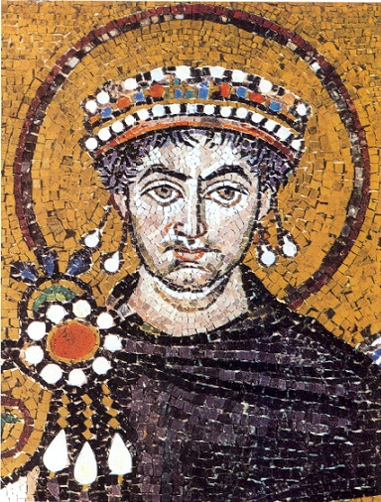
Historical Development of Law
Hammurabi’s Code (1750BC):
first written set of laws.
If laws are written and posted for all to see, then everyone has to follow the same laws.
https://www.youtube.com/watch?v=okAtIrT3j6M
Ten Commandments- (1446 BC)
A list of moral and religious principles
Many principles still used today
Roman Law:
- Jurisprudence: the study of law. Roman judges studied and interpreted the laws of Rome the same way our judges do today.
- Code of Justinian (528 AD): Emperor Justinian of Eastern Roman Empire has all existing laws and decrees written down in a single document.

Slide 6
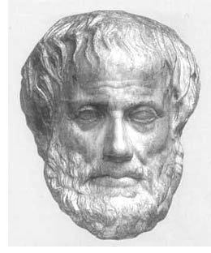
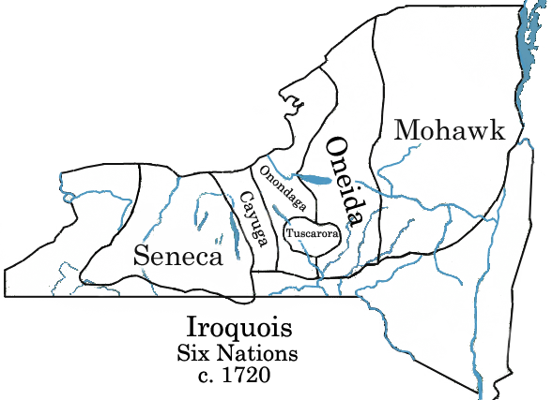
Historical Development of Law
Draconian Law- 621 BC
Written by the first lawgiver of ancient Greece
Laws were harsh and included death penalty for minor offenses
Magna Carta- 1215
England’s first document to check the power of the king
Declared people could not be deprived or lives, liberty, or property except by judgment of their peers
This is shown in the 5th Amendment of the US Constitution
Iroquois Nation Constitution- 1500
Established a confederacy of nations & participatory government
Influenced the U.S. Constitution
Native American laws

Slide 7
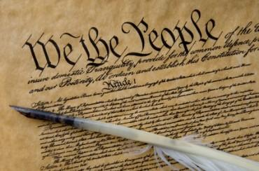
Types of Law
English Law:
- Common Law: based on traditions and precedent. Not all laws written down.
- Trial by jury.
- Innocent until proven guilty.
US Constitution (Constitutional Law):
- Titles of nobility outlawed.
- Specific powers granted to the government.
- Specific rights guaranteed to citizens.

Slide 8
Types of Law
Criminal Law: Prevent people from deliberately or recklessly harming others or other’s property.
Civil Law: disputes between people or groups when no law has been broken. Disputes get settled in a court case called a lawsuit.
- Tort: a civil case where injury occurs because of negligence.
- Family Law: Divorce, custody, child support, adoption.
Administrative Law: describes how executive agencies of the Federal government function.
Statutory Law: laws for states. Ex: speed limits, alcohol laws, food inspection.
International Law: deal with geographic areas outside of a single country (oceans) and agreements between two or more countries.
- The World Court: settles disputes between two or more nations. Also prosecutes war criminals.

Slide 9
On Your Own...
You and a group of 5 are going to create a timeline of the history of laws
Assign each person a law, they are responsible for creating a piece of paper with details about that law (what it is, the impact it had, etc. You should have info from the powerpoint and other reliable sources)
You are then going to put all of the papers together to make a timeline
It should be detailed and visually appealing

Slide 10
Exit Ticket
Summarize the lawmaking process (what you remember)
Can you include the terms veto, filibuster, cloture?
2. What was the first set of written laws?

